Slide 1
Consumer-Mediated Exchange
Presentation

Slide 2
Connectathon Track Presentation
Participating Organizations
Nick Ronnei
Avery Fischer
Peter Murphy
Sandy Vance
Andy Stechishin
Mark Scrimshire
Gregory Harris
Sheridan Cook
Kathleen Connor
Neil Dontje
Rachel Dzapo
Aaron Seib
Mike Campbell
® FHIR is the registered trademark of Health Level Seven International.
Copyright 2018 - Michigan Health Information Network Shared Services

Slide 3
Consumer-Mediated Exchange Track Presentation
Summary of Track
Consumer-mediated exchange of immunizations using FHIR APIs
Apply Right of Access (ROA), pull immunization information from HIPAA covered entity to deliver under consumers control so that it can be used in educational domain
Filter immunizations shared with inNocuus app and SchoolDoc app using consent directives and security labels using Perspecta’s Digital Health Platform based on DXC Technology Open Health Connect, in three data sharing scenarios
® FHIR is the registered trademark of Health Level Seven International.
Copyright 2018 - Michigan Health Information Network Shared Services

Slide 4
Consumer-Mediated Exchange Track Presentation
Cady Grace Paulson (Scenario 1)
Cady Grace Paulson, is a 7-year-old enrolling in a new elementary school. Her father, Ryan Paulson is busy making sure all the paperwork is in order so Cady can start on time. This means having to get immunization records for Cady.
Cady’s dad wants to use her school portal to request her immunization records
Ryan will create a Right of Access consent directive that allows for her immunizations to be shared with SchoolDoc
SchoolDoc will request Cady's immunization on Ryan’s behalf
Security Labeling Service (SLS) “Perspecta” will filter what is returned to SchoolDoc based on Cady’s consent directive and security labels
Copyright 2018 - Michigan Health Information Network Shared Services

Slide 5
Consumer-Mediated Exchange Track Presentation
Cady Grace Paulson (Scenario 1)
Demonstration
Copyright 2018 - Michigan Health Information Network Shared Services

Slide 6
Patient journey
Care Manager
VA Clinic
MHS Clinic
VA Clinic
Home Care
Private Hospital
Systems of record
System of Engagement
System of Engagement
System of Engagement
System of Engagement
MHS EMR
VA EMR
Private Practitioner EMR
Patient Self-Reported Data
Medical and Consumer Devices

Slide 7
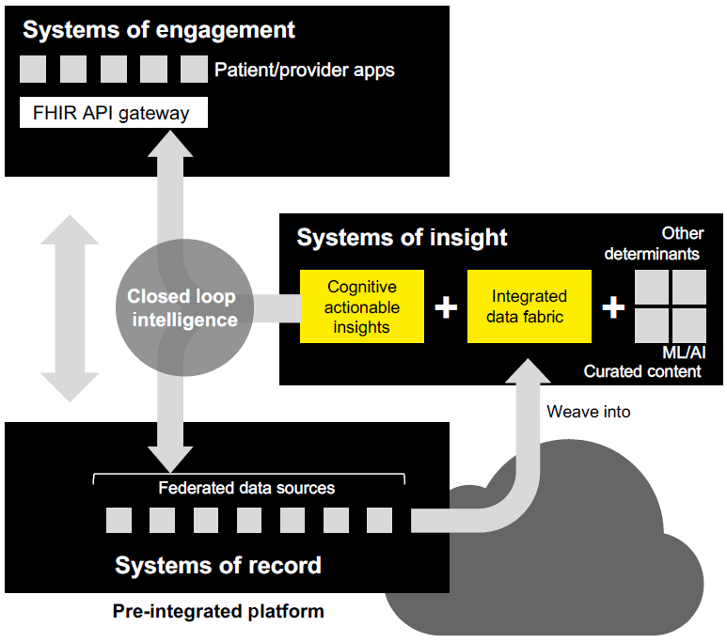
Vision
& Objective
Bridge the gap between the systems of engagement and the systems of record
Benefits of Mediation
Complete longitudinal record
Standardize / process data
Rapid search and retrieval
Execute business rules
Extrapolate meaning from data
…Manage complexity …New insights …Closed Loop Intelligence …Rapid Innovation
June 5, 2018
7

Slide 8
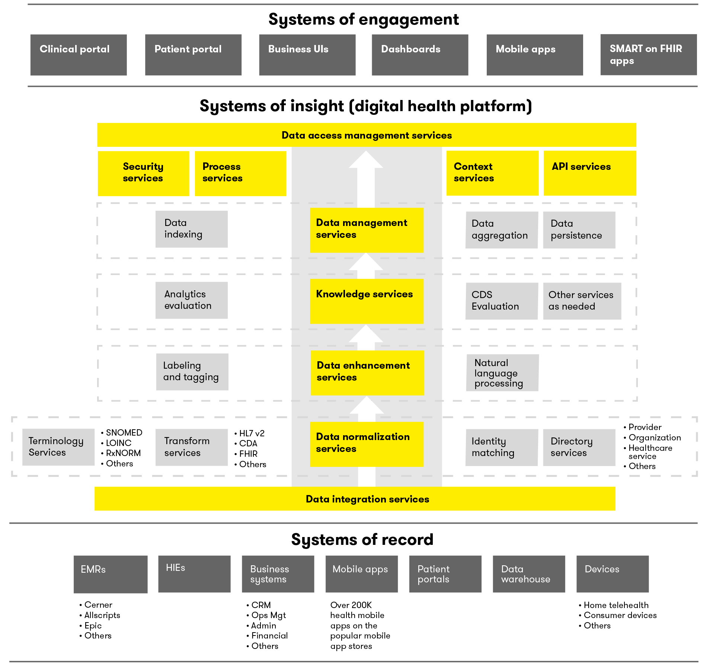
DHP Reference Architecture

Slide 9
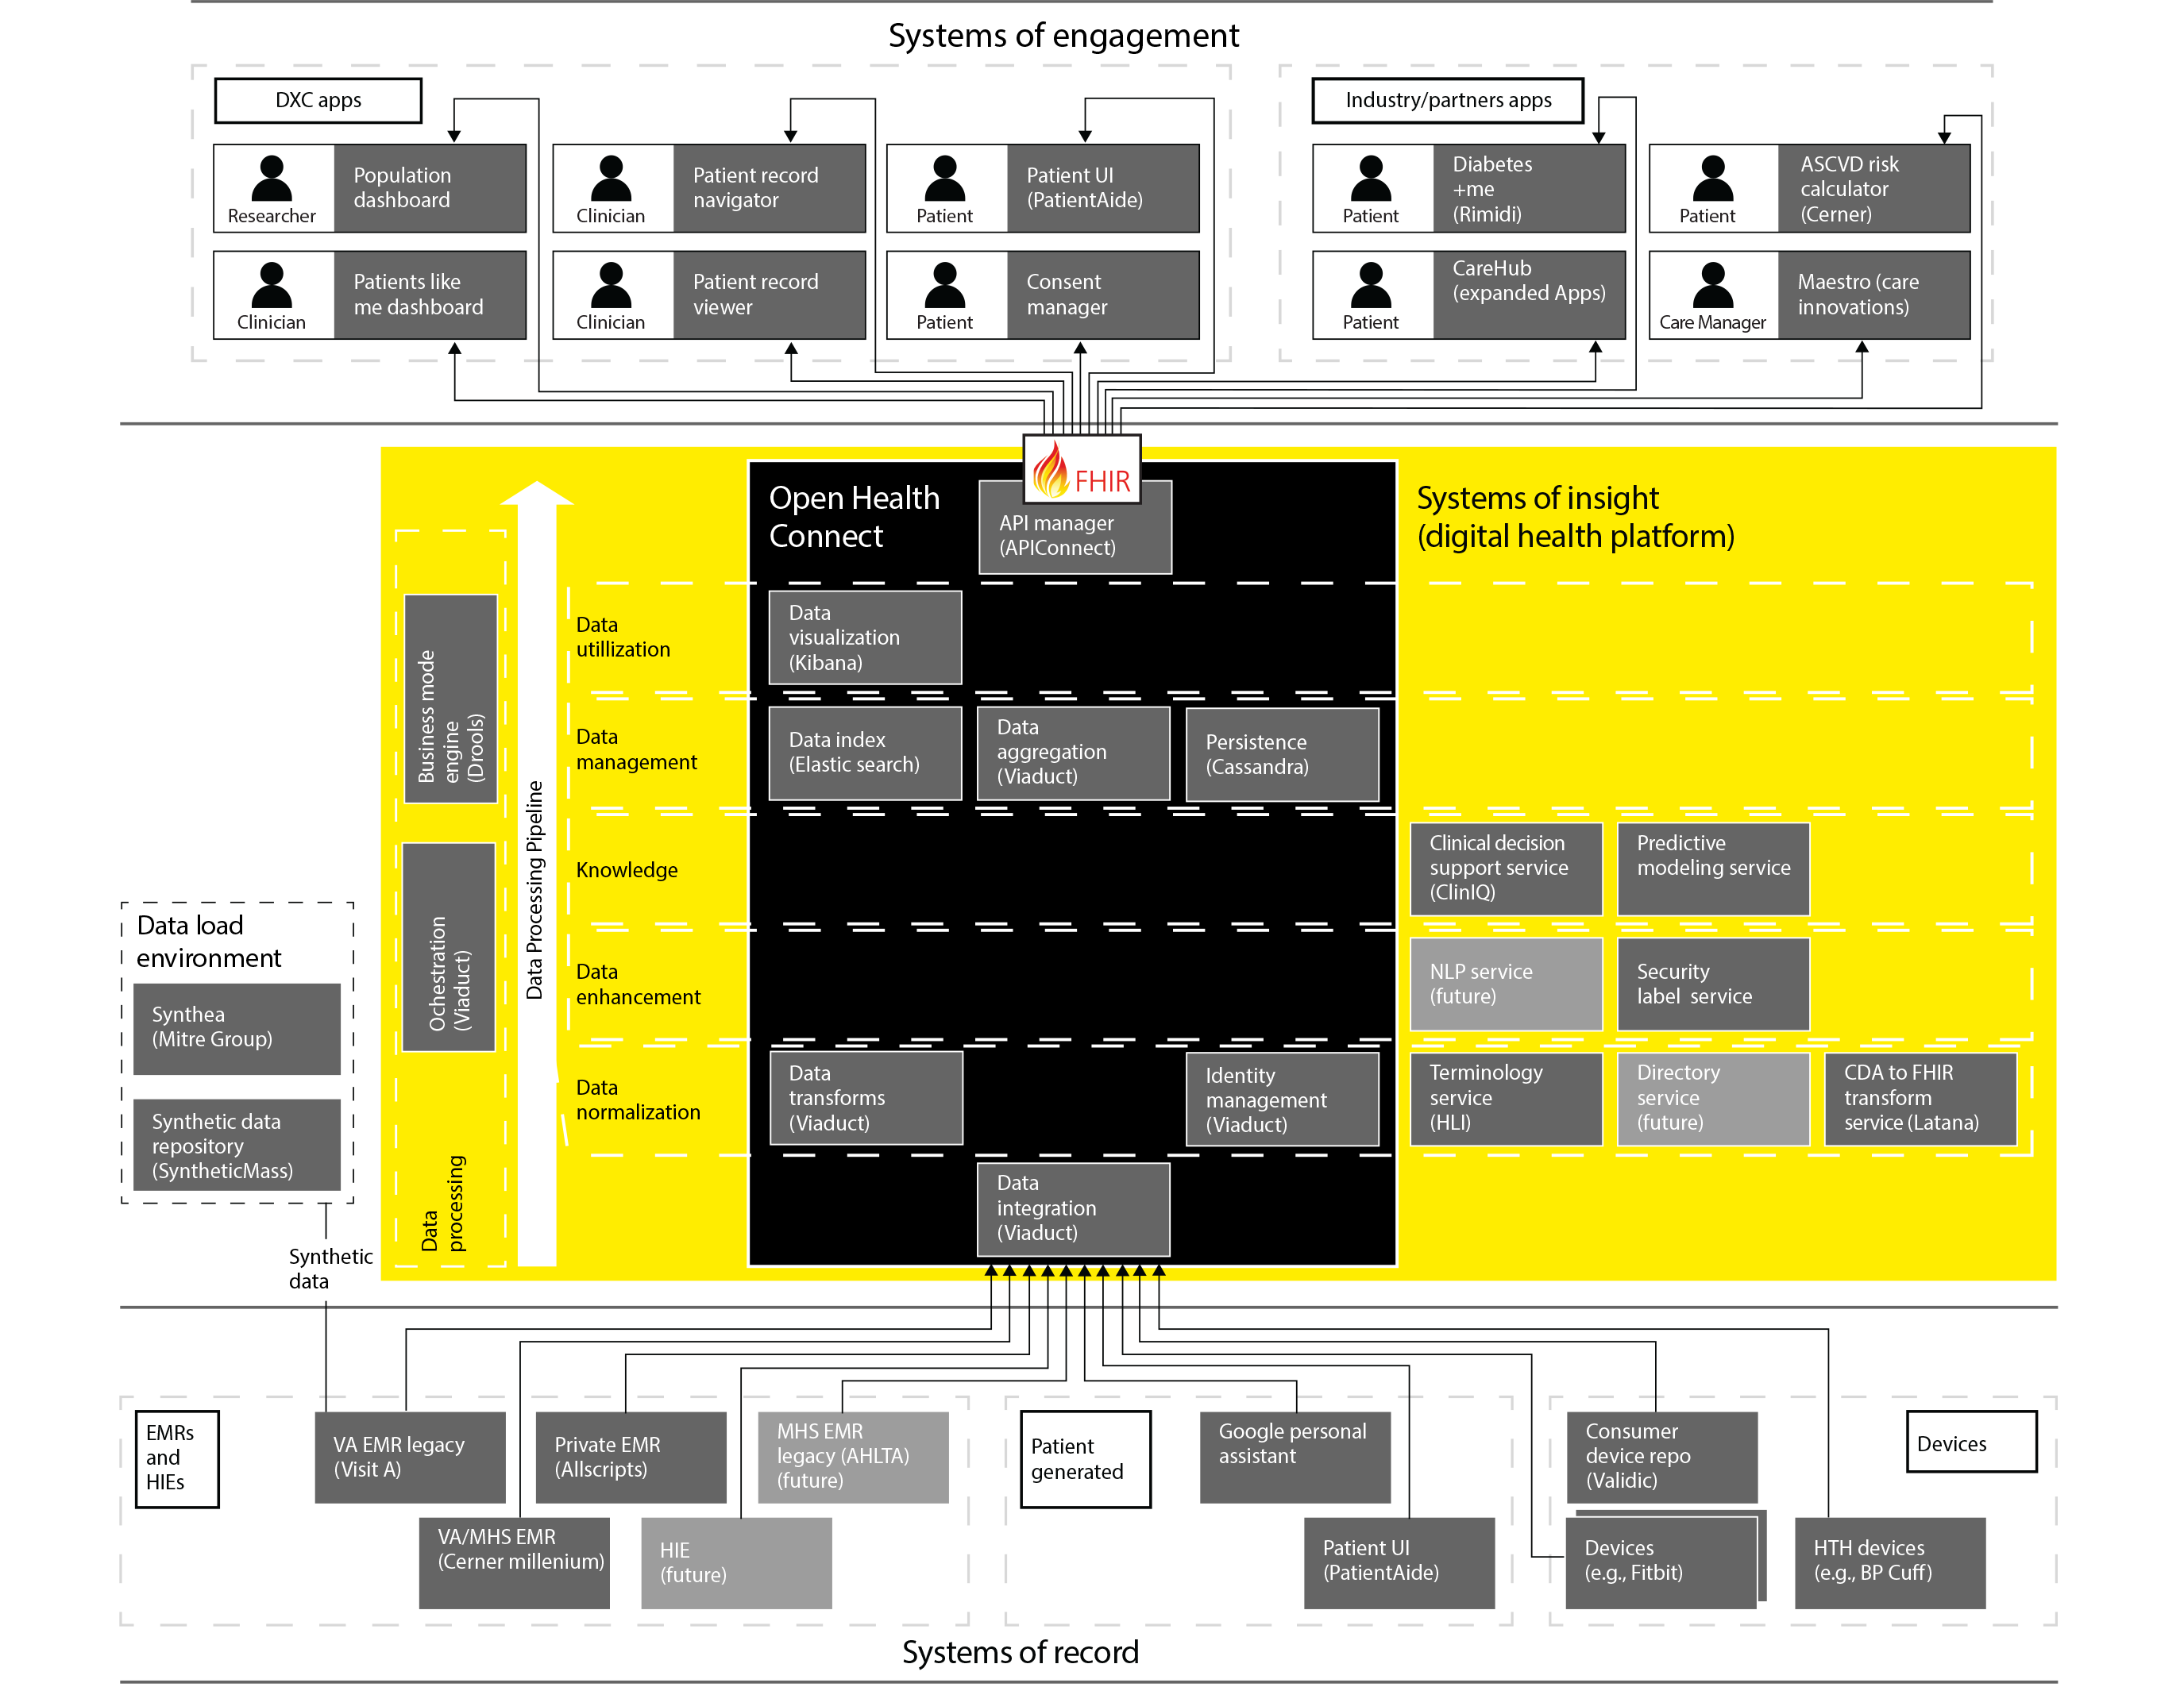
DHP Ecosystem Reference Implementation
Objective: Build an ecosystem of technologies and a community of partners that mimics the complexity and heterogeneity of a real-world healthcare IT environment.
Technology: Demonstrate interoperability, data standardization and the power of a platform-based approach to addressing health data fragmentation.
Community: Collaborate with partners willing to integrate with our platform to showcase their technology working cohesively in this ecosystem.
Purpose: Showcase the ecosystem and the technologies involved to demonstrate the art of the possible.
The diagram is always changing.
It is organic and built iteratively.

Slide 10
Consumer-Mediated Exchange Track Presentation
Linda May Shannon (Scenario 2)
Linda May Shannon, an 18-year-old enrolling freshman is “on her own” for the first time and needs to find and collect her immunization records so that she can share them with her parents.
Linda wants her family to access some information, but not all
She will create a Right of Access consent directive that allows her parents to view her non-sensitive information (i.e. restricts access to HPV)
inNocuus will request Linda’s immunizations information from SLS for access by her parents
SLS will filter what is returned to inNocuus based on Linda’s ROA consent directive
Copyright 2018 - Michigan Health Information Network Shared Services

Slide 11
Consumer-Mediated Exchange Track Presentation
Linda May Shannon (Scenario 2)
Demonstration
Copyright 2018 - Michigan Health Information Network Shared Services

Slide 12
Consumer-Mediated Exchange Track Presentation
Linda May Shannon (Scenario 3)
Linda May Shannon, has been accepted to study fine arts during a semester abroad at Sorbonne University in Paris, she needs
Linda wants to share her immunization records with the university
She feels comfortable sharing her sensitive information because it’s governed under the General Data Protection Regulation (GDPR) and further use requires consent
She will create a Right of Access consent directive for her disclosure of immunizations to the Sorbonne University labeled with GDPR privacy tags
inNocuus will request Linda’s immunizations information from SLS so that Linda can send her immunizations to Sorbonne when she’s ready
SLS will apply a GDPR label to the immunization resource based on Linda’s ROA consent directive
immunization records so she can complete enrollment
Linda creates Right of Access to permit her parents to view Bonus Round:
Linda is accepted to study abroad for a semester at Sorbonne University
Copyright 2018 - Michigan Health Information Network Shared Services

Slide 13
Consumer-Mediated Exchange Track Presentation
Linda May Shannon (Scenario 3)
Demonstration
Copyright 2018 - Michigan Health Information Network Shared Services

