Slide 1
Da Vinci Plan-Net (AKA Provider Directory)
Connectathon – January 2021
Saul A. Kravitz, MITRE
01/11/2021

Slide 2
Housekeeping Announcements
If you have technical difficulties, log out of Whova and sign back on. In most cases, this should resolve your issues.
Post your questions in the Q&A box and not through the chat feature.
Do not enable your video or microphone unless prompted by the presenter.
If you can’t hear or see something, use the chat box to let us know.
Sessions will be recorded. Recordings will be posted in Whova later in the day. Slides will be posted in HL7’s Education on Demand within a week.

Slide 3
Tutorial Outline
Introduction - Purpose of the IG
Regulatory context, if applicable
Workflows addressed
FHIR Resources
FHIR Operations
Conformance

Slide 4
Introduction

Slide 5
Tour of the IG
All Info on Connectathon Confluence Page:
https://confluence.hl7.org/pages/viewpage.action?pageId=97464494
STU1 Implementation Guide:
http://hl7.org/fhir/us/davinci-pdex-plan-net/
Zulip Stream:
https://chat.fhir.org/#narrow/stream/229922-Da.2BVinci.2BPDex.2BPlan-Net (Davinci+Pdex+Plan+Net)

Slide 6
Open Source Reference Implementations
Client
https://plan-net-client.herokuapp.com/
https://github.com/HL7-DaVinci/plan-net_client/
Server
https://davinci-plan-net-ri.logicahealth.org/fhir
https://github.com/HL7-DaVinci/plan-net-ri
Sample Data
https://github.com/HL7-DaVinci/pdex-plan-net-sample-data

Slide 7
Workflows

Slide 8
What is a Plan-Net?
Plan-Net defines a FHIR interface to a health insurer’s insurance plans, their associated networks, and the organizations and providers that participate in these networks. In other words, it is a Payer Provider Directory.
Enables 3rd parties to develop applications through which consumers and providers can query the participants in a payer’s network that may provide services that address their health care needs

Slide 9
CMS Interoperability and Patient Access Final Rule
A Provider Directory API is required by the CMS Interoperability and Patient Access Final Rule
Enforced July 1, 2021:
Medicare Advantage organizations, state Medicaid and Children’s Health Insurance Program (CHIP) fee-for-service (FFS), Medicaid managed care plans, and CHIP managed care entities, or plan years beginning on or after January 1, 2021 for Qualified Health Plans (QHPs) on the Federally-facilitated exchanges (FFEs)
Must include, at a minimum:
Provider names, addresses, phone #s and specialties
Pharmacy names, addresses, phone numbers, and type
Must be updated within 30 calendar days of payer receiving updates

Slide 10
CMS Interoperability and Patient Access Final Rule
CMS is strongly encouraging the use of the Da Vinci Plan-Net Implementation Guide as one way to meet Provider Directory API requirement.
Objective:
Enable third parties to develop applications that allow consumers and providers to find providers and pharmacies within a payer’s network that can address their health care needs

Slide 11
Targeted Users
Members
Looking for information about providers in their current network
Potential Members
Looking or information about current providers in competitors’ networks
3rd Party App Developers
Aggregating information from multiple plans
Add value by augmenting directory content with additional data or functionality

Slide 12
Use Cases
General Search:
Find Urgent Care near me in my network
Find mail order pharmacy services
Look up information about a specific practitioner or organization
Where does Dr. Smith practice on Wednesday
Is Dr Smith in-network and accepting new patients from existing patient’s families
Search for a practitioner or organization by specialty
Find a compounding pharmacy near me in my network
Find an internist with admitting privileges to a specific hospital with an office in my town

Slide 13
Plan-Net Search Types
Search | Example | Focal Resource and Field | Qualifications of Search
General Search | Pharmacy | HealthcareService.category, HealthcareService.specialty | Location, network
Provider by Name | “Joe Smith” | Practitioner.name | Location, network, specialty/role, privileges
Organization by Name | “Montgomery Cardiology” or CVS | Organization.name | Location, network, specialty
Provider by Specialty | Cardiologist | Practitioner.qualification, PractitionerRole.specialty | Location, network, name
Organization by Specialty | Compounding Pharmacy | Organization.qualification, OrganizationAffiliation.specialty | Location, network, name
All clients shall support search via HealthcareService.category
All examples will include HealthcareService resources

Slide 14
Plan-Net “Pharmacy Mix”
The CMS Interoperability rule says that:
“At a minimum, these payers must make available via the Provider Directory API provider names, addresses, phone numbers, and specialties. For MA organizations that offer MA-PD plans, they must also make available, at a minimum, pharmacy directory data, including the pharmacy name, address, phone number, number of pharmacies in the network, and mix (specifically the type of pharmacy, such as “retail pharmacy”).”
The Plan-Net IG supports these tools that address these requirements

Slide 15
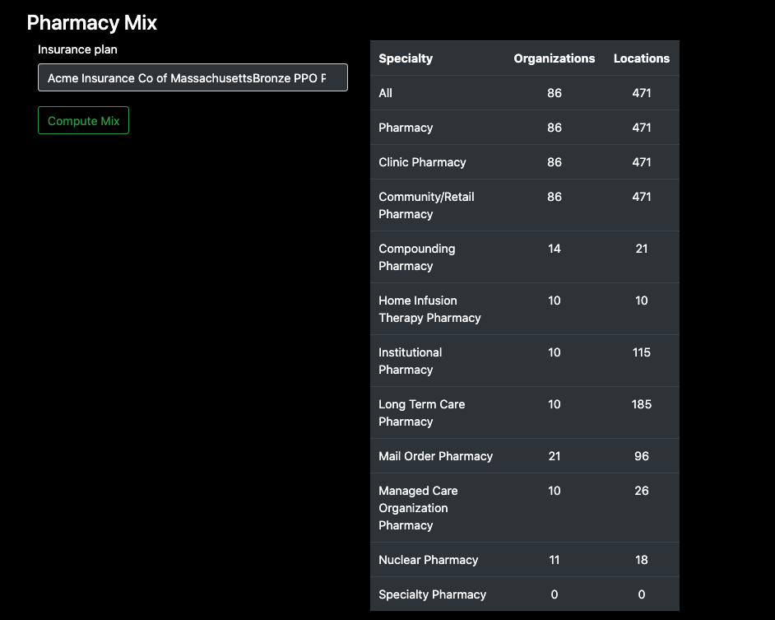
Pharmacy Mix in the Reference Client
One interpretation of a pharmacy mix report

Slide 16
FHIR Resources

Slide 17
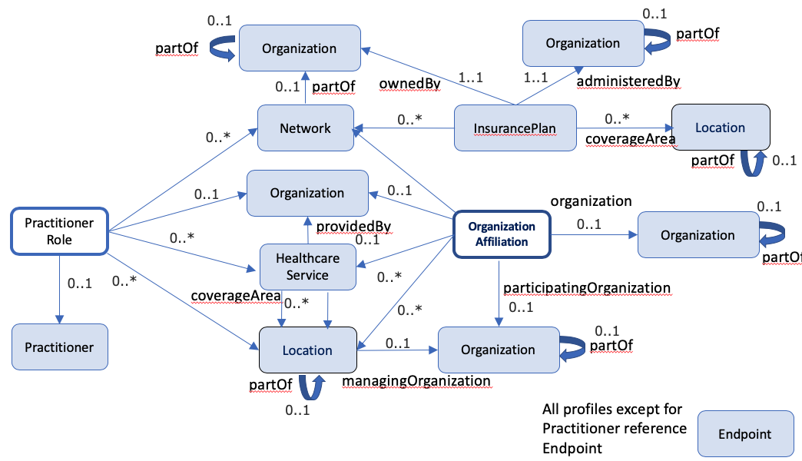
Plan-Net Profiles
*
*
*
*
* = profiles not based on USCore

Slide 18
Implementation Guide Profiles (1)
Profile | Based On | Description
PlannetEndpoint | Endpoint (R4) | Endpoint that can be used for electronic services, such as a portal or FHIR REST services, messaging or operations, or DIRECT messaging.
PlannetHealthcareService | HealthcareService(R4) | The HealthCareService resource describes services offered by an organization/practitioner at a location, and includes services covering the entire healthcare spectrum.

Slide 19
Implementation Guide Profiles (2)
Profile | Based On | Description
PlannetInsurancePlan | InsurancePlan (R4) | Describes a package of health insurance coverage benefits that are offered under specific networks.
PlannetLocation | Location(USCore) | A physical place where healthcare services are provided, practitioners are employed, organizations are based.

Slide 20
Implementation Guide Profiles (3)
Profile | Based On | Description
PlannetNetwork | Organization (USCore) | A network is an aggregation of organizations and individuals that deliver a set of services across a geography through health insurance products/plans
PlannetOrganization | Organization(USCore) | A formal or informal grouping of people or organizations with a common purpose

Slide 21
Implementation Guide Profiles (4)
Profile | Based On | Description
PlannetOrganizationAffiliation | OrganizationAffiliation(R4) | Describes relationships between organizations, including the services one organization provides another.
PlannetPractitioner | Practitioner(USCore) | Practitioner is a person who is directly or indirectly involved in the provisioning of healthcare.
PlannetPractitionerRole | PractitionerRole(R4) (USCore profile not used) | A person who is directly or indirectly involved in the provisioning of healthcare.

Slide 22
Implementation Guide Key Extensions
Extension | Description
Accessibility | Describes accessibility options offered by a practitioner or at a location.
Communication Proficiency | Expresses a practitioner’s spoken proficiency with the language indicated in practitioner.communication
Contactpoint Available Time | Represents the days and times a contact point is available
Delivery Method | Describes the physical/virtual service delivery method.
Endpoint Use Case | Describes the specific use cases (service descriptions) supported by the endpoint.
New Patients | Indicates whether a provider accepts new patients by location and network.
Qualification | Used to add qualifications for an organization (e.g. accreditation) or practitionerRole (e.g. registered to prescribe controlled substances).
Via-Intermediary | A reference to an alternative point of contact

Slide 23
Required Resources and Data Elements
All profiles in the IG are required (SHALL)
Best effort has been made to align with current Payer directory content.
Min Cardinality >= 1 elements and Must Support (MS) data elements ensure compliance with CMS rule

Slide 24
Required Terminologies
No licensed terminologies
Several valuesets based on subsets of NUCC Provider Taxonomy
All valuesets supported by HL7 Terminologies or defined within IG

Slide 25
FHIR Operations

Slide 26
Core FHIR Technologies
REST

Slide 27
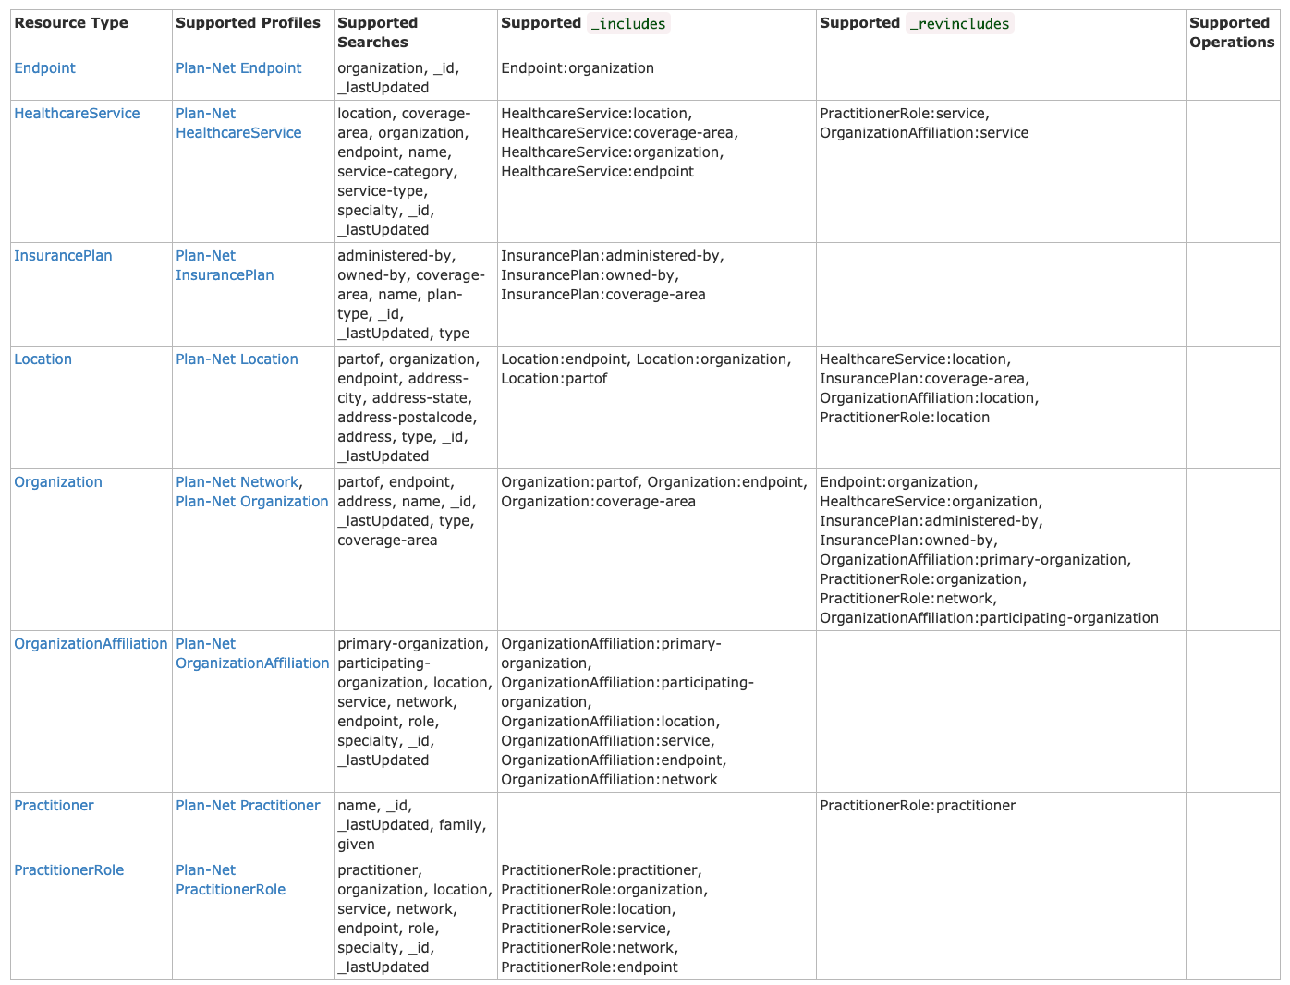
Required Search Capabilities

Slide 28
Bulk FHIR (aka Flat FHIR)
Not mentioned or required by IG (yet)
Asynchronous interaction via $export operation to request access to full content of directory in NDJSON files
Server and Client Reference Implementations demonstrate usage

Slide 29
Reference ImplemeNtation

Slide 30
Reference Implementations
Reference Client
MITRE: Initial Web GUI (Ruby):
Code: https://github.com/HL7-DaVinci/plan-net_client/
Deployed Web-Client: https://davinci-plan-net-client.logicahealth.org/
Reference Server
MITRE: HAPI server with Conformance resources and Sample Data:
Code: https://github.com/HL7-DaVinci/plan-net-ri
Deployed Server: https://davinci-plan-net-ri.logicahealth.org/fhir
Demonstration and Discussion on Thursday

Slide 31
Testing Resources

Slide 32
Testing Resources
Touchstone Tests
https://touchstone.aegis.net/touchstone/testdefinitions?selectedTestGrp=/FHIRSandbox/DaVinci/FHIR4-0-0-Test/PDex/03-PlanNet&activeOnly=false&contentEntry=TEST_SCRIPTS
Presentation on Aegis/Touchstone resources for Formulary and Plan-Net Testing:
Thursday 12:30-1pm ET

Slide 33
Putting it all together

Slide 34
Next Steps
Join session tomorrow 11am-4pm
Formulary + Plan-Net
Weekly Call

Slide 35
Implementation Day

Slide 36
Agenda
Note: Plan-Net + Formulary together
Deep Dive into examples for representing directory information using Plan-Net profiles
Demonstration of Plan-Net reference client/server
Q&A with IG developers and CMS
Aegis/Touchstone testing resources
Integration with other clients/servers (TBD)

Slide 37
Thank you!

