Slide 1
How to copy and update a dashboard and filters in Jira

Slide 2
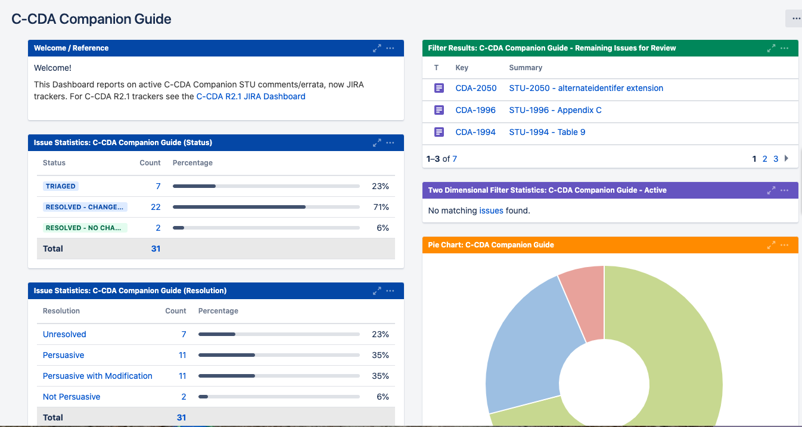
Navigate to the dashboard you want to copy
https://jira.hl7.org/secure/Dashboard.jspa?selectPageId=12105

Slide 3
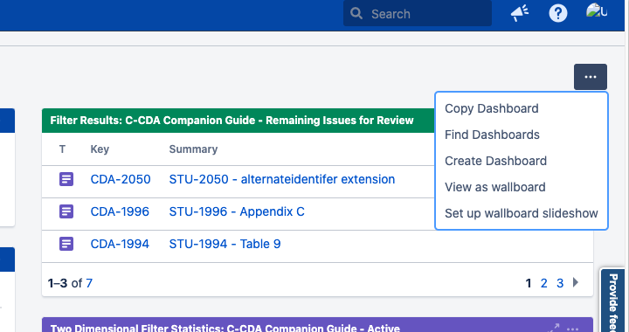
Select Copy Dashboard from top right

Slide 4
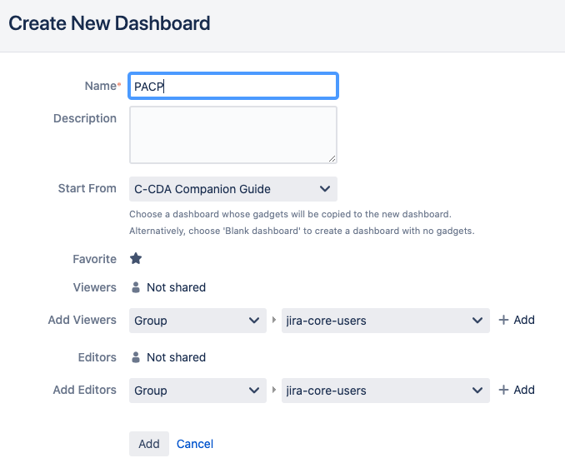
Type a name for your Dashboard, select Add

Slide 5
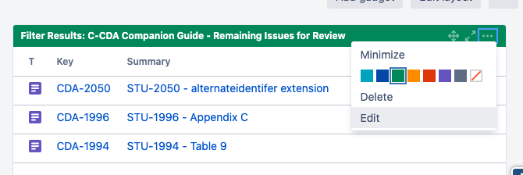
Edit each gadget by selecting Edit from the top right corner of the box

Slide 6
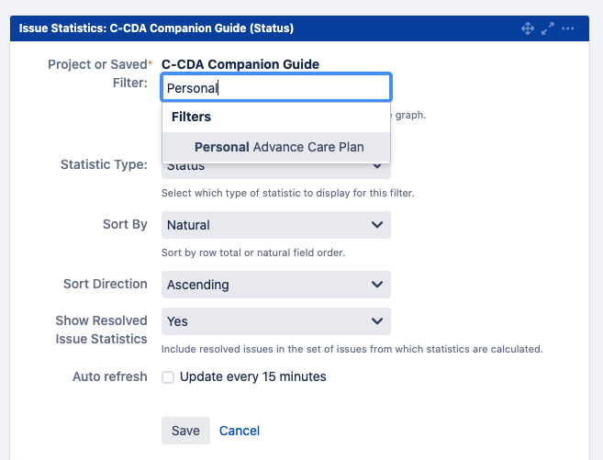
Update the filter to the corresponding newly created one, then Select Save (See How to Create New Filters below.)

Slide 7
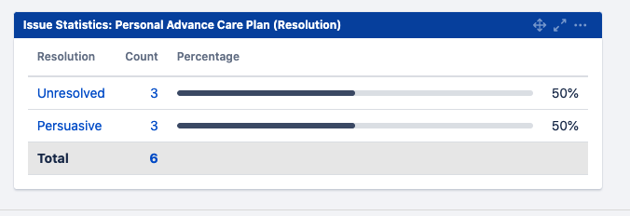
The title of the gadget automatically updates

Slide 8
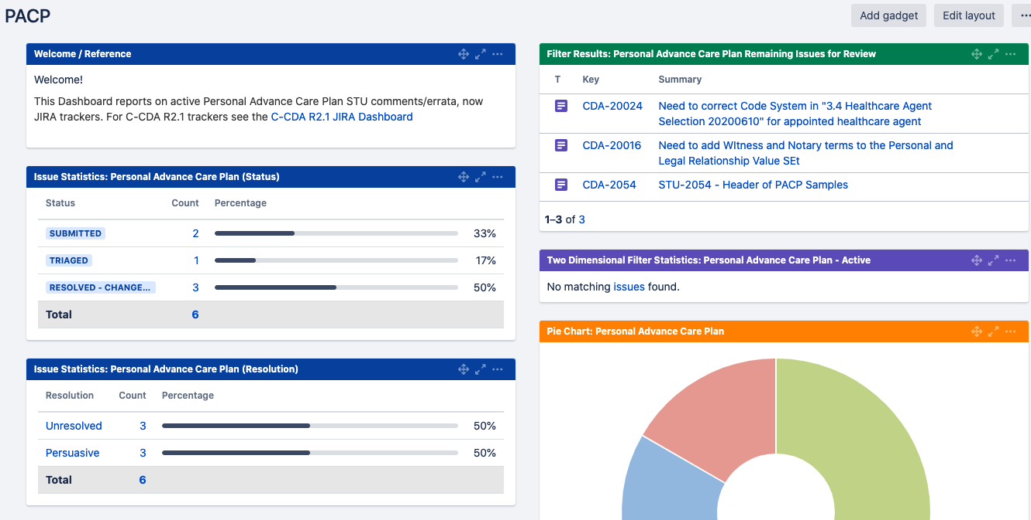
Repeat the process of updating the filter for each widget

Slide 9
How to create new filters from previously defined filters

Slide 10
Overview: Start with a Jira filter in the current dashboard - copy, paste and update spec name then Save as new filter
IG NAME Remaining Issues for Review:
project = "CDA Specification Feedback" AND issuetype in ("Change Request", Comment, Question, "technical correction") AND status in (Submitted, Triaged, "Waiting for Input") AND Specification in ("C-CDA R2.1 Companion Guide (CDA) [CDA-ccda-two-one-companion]") AND (Grouping is EMPTY OR Grouping not in (Block-Vote-1, Block-Vote-2, Block-Vote-3, Block-Vote-4, Block-Vote-5, Block-Vote-6, Ready-For-Vote, Postballot)) ORDER BY created DESC, key ASC
IG NAME -Active
project = "CDA Specification Feedback" AND issuetype in ("Change Request", Comment, Question, "Technical Correction") AND Specification = "C-CDA R2.1 Companion Guide (CDA) [CDA-ccda-two-one-companion]" AND status in (Triaged, Submitted, "Waiting for Input", Deferred)
IG NAME
project = "CDA Specification Feedback" AND Specification = "C-CDA R2.1 Companion Guide (CDA) [CDA-ccda-two-one-companion]"

Slide 11
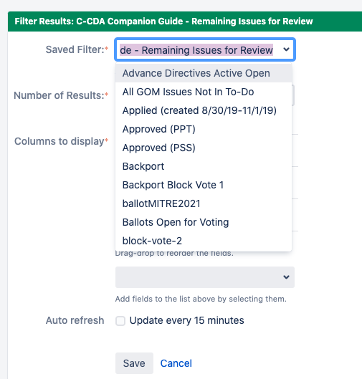
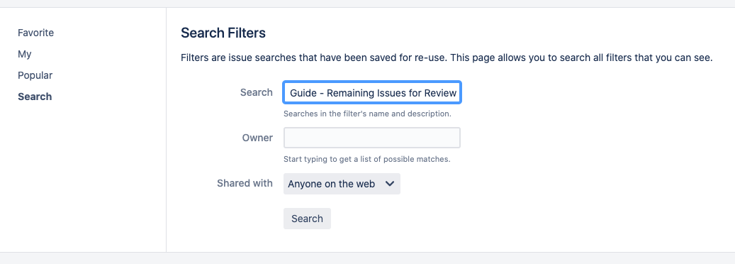
How to copy a filter
Top menu select Issues
Navigate to the bottom of the drop down menu, select Manage Filters
Enter the name of the filter which can be copied from widget in Edit mode
Copy from Dashboard Paste in Filters

Slide 12
Select the correct filter, copy filter parameters

Slide 13
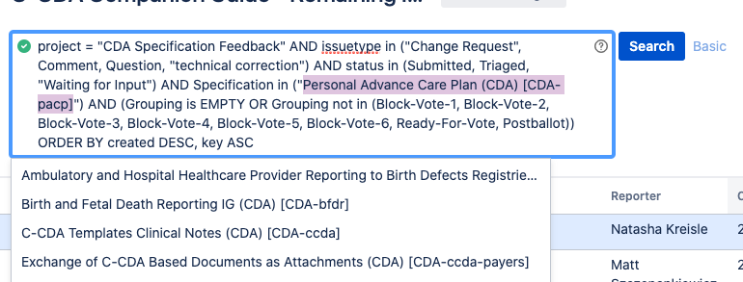
Update Spec Name, Select Search

Slide 14
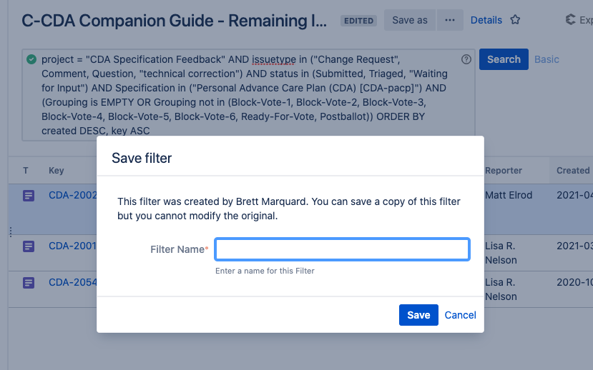
Select Save As, then create new filter name

Slide 15
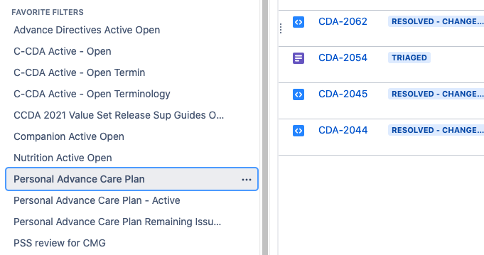
All saved filters will be found in Favorite Filters on the left menu

