Slide 1
mCODE Genomics Update
May Terry / James Chen, MD
January 26, 2021

Slide 2
Agenda
Implemented genomics-related changes for STU2 Ballot
Planned / proposed changes for STU2 Ballot
Use Cases for discussion

Slide 3
Current mCODE Status
STU1 publication in mid-March 2020.
STU2 ballot ETA: May 2021
General scoping for STU2:
Additions considered.
No breaking changes unless absolutely necessary.

Slide 4
mCODE Genomics-related STU2 Changes
Committed
ADD: Variant.dna-change-type
ADD: expanded example which included Oncotype DX for showing gene-expression (as Tumor Marker test)
Not yet committed, considered for inclusion
enhancements to mCODE Cancer Genetic Variant profile
component:copy-number
component:ref-allele
component:sample-allelic-frequency
component:gene-studied – how to represent fusion genes - additional qualifier to support fusion gene type
New profile addition: Diagnostic Implications
component:clinical-significance
Other – For Future Discussion
use of variant interpretation code?
Is RegionStudied needed? – added based on STU1 ballot comments, but might not fit mCODE’s provider-centric use case
Should genomics reporting IG should revisit support for gene-expression?
Representing amplification
Notes:
Example of a Tempus test.

Slide 5
For Discussion

Slide 6
What is actionable makes what is minimal
4 major types of alterations that are actionable
SNV allelic fraction?
Insertions/deletions allelic fraction?
Copy Number Alterations how many copies?
Structural rearrangements (fusions)
how are they re-arranged?

Slide 7
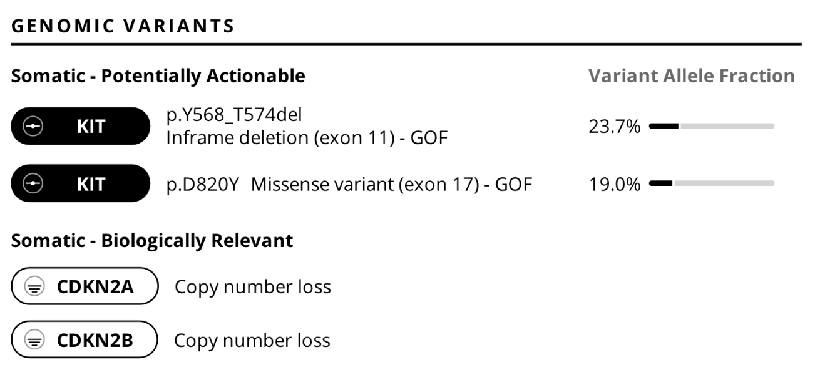
What is actionable makes what is minimal
4 major types of alterations that are actionable
SNV allelic fraction?
Insertions/deletions allelic fraction?
Copy Number Alterations how many copies?
Structural rearrangements (fusions)
how are they re-arranged?

Slide 8
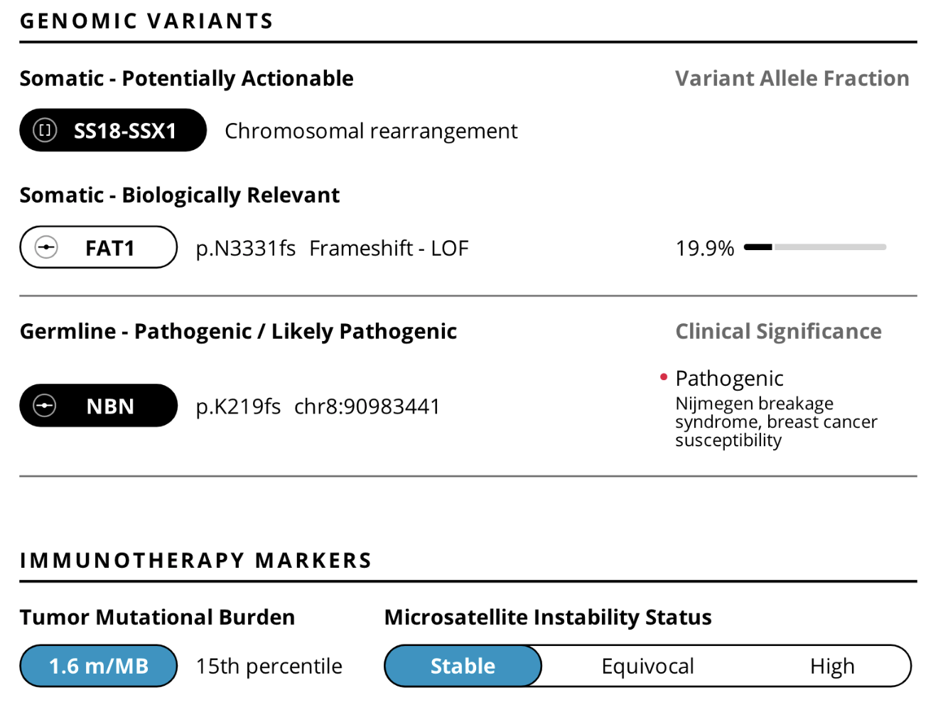
What is actionable makes what is minimal
4 major types of alterations that are actionable
SNV allelic fraction?
Insertions/deletions allelic fraction?
Copy Number Alterations how many copies?
Structural rearrangements (fusions)
how are they re-arranged?

Slide 9
RNA expression data are becoming standard portions of molecular reporting
Commercial Signatures:
Mammoprint
OncoTypeDx breast
CancerType ID
Embedded signatures:
Specific gene changes
HRD
Immune signatures

Slide 10
Fusion Genes in mCODE and CG Reporting IG
Example: EML4-ALK
"component": [
{
"code": {
"coding": [
{
"system": "http://loinc.org",
"code": "48018-6"
}
]
},
"valueCodeableConcept": {
"coding": [
{
"system": "http://www.genenames.org",
"code": "HGNC:1316",
"display": ”EML4"
}
]
}
},
{
"code": {
"coding": [
{
"system": "http://loinc.org",
"code": "48018-6"
}
]
},
"valueCodeableConcept": {
"coding": [
{
"system": "http://www.genenames.org",
"code": "HGNC:427",
"display": ”ALK"
}
]
}
}
...etc.
]
Currently could be represented in Variant.component:GeneStudied > 1.
Current representation could imply a fusion, but this might not be enough.
Q: is there > 1 gene, including fusion-gene per variant?
if yes, do we represent one gene per variant?
For discussion:
How to group genes and explicitly call it a fusion-gene.
explicitly represent the gene-fusion type.
Does the Genomics Reporting IG have an alternation type in Variant?
how to handle interpretation at the variant level
currently FHIR Observation binds interpretation to an HL7 value set as extensible;
the more appropriate choice would be to use a ClinGen concept; we could consider create an extension, but we can also add new concepts if they don’t exist in the HL7

Slide 11
Next Steps
follow-up discussions within mCODE Technical Review Group (TRG) on proposed genomics additions.
Follow-up discussions with CGWG re: fusion-genes, if needed.

Slide 12
Thank You!

Slide 13
Supplemental Slides

Slide 14
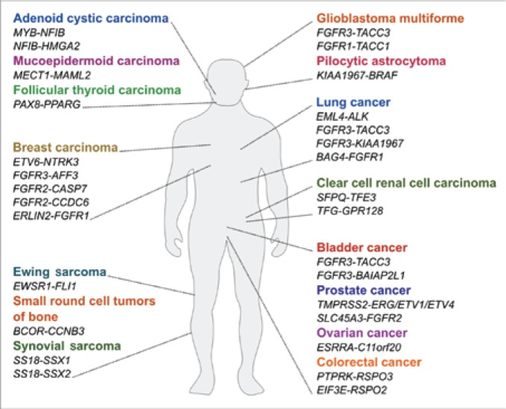
Gene fusions
fusion gene: A gene made by joining parts of two different genes
There are over 300 gene fusions in cancer (https://cancer.sanger.ac.uk/cosmic/fusion).
Examples of gene fusions
source: ncbi.nlm.nih.gov/pmc/articles/PMC3845546/

