Slide 1
FHIR Connectathon 25 Clinical Reasoning
Track Highlights
Bryn Rhodes

Slide 2
Track Summary
Test the Clinical Reasoning Module and related implementation guides:
QI Core IG
Quality Measure IG
Data Exchange for Quality Measures IG
Clinical Practice Guidelines IG

Slide 3
Participants
American Academy of Neurology
Bellese Technologies
Commure
Dynamic Health IT
eHealth NSW
ESAC, Inc
Flexion, Inc
HRSA
Indicina, LLC
iParsimony, LLC
Lantana Consulting Group
Mathematica
Medisolv, Inc
Oregon Urology Institute and Large Urology Group Practice Association
Philips Healthcare
PJM Consulting, LLC
SAMHSA
SemanticBits
Telligen
The Joint Commission
The MITRE Corporation
UPMC Enterprises
Yale-CORE

Slide 4
Testing Focus
More Quality Measure Features
Supplemental Data
Continuous Variable Measures
PACIO Data in a FHIR eCQM
Cognitive and Functional Status Assessment Data
End-to-End Gaps-in-Care Scenario
Continued testing of Opioid IG via CDS Hooks
MAT-on-FHIR

Slide 5
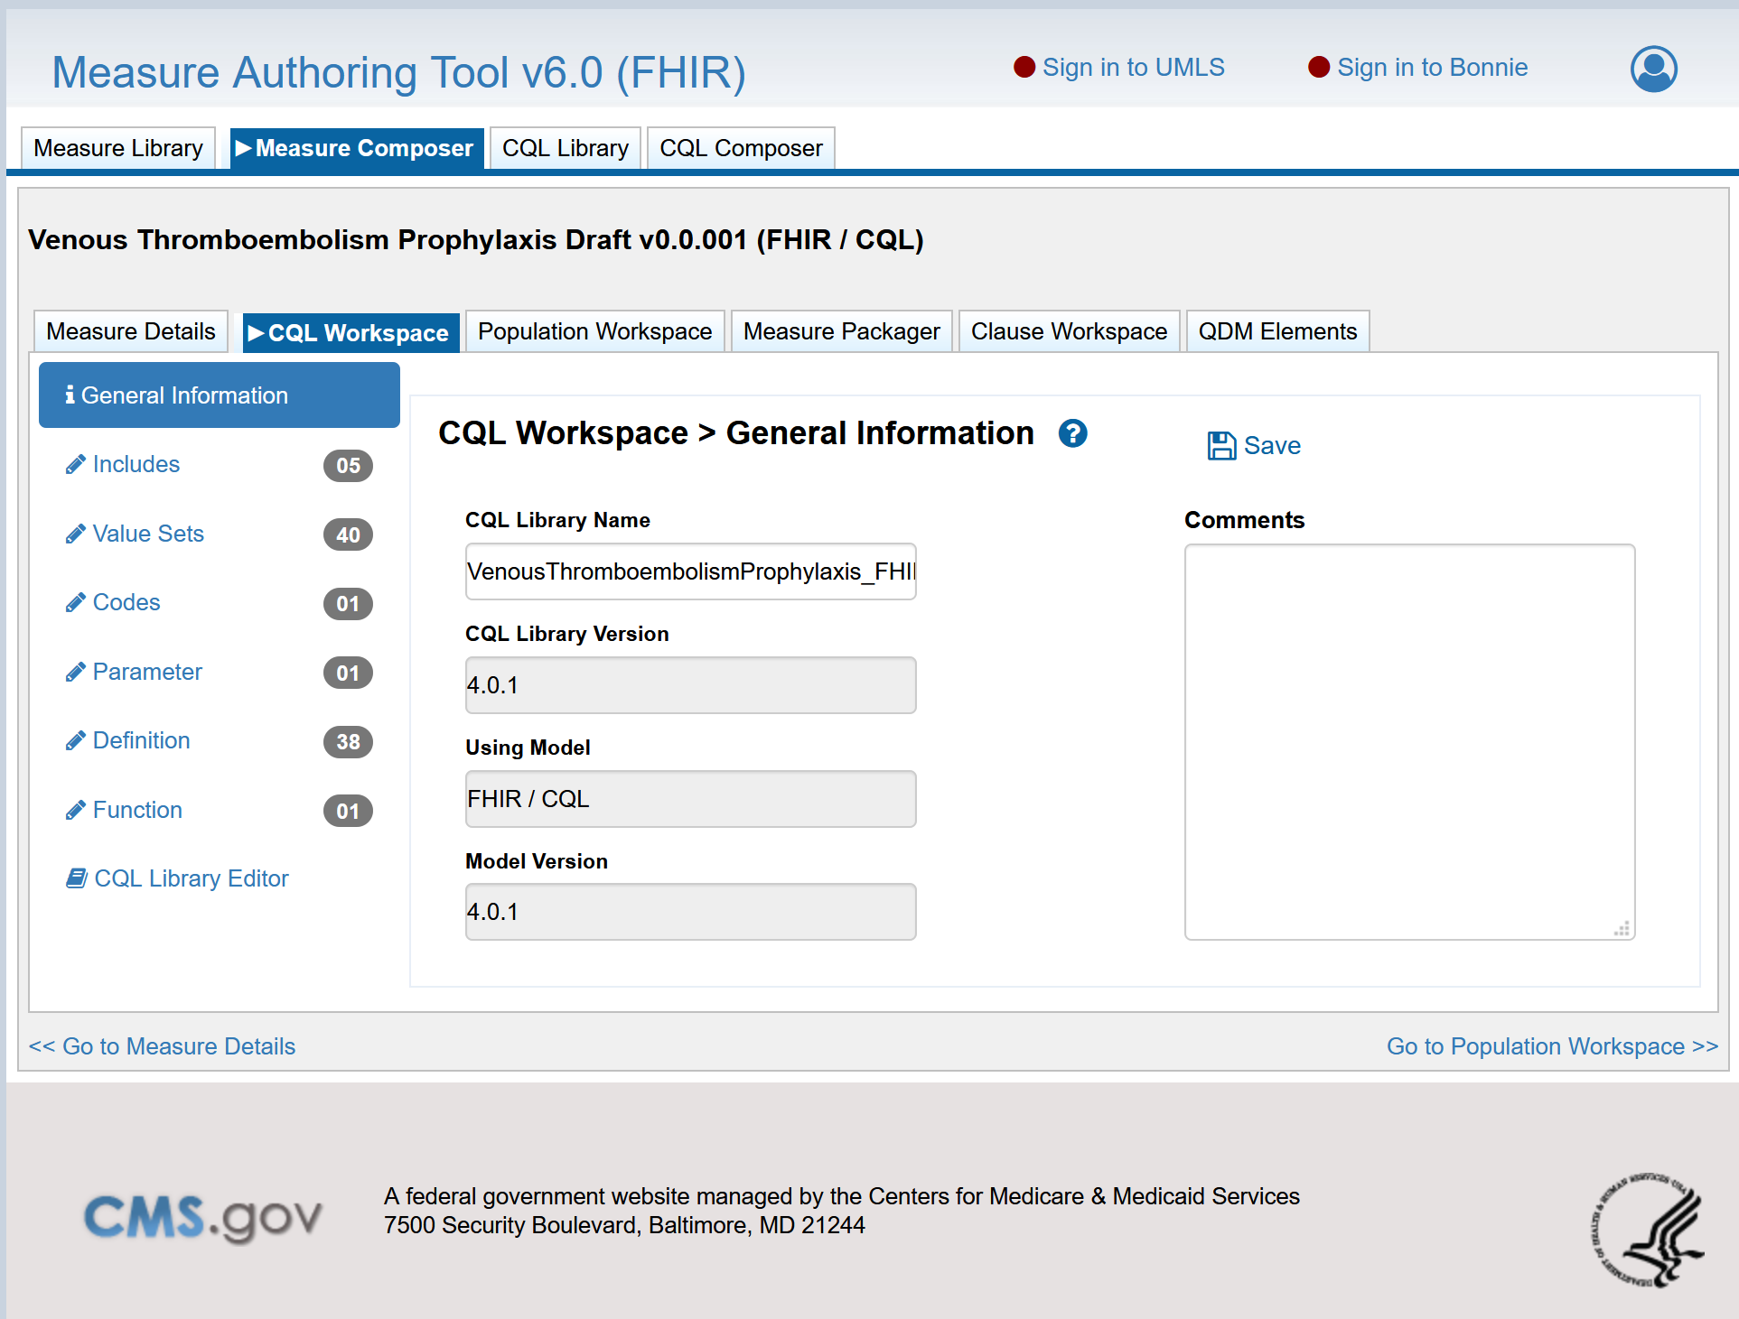
MAT-on-FHIR (Measure Authoring Tool v6.0)
Supports FHIR-based Measures
Exported packages conform to the Quality Measure IG
Developer-assisted QDM-to-FHIR measure conversion

Slide 6
Testing Results So Far
Successfully tested supplemental data with
124, 125, 111, 104, 108
Continuous Variable Measures still have some kinks
Tests pass in Atom, but failing in the reference implementation
Successfully packaged measures with MAT-on-FHIR
Found some issues attempting to load the packages and evaluate
Testing with PACIO data
Able to load PACIO data, currently investigating an evaluation failure

Slide 7
Thank you Connectathon Support!

