Slide 1
Context-aware app suggestions
Aziz Boxwala, MD, PhD, Elimu Informatics
Guilherme Del Fiol, MD, PhD University of Utah
June 6, 2018

Slide 2
Recap: Sep 12 2018
Develop a standard approach for users to discover apps available around specific data contexts (e.g., apps for a problem or a med in a patient’s chart)
Previously, we have looked at
Using CDS Hooks with new triggers
Concerns about this type of trigger not falling in hooks spec
Usability
Extending Infobutton spec to include apps in responses
Major issue is with distinguishing app links from other links in the popular URL-based spec
Last week, we looked at a proposal for adding new tag types to HTML
Concern around difficulties for clients to implement this spec

Slide 3
Updates
Use HTML syntax to distinguish links to apps
Custom tags
Custom URL scheme
data-* attribute
Thanks Chris M!

Slide 4
New proposal
Request
Add optional parameter for resourceType
Define value-set to include “apps”
Response
data-* attribute approach

Slide 5
Request -
Add a request parameter to allow the client to specify the types of resources it will accept
Didactic resources
Apps
…[value set to be developed]
Default will be didactic resources only
For backward compatibility, so “legacy” clients don’t receive app links
As clients start accepting apps, they can include apps in their request
ageGroup.v.c=D000368&ageGroup.v.cs=2.16.840.1.113883.6.177&
taskContext.c.c=PROBLISTREV&taskContext.c.dn=Problem+list+review&
mainSearchCriteria.v.c=D018410&mainSearchCriteria.v.cs=2.16.840.1.113883.6.177& mainSearchCriteria.v.dn=Bacterial+Pneumonia&
mainSearchCriteria.v.ot=Pneumonia&resourceType=apps&resourceType=didactic

Slide 6
Use data-* attribute in response
HTML5 allows custom attributes starting with the prefix “data-”
Plus, we also specify a class for css or other processing
<html>
…
<h1>Patient handout</h1>
<a href=“https://medlineplus.gov/some-disease”>Learn more about some disease</a>
…
<h1>Apps</h1>
<a class="hl7.org:fhir-app" data-fhir-app-redirect="https://smartapp.com/diabetes/redirect.html" href= =“https://smartapp.com/diabetes/launch.html”>Diabetes app</a>
</html>
Notes:
https://developer.mozilla.org/en-US/docs/Web/HTML/Global_attributes/data-*
The href attribute is the launch url

Slide 7
Why data-*
Why
Likely easiest to implement of the HTML response approach
Browser support universal

Slide 8
Handling data-* in “legacy” clients
data-* is a feature of HTML5
SMART on FHIR requires HTML5$
So any client that gets app links should support HTML5 anyways
Solutions for backward compatibility
Infobutton request includes a new parameter to indicate that response may contain app links
By default, infobutton servers will not send app links
Notes:
$ http://docs.smarthealthit.org/

Slide 9
Old slides

Slide 10
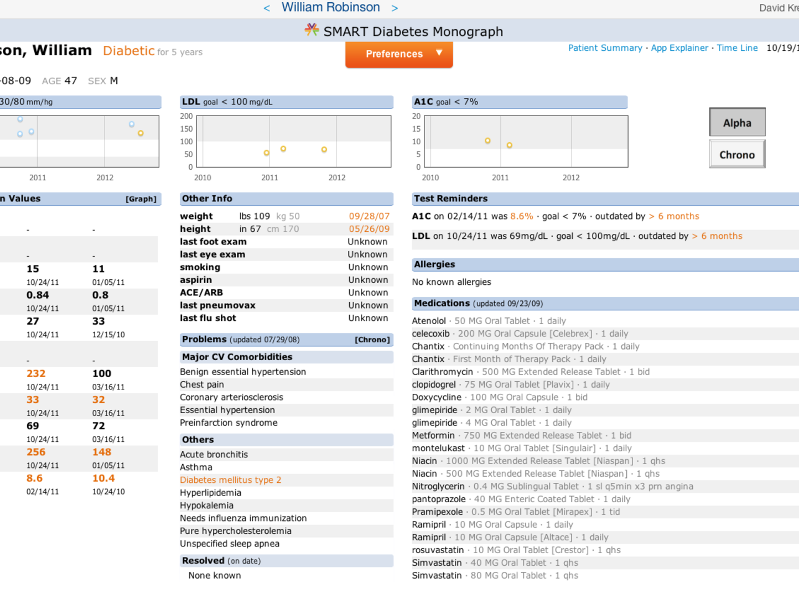
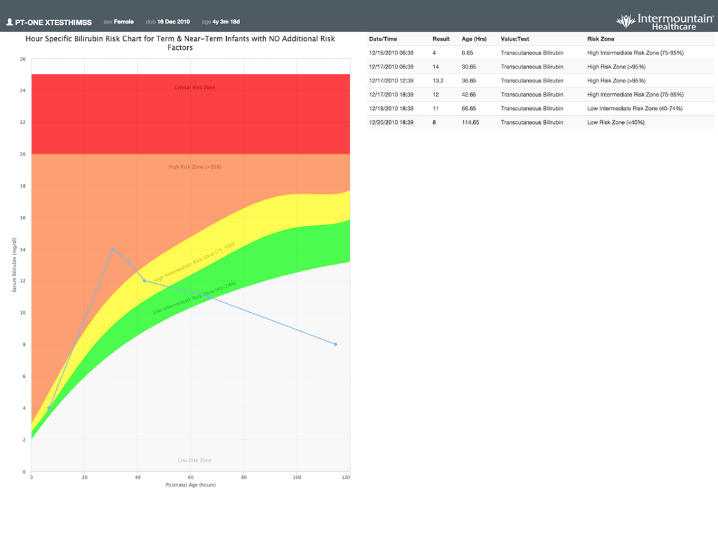
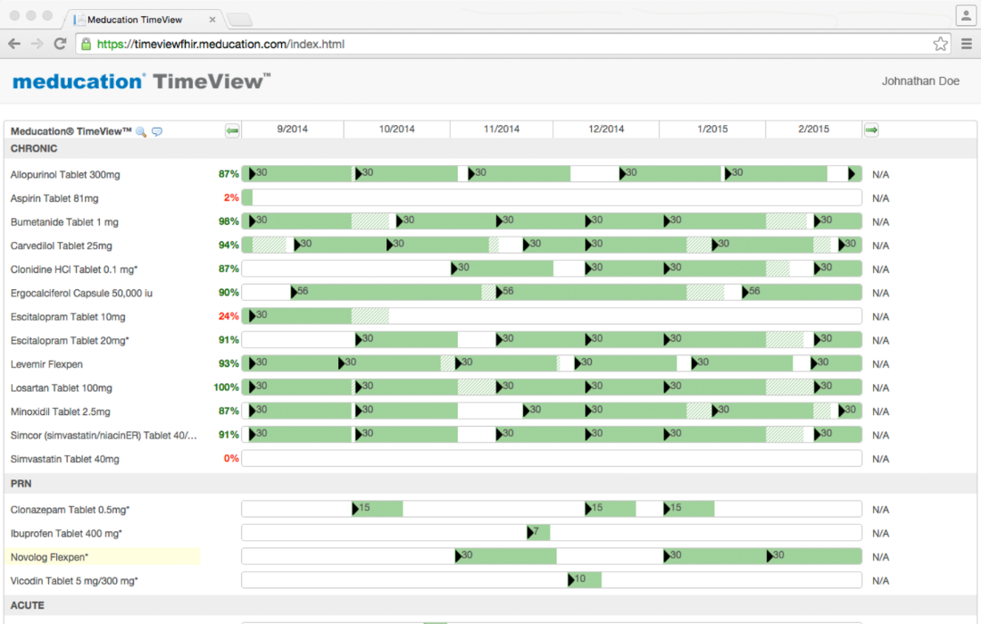
Launching apps in context
Many SMART on FHIR apps should be used in specific data contexts (problem, abnormal lab, med)

Slide 11
Leads to
Proprietary approaches to launching apps: write rules, menu configuration…
No standard for when an app should be surfaced

Slide 12
Two standards with partial capability to fill this need
Surfaces context-aware patient information
But…no PHI exchanged – SMART apps need patient identifier
Cards provide links to SMART apps
But … initial hooks are workflow triggered, not user triggered in specific data contexts

Slide 13
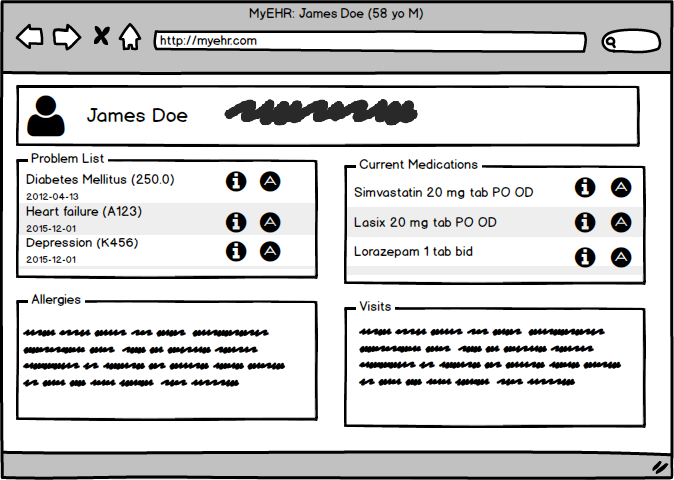
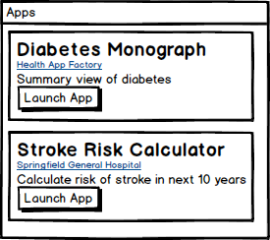
Proposal
New hook: similar launch triggers as infobutton – “app button”
Clicking on those buttons evokes cds-hooks request with app cards (or others) returned

Slide 14
Hook proposal
Workflow
User initiates request
Same triggers as infobutton
Hook:
Context-aware-app-request
Or any other name
Context
patientId
context-item: The resource representing the condition/medication-statement/observation/… that the user clicked on
The Diabetes condition resource in the example on the previous page
Note: this is purely a cds-hooks proposal, influenced and informed by the infobutton spec

Slide 15
Infobutton-based solution

Slide 16
Extending infobuttons
Infobuttons retrieve context-relevant resources
Can they be used for returning apps?

Slide 17
Key limitations
Apps less patient-specific
With infobutton, app-discovery can only be driven by codes sent in request for age group, gender, diagnosis, and such
This is less-specific than using all FHIR data as in hooks
But…
Acceptable for discovering apps, perhaps
Distinguishing app links
In the widely used URL-based implementation, response is HTML
How does a client distinguish between SMART on FHIR app links versus a reference resource link?

Slide 18
Identifying app links
HTML response
Use HTML syntax to distinguish links to apps
Approaches
Custom tags
data-* attributes
Custom URL scheme
JSON (SOA) response
The json schema is extended with new attributes to indicate app links
URL request
http://myinfobutton...
{…}
JSON response

Slide 19
JSON schema approach
Why JSON
Small change to existing SOA spec
Why not JSON
Most infobutton clients implement URL-based spec
Bigger task for those clients to support this approach
URL request
http://myinfobutton...
{…}
JSON response

Slide 20
Custom HTML tags
HTML5 is extensible with custom tags
Create new tags for app links
Javascript added to the page can support these tags
Why tags
Small change to URL-based spec
Relatively simpler for clients to implement
Why not tags
New technology element in HL7 standards
Not universally supported in browsers
<html>
…
<h1>Patient handout</h1>
<a href=“https://medlineplus.gov/some-disease”>Learn more about some disease</a>
…
<h1>Apps</h1>
<app-link launchURL=“https://supersmart.app.com” name=“Risk calculator for some disease”/>
</html>
Notes:
https://www.w3.org/TR/custom-elements/
https://dzone.com/articles/web-components-how-to-craft-your-own-custom-compon
https://caniuse.com/#feat=custom-elements

Slide 21
Custom URL scheme
Why not URL scheme
Common in ios but otherwise not widely used
Possibly difficult to implement in non-ios
New technical approach for HL7
<html>
…
<h1>Patient handout</h1>
<a href=“https://medlineplus.gov/some-disease”>Learn more about some disease</a>
…
<h1>Apps</h1>
<a class="hl7.org:fhir-app" href=“fhirapp://launchUrl=smartapp.com/diabetes/launch.html”>Diabetes app</a>
</html>
Notes:
How to add the redirect url to the custom schema?

