Slide 1
Transforming to FHIR - Breakout
FHIR is an interchange standard
Its main use case is: A => FHIR => B
This requires transforms: A ⬄ FHIR and B ⬄ FHIR
A and B can be: RDB, HL7 V2, OpenEHR, CDA, XML ....
Developing and maintaining those transforms will consume 1000s of man years effort
What are the most important use cases?
What is the best way to do it?

Slide 2
Transforms By Example (TBX)
Build Transforms by making examples of what you want (source + target)
Is this the most cost effective way to build transforms?
Try it for yourself and find out
Now in free Beta Test (limited)
Aim is to evaluate cost savings

Slide 3
TBX: How it Works
To build a transform, you usually write code or make mappings.
With TBX, you do neither.
You build a few good example pairs of what you want:
  An instance of the source
  The instance of the target that you want from it
TBX does the rest:
  Generate a transform
  Test it and highlight problems
  Deliver it as FML, Java, XSLT,.....
Rapid, test-driven refinement cycle (TDD)
Depends only on knowledge of the requirement
High quality transforms

Slide 4
Economy of TBX
To maintain a transform, maintain the test cases – easier than maintaining code
You can reverse engineer any existing transform into TBX (from its test cases)

Slide 5
Relational Databases and FHIR
80% of healthcare data is in relational databases (discuss)
The most important transform use case is
RDB ⬄ FHIR
TBX can generate from an example pair:
  RDB to FHIR
  FHIR to RDB
  RESTful search to SQL Query
This is the best way to build a FHIR server from legacy data

Slide 6
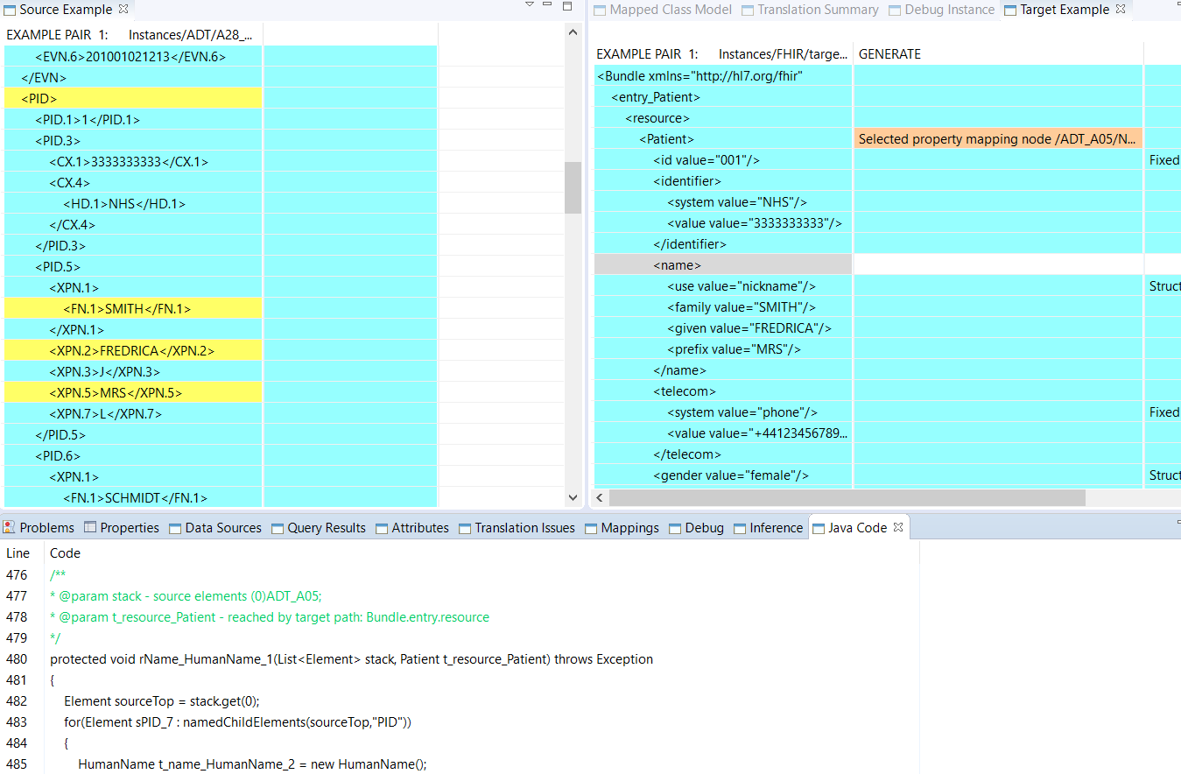
TBX Screenshot (V2 to FHIR)
Source
Editor
Target
Editor
Generation
Issue
Source
Nodes
Mapped
To Target
Node
Selected
Target
Node
Generated Java for target node

Slide 7
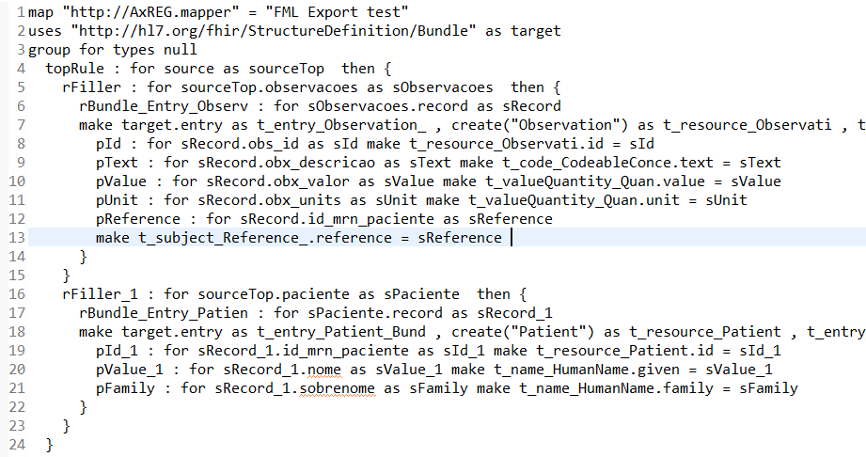
Generated FHIR Mapping Language
To try out TBX, contact rpworden@me.com

