Slide 1
PACIO-eLTSS Post-Acute Care Transition Summary Track
Track KICK OFF
May 13, 2020

Slide 2
Agenda
Background
Purpose of this track
Goals
Use case description and diagram
System roles and diagram
Testing
Participants
Track schedule
Connectathon support tools
Track Resources

Slide 3
Background: Transitions of Care
Care coordination, when a person transitions between healthcare settings, including ambulatory care, acute care, long term post-acute care (LTPAC), and home & community-based services (HCBS), is often fragmented and can lead to poor health outcomes, increased burden and increased costs.
Interoperable health information exchange has the potential to improve patient and provider communications and supports access to longitudinal health information that enables improved efficiencies, improved quality of care, and improved health outcomes.
Data should be usable across the continuum of care and beyond the traditional healthcare system – into the community.
https://github.com/paciowg/PACIO-Project/blob/master/PACIO%20Project%20Charter%20(508).pdf

Slide 4
Background: CMS Assessments
The 2014 Improving Medicare Post-Acute Care Transformation Act (IMPACT Act) requires the reporting of standardized patient assessment data with regard to quality measures and standardized patient assessment data elements (SPADEs). The Act intends for standardized post-acute care data to improve Medicare beneficiary outcomes through shared-decision making, care coordination, and enhanced discharge planning.¹
Post-acute care (PAC) providers are required to complete and submit assessments at specified intervals. The assessment instruments that collect this data are:
The Long-Term Care Hospital CARE Data Set (LCDS) for LTCHs
The Minimum Data Set (MDS) for SNFs
The Outcome and Assessment Information Set (OASIS) for HHAs
The Inpatient Rehabilitation Facility Patient Assessment Instrument (IRF PAI) for IRFs
CMS created the Data Element Library (DEL) to support standardization and interoperability of patient assessment data elements. The DEL is the centralized resource for CMS assessment instrument data elements (e.g. questions and responses) and their associated health information technology (IT) standards
CMS prioritized cognitive and functional status as an area of clinical importance in need of standardization
¹ https://www.cms.gov/Medicare/Quality-Initiatives-Patient-Assessment-Instruments/Post-Acute-Care-Quality-Initiatives/IMPACT-Act-of-2014/IMPACT-Act-of-2014-Data-Standardization-and-Cross-Setting-Measures

Slide 5
Purpose of This Track
Test integration of CMS assessment data elements from the Data Element Library (DEL) into health IT systems using FHIR APIs.
Exchange patient level cognitive and functional status data between two disparate health IT (HIT) systems, incorporated with electronic Long-Term Services and Support (eLTSS) care plan and patient goals data, in a consumable format for clinicians, patients, and family members.

Slide 6
Goals
The goals of the PACIO-eLTSS Transition Summary connectathon track are to:
Confirm the quality of the PACIO Functional Status, Cognitive Status, and CMS Data Element Library IG materials,
Gain experience with testing, and
Identify additional revisions to the IGs that may be helpful for implementers.

Slide 7
Participants
Organizations
Altarum
MITRE
Patient Centric Solutions
Track Leads
Ty Mullen, tmullen@mitre.org
Siama Rizvi, rizvi@mitre.org
Sean Mahoney, smahoney@mitre.org
Dave Hill, dwhill@mitre.org

Slide 8
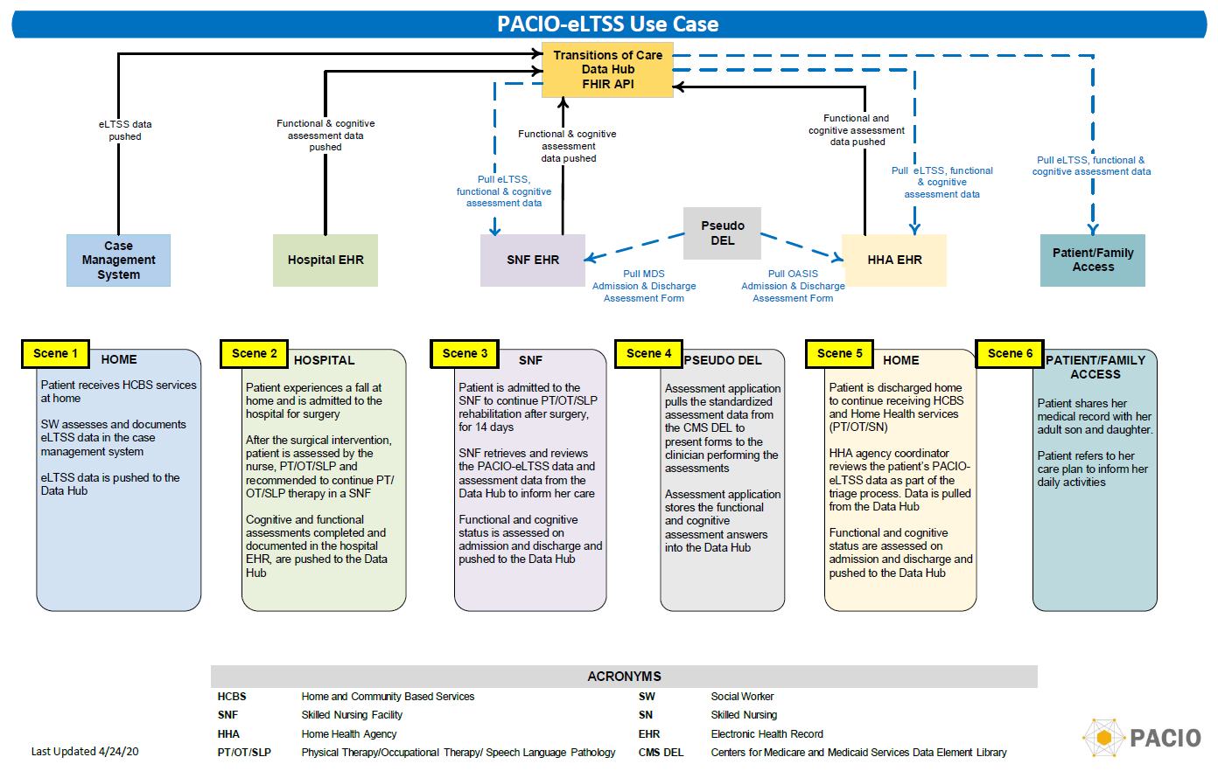
Use Case Diagram

Slide 9
Use Case
Scene 1: Ms. Betsy Smith Johnson receives home community-based services (HCBS) services at home. A social worker documents eLTSS data including care plan and goals. eLTSS data is pushed to the Data Hub.
Scene 2: Betsy experiences a fall at home and is admitted to the hospital for surgery. After the surgical intervention, Betsy is assessed by physical, occupational & speech language pathology therapists (PT/OT/SLP) and is recommended to continue her therapy in a skilled nursing facility (SNF). Cognitive and functional assessments completed and documented in the hospital EHR are pushed to the Data Hub
Scene 3: Betsy is admitted to the SNF for PT/OT/SLP services for 14 days. The SNF retrieves the eLTSS data and assessment data from the Data Manager to inform her care. Functional and cognitive status is assessed on admission and discharge and pushed to the Data Hub
Scene 4: The assessment application pulls the standardized assessment data from the CMS DEL and presents forms to the clinician performing the assessments.
Scene 5: After 14 days, Betsy is ready for discharge back home. The HHA agency coordinator reviews the patient's data from the Data Manager as part of the triage process.
Scene 6: While at home, Betsy and her authorized family caregiver access the eLTSS data and assessment data through a patient mobile/web application.
https://github.com/paciowg/sample-data/tree/master/2020-05%20HL7%20May%20Connectathon

Slide 10
System Roles
Role | Description
Data Element Library (DEL) | Provides CMS standardized assessment data elements via FHIR API
Case Management System/ Care Coordinator | Long-Term Care Plan App - captures care plan and goals for the patient eLTSS Server - FHIR-based HIT system that contains the eLTSS care plan and goals for the patient and pushes that data to the Data Manager using the eLTSS IG.
Care Setting A: Hospital | PAC Assessment Application - FHIR-based assessment application that retrieves the standardized assessment data elements from the DEL and captures the cognitive and functional status data for the patient. "EHR"/Server/Database - FHIR-based HIT system storing cognitive and functional status data from the assessment application for the patient and pushes that data to the Data Manager using the PACIO Functional Status and PACIO Cognitive Status IGs.
Health Data Manager | FHIR-based HIT system that collects data from the Care Coordinator and Healthcare Setting A using the eLTSS and PACIO Functional Status and PACIO Cognitive Status IGs. Authorization/Identity Server - handles authentication and identity management
Care Setting B: SNF | PAC Assessment Application - FHIR-based assessment application that retrieves the standardized assessment data elements from the DEL and captures the cognitive and functional status data for the patient. eLTSS/PACIO Server - Client HIT system to receive patient’s eLTSS, cognitive and functional status data from the Data Manager system
Care Setting C: HHA | Care Coordinator System - updates the care plan and goals eLTSS/PACIO Server - Client HIT system to receive patient’s eLTSS, cognitive and functional status data from the Data Manager system, for display to receiving clinician
Patient/Family Mobile/Web Client | FHIR-based web/mobile application that can receive patients’ eLTSS, cognitive and functional status data from the Data Manager for display to a patient or family member.

Slide 11
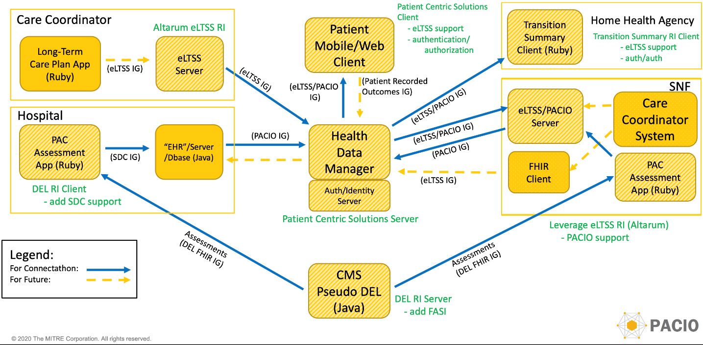
System Diagram

Slide 12
Testing with
What is Inferno?
Open Source FHIR® Testing
Inferno is a streamlined FHIR Server testing tool that is use-case / implementation guide focused
Supports the creation of automated tests through Implementation Guide Capability Statements
Inferno makes it easier to write or reuse tests assessing conformance to other FHIR Implementation Guides with flexibility to test non-FHIR requirements
Sponsored by the Office of the National Coordinator
Acts as a client to validate that servers adhere to SMART on FHIR and FHIR Implementation Guide requirements
Custom tests can be written in Ruby
https://inferno.healthit.gov/
FHIR Server

Slide 13
Track Schedule
All times are Eastern U.S.
Day 1: Wednesday, May 13 | 4:30pm – 5pm: Track Kickoff Introductions Review track goals, Review track schedule
Day 2: Thursday, May 14 | 9.15am – 3pm: Collaboration Smoke test whole sequence Identify priorities to address today Test, code, monitor progress 3pm – 5pm: Prepare for demos Final adjustments, dry-run
Day 3: Friday, May 15 | 9.15am – 2pm: Record demos Use Zoom 2pm – 6pm: Report out

Slide 14
Connectathon Support Tools
Zulip: #Post-Acute Care
Sign up at http://chat.fhir.org
The Post Acute Care stream is the primary method of communication for members participating in the PACIO-eLTSS track.
Track participants should use Zulip when discussing the Implementation Guide (IG), Reference Implementation (RI), or for general track discussions.
Slack: #General
pacioproject.slack.com
Track participants should use Slack when discussing administrative items, logistical items, and for cross track coordination
JIRA:
https://jira.hl7.org/
Track participants should use JIRA to communicate bugs and issues in the IG/RI only

Slide 15
Track Resources (1/3)
Resource List
CMS Data Element Library FHIR API Prototype Implementation Guide: https://paciowg.github.io/del/ Hosted Reference Implementations Server: https://api.logicahealth.org/PACIO/ Client: https://deldemo.herokuapp.com Reference Implementation Code (Apache 2.0 license) Server: https://github.com/paciowg/del Client: https://github.com/paciowg/delDemo Test Scripts: https://github.com/paciowg/inferno
Structured Data Capture (SDC) Project: https://www.healthit.gov/topic/scientific-initiatives/pcor/research-evaluation/structured-data-capture-sdc Implementation Guide: http://hl7.org/fhir/uv/sdc/2019May/
eLTSS (Electronic Long-Term Support and Services) Implementation Guide: http://hl7.org/fhir/us/eltss/ Reference Implementation Code: https://github.com/onc-healthit/eLTSS-reference-implementation

Slide 16
Track Resources (2/3)
Resource List
PACIO Functional Status Implementation Guide: https://paciowg.github.io/functional-status-ig/ Hosted Reference Implementations Server: http://hapi.fhir.org/baseR4 Client: https://snf-transfer-summary.herokuapp.com/ Reference Implementation Code (Apache 2.0 license) Server: https://github.com/jamesagnew/hapi-fhir Client: https://github.com/paciowg/transfer-summary-ri-client
PACIO Cognitive Status Implementation Guide: https://paciowg.github.io/cognitive-status-ig/ Hosted Reference Implementations Server: http://hapi.fhir.org/baseR4 Client: https://snf-transfer-summary.herokuapp.com/ Reference Implementation Code (Apache 2.0 license) Server: https://github.com/jamesagnew/hapi-fhir Client: https://github.com/paciowg/transfer-summary-ri-client

Slide 17
Track Resources (3/3)
Resource List
FHIR Endpoints Please contact the track team for FHIR endpoints. Includes an authenticated end point. For those who wish to use the authenticated end point, your client will need to be registered. Please provide your client name, redirect URL and contact information Prior to the Connectathon, we will have our test patient populated with the full sample data for testing. During that Connectathon, that patient will be reset to a starting data configuration as needed to support our user stories. This will be accomplished by resetting the database. (Please be aware that this would overwrite any test data when this occurs.) If you need assistance with the DataHub, please reach out at Support@patientcentricSolutions.com. Include the word PACIO in the subject line.
Detailed Use Case Information https://github.com/paciowg/sample-data/tree/master/2020-05%20HL7%20May%20Connectathon JSON data for the Connectathon https://github.com/paciowg/sample-data/blob/master/2020-05%20HL7%20May%20Connectathon/sample%20data/Full%20Data_Seed_Story_Connectathon%20May%202020.zip
Additional track information can be found at:
https://confluence.hl7.org/display/FHIR/2020-05+PACIO-eLTSS+Post-Acute+Care+Transition+Summary

