Slide 1
FHIR Server – How to set up?
Notes:
The HL7 Connectathon 22 happened in Atlanta during the Sept 14th and 15th weekend. There were more than 40 different tracks that participated and about 700 fhir developers who came together to work on different tracks for various use cases.
Show the confluence page:
Our track was number 36 lead by David and Tom from Colonial Med

Slide 2
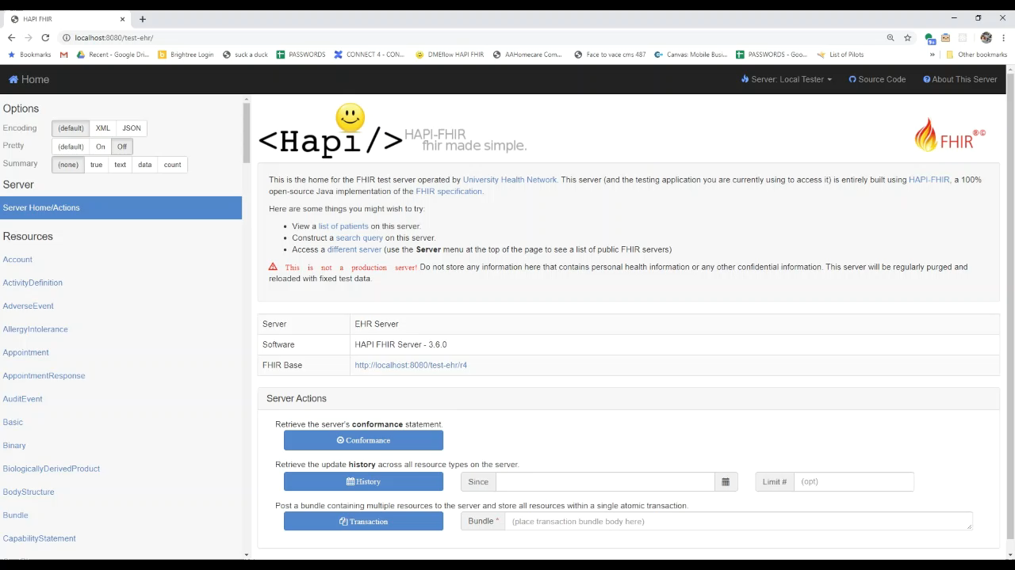
How to setup a FHIR Server

Slide 3
How to setup a FHIR Server
Download
Download files from repo
https://github.com/HL7-DaVinci/test-ehr
Unzip
Unzip the files
Open
Open Command Prompt
Type
Type command gradle appRun
Go
Go to your web browser localhost:8080/test-her

