Slide 1
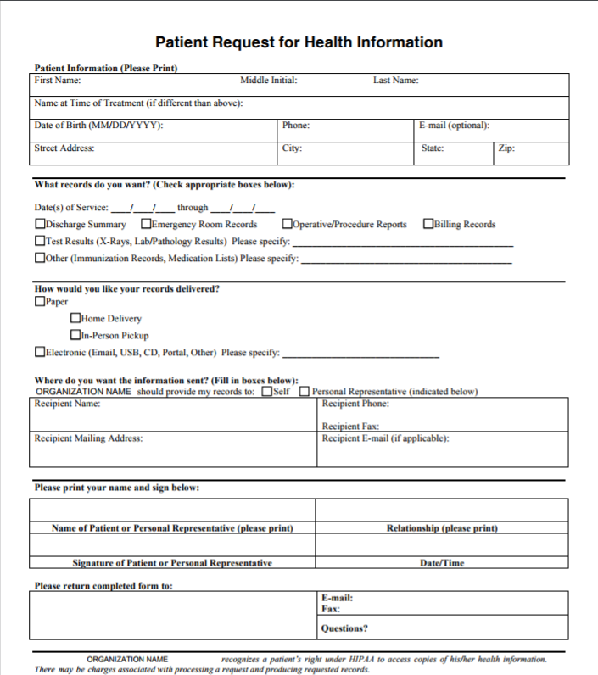
CommunicationRequest
Consent
.basedOn – *Consent
.patient – Reference(Patient)
.subject – Reference(Patient)
.requester
Choice:
.except.dataPeriod
.except.data
.except.class
.except.code
.payload
.medium
.actor[0].role = IRCP
.actor[0].reference
.recipient
.consentingParty
.sender
.organization
.reasonCode = LOINC#64292-4
.category = LOINC#64292-4
.category = LOINC#64292-4
.action = disclose
.policyRule = AHIMA url

