Slide 1
Sync-error deep dive
Bas van den Heuvel

Slide 2
Normal Behavior
Application sends context-change (open, close).
All applications respond with 200 OK.
Everyone is in synch.

Slide 3
One application is not sure
Application A sends context-change (open, close).
Application B responds with 200 OK.
Application C respond with 202 Accepted.
Application C decides to follow and does not send a SyncError
Everyone is in sync
Is this the behavior we expect? The 202 seams to suggest something more is coming.

Slide 4
One application refuses.
What error code to return by the client?
500 - Server error - client issue
409 - Conflict - client is in conflict - refuses
Application A sends context-change (open, close).
Application B responds with 200 OK.
Application C respond with ????
Hub sends sync-error
Everyone knows synchronization is lost.

Slide 5
One application is not sure and refuses
Application A sends context-change (open, close).
Application B responds with 200 OK.
Application C respond with 202 Accepted.
Application C decides to not to follow and sends a SyncError
Everyone knows synchronization is lost.
In this case the Application decides to send the sync-error and can inject meaningful information, such as the application that refuses. This will go in the issue.diagnostics field.

Slide 6
An application can no longer be reached (dead or lost network)
How can App C detect synchronization is lost?
Websocket connection lost.
No event received in xx time -> suggest to add a heartbeat/monitor event.
Application A sends context-change (open, close).
Application B responds with 200 OK.
Application C cannot be reached
Hub sends sync-error
Everyone (except for App C) knows synchronization is lost.
Only the hub can tell which one - how do present this in a meaningful manner?
How to recover from this state?
Options:
Do not recover.
Wait until subscription time-out. If no re-subscribe happens, a resent of the context-change event will succeed.
App C reconnects - context-change is resend - event is accepted - hub decides all is in sync -> how to indicate. Resend context-change event? Will introduce a race condition. Better wait on App A to resend it.
hub is down
Applications can detect this using the heartbeat, websocket disconnect.
Indicate sync-error situation. Try to resubscribe. When Hub is up again, resync.

Slide 7
Which applications are connected
Recommendation:
show current topic
How do I know which applications are synced?
Within an session:
Tracking of the state of the different applications can only be done when an sync-error occurs.
Can I also provide a list of registered applications and their state?
Options:
endpoint
separate event

Slide 8
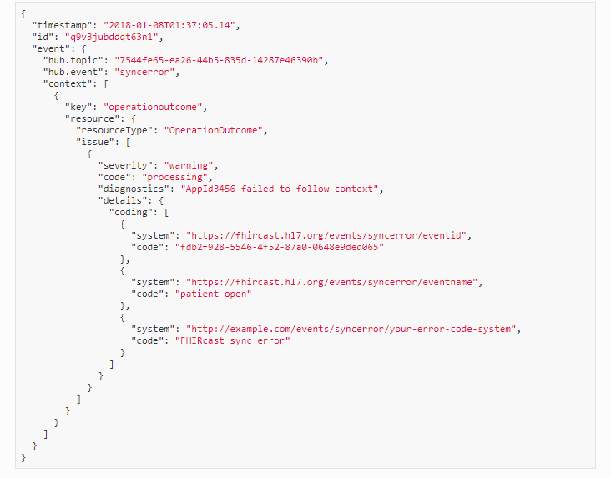
sync error content
https://fhircast.org/events/syncerror/
FHIR resource describing an outcome of an unsuccessful system action. The OperationOutcome SHALL use a code of processing. The OperationOutcome's details.coding.code SHALL contain the id of the event that this error is related to as a code with the system value of "https://fhircast.hl7.org/events/syncerror/eventid" and the name of the relevant event with a system value of "https://fhircast.hl7.org/events/syncerror/eventname" . Other coding values can be included with different system values so as to include extra information about the syncerror.
https://www.hl7.org/fhir/valueset-issue-type.html
Instance: SyncErrorOperationOutcome
InstanceOf: OperationOutcome
* issue.severity = "warning"
* issue.code = "processing"
* issue.diagnostics = "AppId3456 failed to follow context" // where does this information come from?
* issue.details[+].coding.system = "https://fhircast.hl7.org/events/syncerror/eventid"
* issue.details[=].coding.code = "fdb2f928-5546-4f52-87a0-0648e9ded065"
* issue.details[+].coding.system = "https://fhircast.hl7.org/events/syncerror/eventname"
* issue.details[=].coding.code = "patient-open"
isue.code.diagnostics
Where does this information come from when the sync-error is send by the hub? The token used by the application to register with the hub?
should be error according to the definition in FHIR
Recommendation:
Add human readable description of the application to subscribe.

Slide 9
How to recover from a sync-error state
App A -> send context change event
App B -> follows
App C -> refuses
App A after some time (e.g. 30 seconds?), decides to re-sync, and sends context-change again.
If App C follows – no sync error is send -> in sync error
This event has to be send by App A as:
other applications may not have the authorization to do so.
if send by the hub, there is no source event to point to (unless the original is resend)
We want a lean hub - make this an App responsibility.
This should be stated in the spec.

Slide 10
Questions
How do we interoperable identify apps?
which send an event
which participate in a session
When does a hub forcibly unsubscribe an app?
➔ when the websocket is closed.
How do we inform an unresponsive app it is out of sync?
How does a session recover from a sync error?

Slide 11
Client websocket drops
Application → still things it is connected
Hub → resubscribe needed → kicks application → no sync-error
Application knows websocket closed → will resubscribe and connect again
at which point it will be in sync again.
An event send in this time period will not result in a sync error as the dropped application is not part of the topic anymore.
From user perspective → it still part of the topic
how to handle this?
Different sync-errors
cannot deliver by hub -> higher severity →
issue.severity = fatal
rational – hub cannot do anything. App has to.
app refuses
Solution direction
applications SHALL unsubscribe when finishing a topic (or wait for the timeout). If the connection drops in between (e.g. websocket drop) -> a sync-error has to be sent.
How does an app detect it is not in contact
edge case -> e.g. network connection to hub lost
dropped websocket
for a webhook – the only way to do so is a heartbeat.
Proposal: define heartbeat event
recommend supporting this for webhooks – implementer feedback need for whether this is required for websockets as well.
clients will only get it when subscribing to it.
proposed time period ~10 sec | an order of magnitude lower than the subscription timeout.
related topic -> can I use the extend the events supported by a hub from an application?
topic for next Connecthaton?

Slide 12
How does a session recover from a sync error?
Do nothing
applications know do are out of sync
choice of the app
network issue
they are until a new context change is send
SHOULD resend context-change on sync-error by the source application.
if it succeeds - all is well again.
time period => 10 sec?
race condition when a context-chance is sent by a different application -> use time stamp of original event.
Resend context-change on sync-error by the hub.
if it succeeds - all is well again.
time period => 10 sec?
event = last event of the type (reuse event including timestamp).
Applications SHALL be able to receive resends of the same event, even at a later point in time, and handle it appropriately.
(check time stamp later than last, check if it changes the context or restates it)

Slide 13
How do we interoperable identify apps?
How do we interoperable identify apps?
which send an event
which participate in a session
With Oauth and Smart → client-id machine readable identifier.
most authorization servers will have a human readable name as well.
Alternative → add human readable name to subscribe.
Solution options
do noting
Smart/OAuth option
subscribe contains name (optional short human readable name)
smart and subscribe data
AP BvdH -> write PR
Do we need to have a list -> when would this be required? Is this a techie/admin use case or something the end-user really care about?
further homework needed.

