Slide 1
Biomarker Harmonization HL7 Working Group Meeting, January 2022 Joint O&O/CG Wednesday Q3 Discussion
May Terry, MITRE Corporation
January 19, 2022
© 2022 THE MITRE CORPORATION. ALL RIGHTS RESERVED.

Slide 2
Identifying Need and Goals
Provider need a simpler representation of biomarkers to drive decision support in 1) treatment decisions (e.g.: cancer pathways), and 2) clinical trial inclusion/exclusion criteria
Goals:
Create a common “lightweight” representation for molecular biomarkers which might be present in either sequencing/NGS genomic tests or as single, simple molecular tests.
Specify guidance driven by both CG and O&O on representing lightweight “snapshot interpretations” from more complex representations in genomics tests while preserving references to its standardized report.

Slide 3
Background

Slide 4
Biomarker Working Definitions
A defined characteristic that is measured as an indicator of normal biological processes, pathogenic processes, or responses to an exposure or intervention, including therapeutic interventions (NIH-FDA)
A biological molecule found in blood, other body fluids, or tissues that is a sign of a normal or abnormal process, or of a condition or disease. A biomarker may be used to see how well the body responds to a treatment for a disease or condition. Also called molecular marker and signature molecule. (NCI)
A molecular marker is defined as any DNA sequence which shows polymorphism and can be detected using a molecular technique (Sarawasathy & Ramalingam, 2011)
Notes:
Sarawasathy & Ramalingam (2011). Concepts and Techniques in Genomics and Proteomics. https://www.sciencedirect.com/science/article/pii/B9781907568107500067

Slide 5
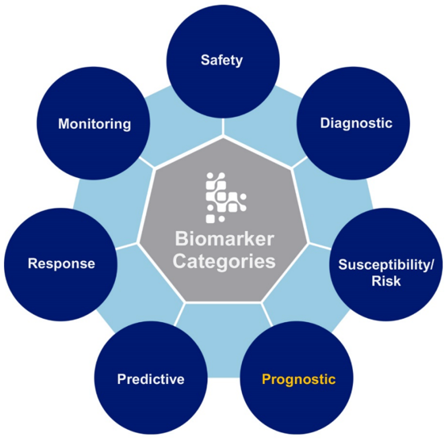
Biomarker – types and categories
Types
Molecular – e.g.: blood glucose, gene mutations, gene expression, protein receptor levels
Histologic – e.g.: Tumor histology
Radiographic – e.g.: Tumor size
Physiologic – e.g.: blood pressure
Categories
Source: NIH-FDA Biomarker Working Group
Notes:
Source: FDA - https://www.fda.gov/files/BIOMARKER-TERMINOLOGY--SPEAKING-THE-SAME-LANGUAGE.pdf

Slide 6
”Biomarkers” are not clearly defined or delineated
Example biomarker tests offered by reference labs
**Not complete. listed for illustration only**
Many oncology providers only want the marker name and presence or interpretation*
They do not always want to know the variant representation or even where the test originated.
Non-specialized Reference Labs
Both reference lab types
Genomic Sequencing Reference Labs
molecular markers:
EGFR
ALK
ROS1
BRCA1
BRCA2
etc..
surface protein/receptor levels, gene expression, etc.
* e.g.: ER, PR, PSA, AFP, PD-L1, etc.
molecular markers
Genes with Variants of unknown significance (VUS)* and benign clinical significance
genetic DNA probe tests for mutations:
78217-7: RARA gene rearrangements [Presence] in Blood or Tissue by FISH
78245-8: MYB gene deletion [Presence] in Blood or Tissue by FISH
VEGFA gene c.-1154A>G [Genotype] in Blood or Tissue by Molecular genetics method Nominal
92902-6: Fetal Chromosome region 8q24 deletion [Presence] based on Plasma cell-free DNA by Sequencing
etc...
Notes:
Several HER2 LOINC codes are categorized as CLASS=Path (32996-1, 72382-5, 72383-3) and others as Class=MOLPATH (31150-6, 85318-4, 42783-1).
(*) Note: point mutation tests are usually for those that have high clinical validity and not VUS.

Slide 7
Background Use cases, sources, and artifacts for representing biomarkers vary
Use Cases
Diagnostic Report Exchange (detailed)
Pathology Report Cancer Registry Reporting (CAP eCC)
Provider EHR-based “biomarker” exchange
Trials Matching
Source Systems
Genomics sequencing labs (e.g.: Foundation Medicine, Illumina, etc.)
Reference labs with broad testing services, including genetic tests (e.g.: LabCorp, Quest, etc.)
Reference labs with specialized disease panels which combine serum prognostic markers and genomic molecular markers (e.g.: Caris)
Pathology information systems which synthesize existing tests and record biomarker results (e.g.: CoPath implementing CAP eCC)
Source Artifacts
HL7v2 messages
CAP eCC forms
Genomics Report PDFs
Proprietary genomics reference lab messages (e.g.: Foundation Medicine XML)
Implementation Guides
HL7 FHIR Genomics Reporting IG
HL7 FHIR mCODE IG
HL7 FHIR Cancer Pathology Data Sharing IG
HL7v2.5.1 Lab Results Interface (LRI)
Notes:
Use Case Story - Provider EHR-based biomarker exchange -> As an oncologist, I want to receive the biomarker name, result, and interpretation so that I can determine (be it by decision support or other) to identify patient treatment options.
Use Case Story – as an oncologist, I want to receive the results from a Pathology report which contains the result of a given biomarker
Use Case – Trials matching leverage “biomarkers” as a surrogate endpoint.

Slide 8
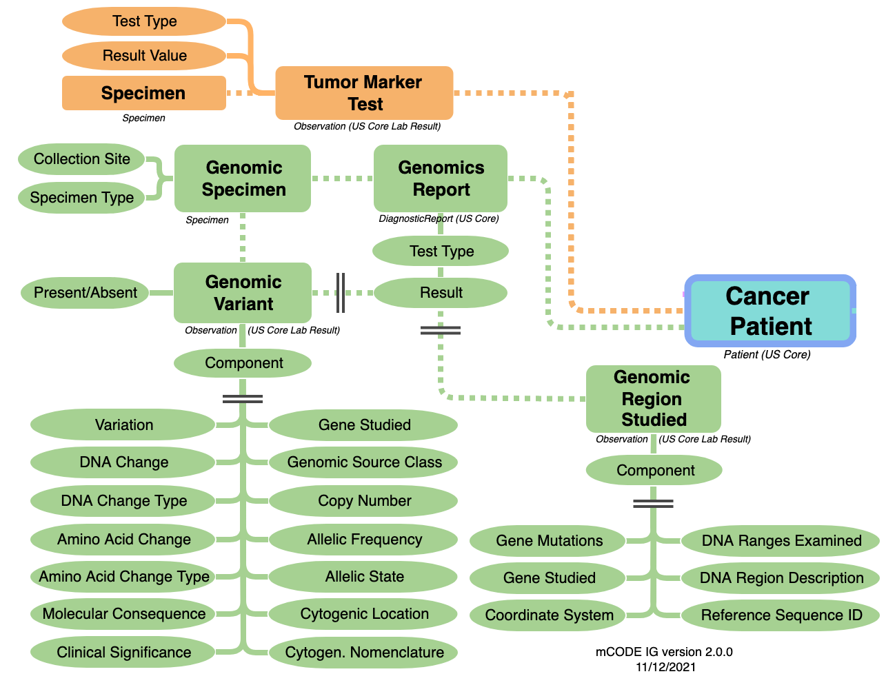
Background (cont’d) mCODE’s current handling of biomarkers
mCODE created 2 separate profiles to separate the different types of labs so as to reduce the complexity of a genomics test with other tests that are non-genomic.
Some biomarkers are simple gene expression tests and others single gene mutation tests that do not include the details of a genomic sequencing test.

Slide 9
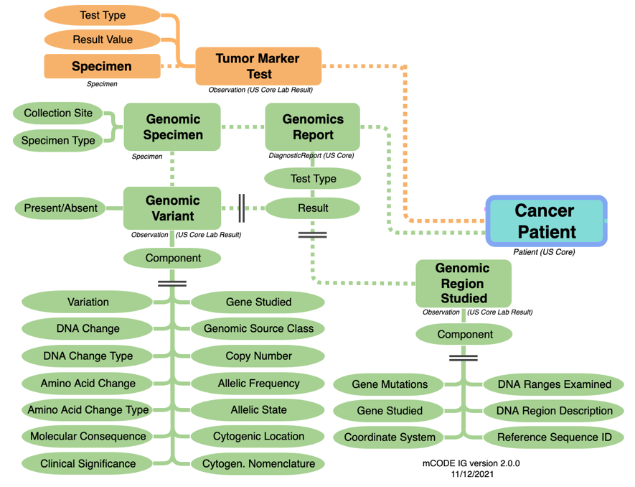
Background
Some mCODE stakeholders (VUMC, OSU, CAP, Pfizer) find that:
mCODE’s genomic elements (i.e.: CG Reporting IG) are too complex for implementation
Use Cases needing simplification:
EHR to EHR
stakeholder: providers;
only needs a very minimal set of observations for treatment decisions
Pathology reporting to Cancer Registries, or to EHRs:
CAP eCC biomarker templates
Stakeholder Feedback: Simplify biomarkers to
treat tumor markers and genetic variants under one bigger umbrella for “Biomarkers”
remove must-support requirements for detailed data elements which are not relevant to the oncologist/patient care workflow.
Biomarker | Example
source | tumor
category | DNA mutation
name | KIT
result | mutated
interpretation | pathogenic
reference() 0..* | Variant

Slide 10
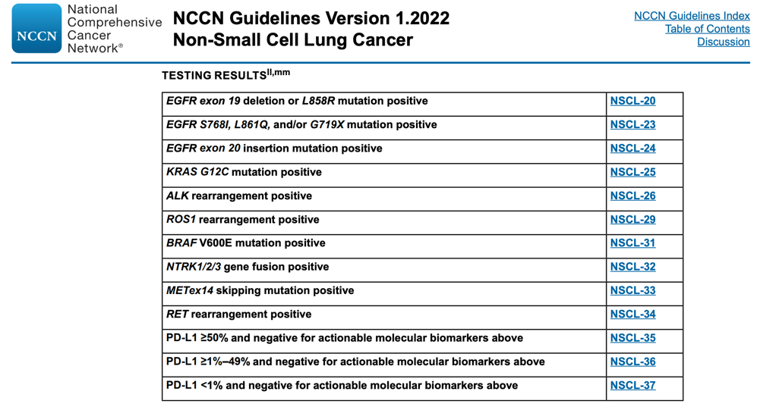
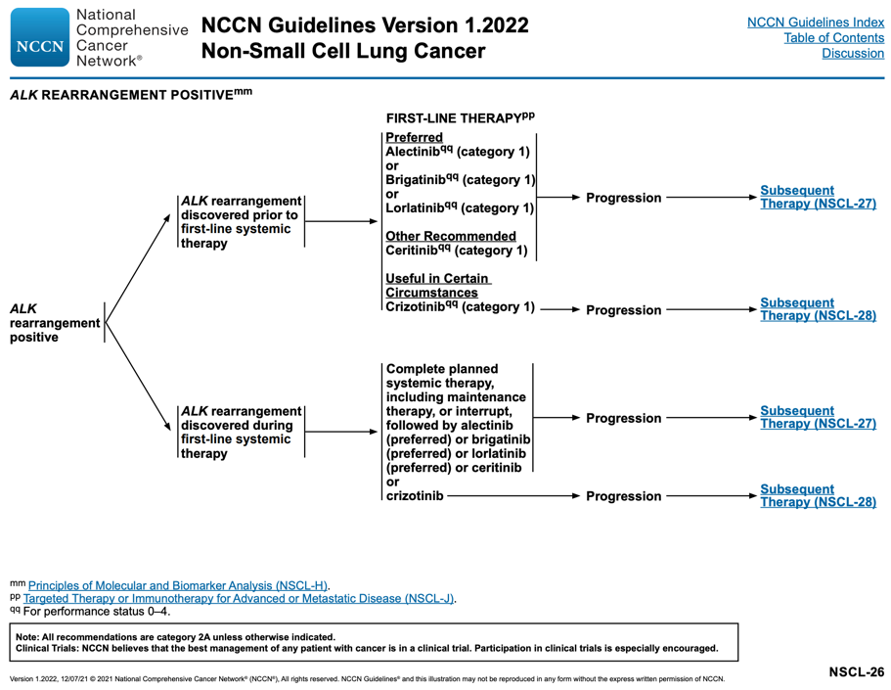
Where a biomarker simplification is found and why it is needed
Oncology standard of care guidelines rely on “positive” interpretation findings for treatment decisions
But not all clinical oncologists clearly know what is positive unless it is specified.
Notes:
The notion of a “positive” interpretation for the presence of certain mutations is expected for treatment decision support. The ALK example conflates ALK gene structure and protein since per NCI, “ALK positive describes cells that have a protein called ALK on their surface. In cancer, it is also used to describe cells that have a change in the structure of the ALK gene or that make too much ALK protein (source: https://www.cancer.gov/publications/dictionaries/cancer-terms/def/alk-positive)”.

Slide 11
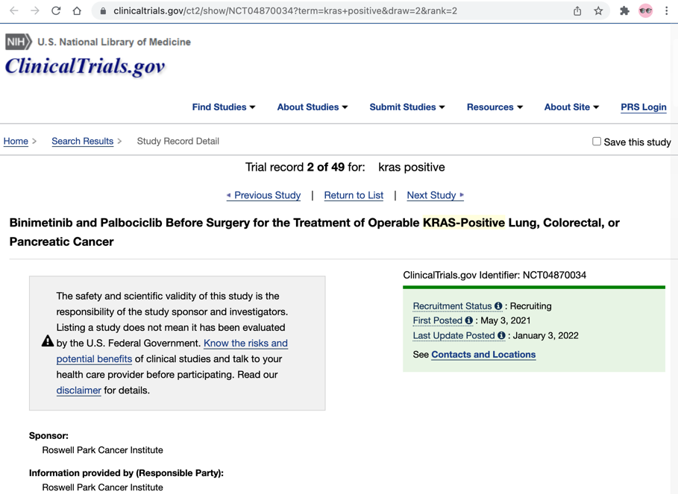
Where biomarker simplification is also found Clinical Trials matching
Inclusion and Exclusion criteria
Translation and logic for matching criteria sometimes identified mutations present as “positive” or “negative”
source: https://clinicaltrials.gov/ct2/show/NCT04870034?term=kras+positive&draw=2&rank=2

Slide 12
Analysis / Observations

Slide 13
Group Notes
If profiling, could we identify or label it as a ”summary”
Some attest that Standard of Care guidlines are wrong.

Slide 14
Analysis Approach
Starting from a requested minimal set of biomarker elements, initially requested by a small group of oncology providers and supported by pharma and clinical trial representatives
Inspected example test reports (available today) and how they represent molecular markers in different ways
Identified possible mappings to the simplified biomarker set with equivalent elements in CG Reporting IG and LOINC observations.
Biomarker | Example
source | tumor
category | DNA mutation
name | KIT
result | mutated
interpretation | pathogenic
reference() 0..* | Variant

Slide 15
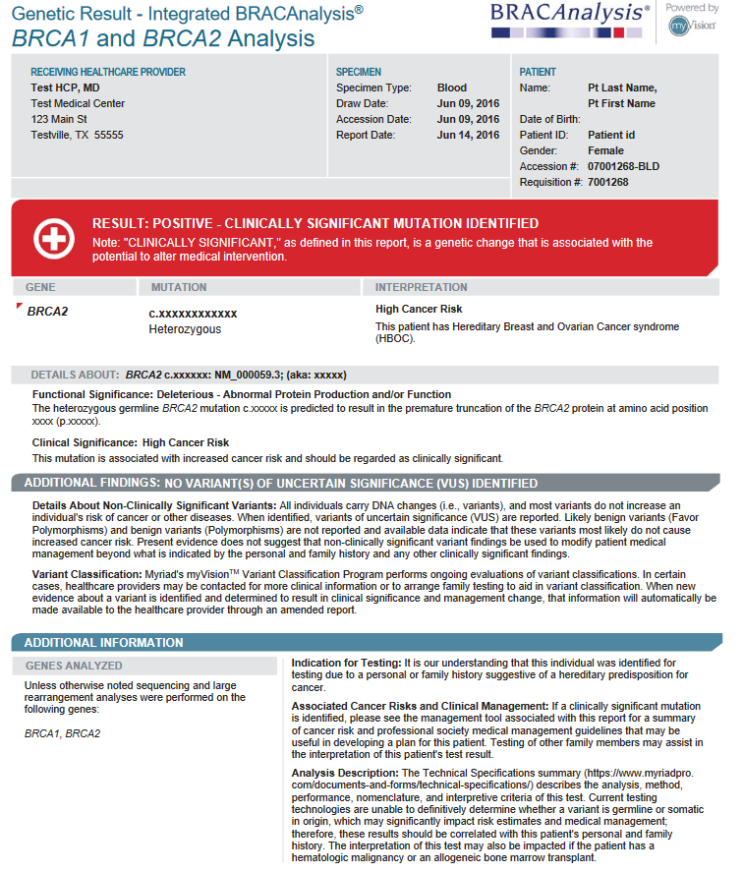
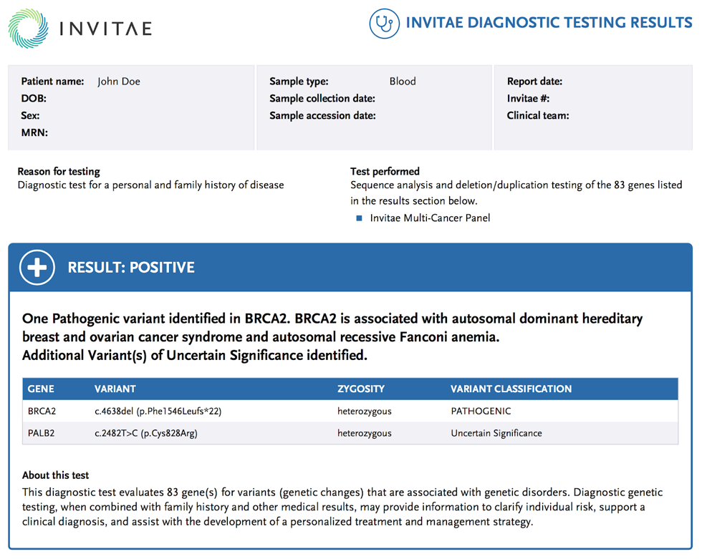
Example Biomarker Lab Result – Germline Mutation
Notes:
Source:

Slide 16
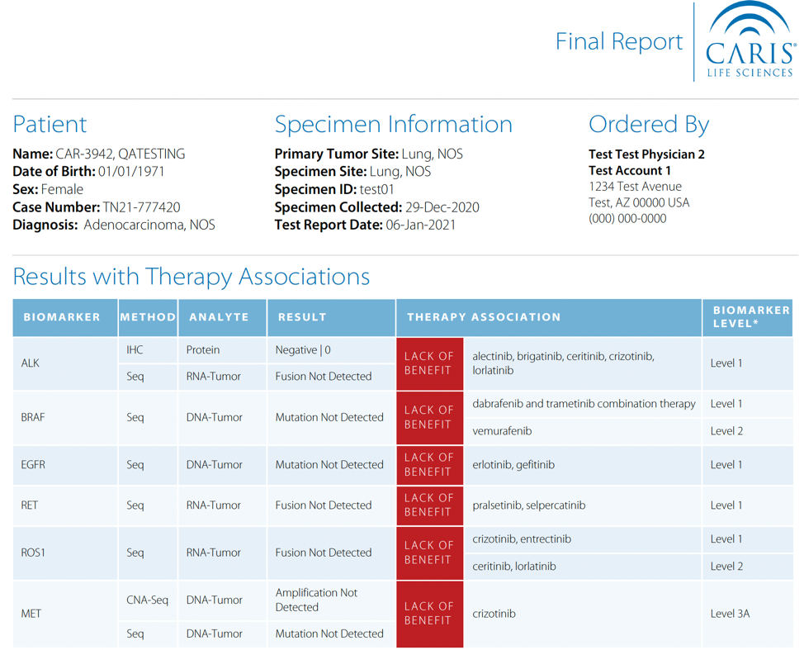
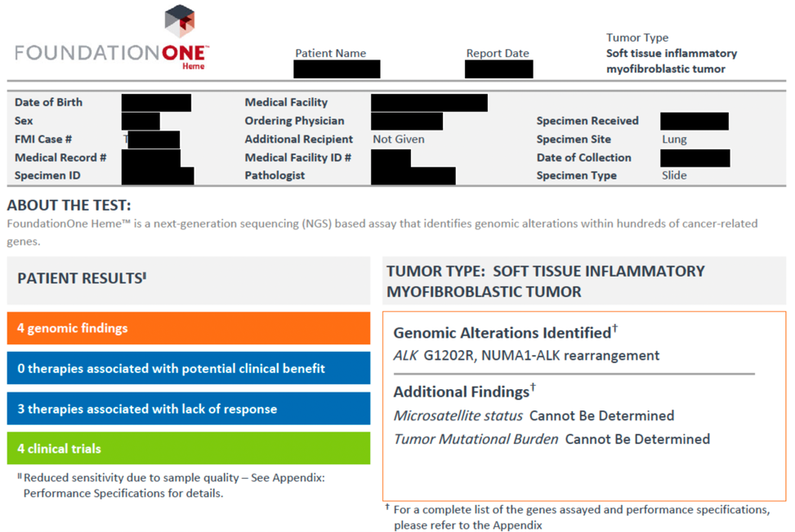
Example Biomarker Lab Panel – Somatic Mutation

Slide 17
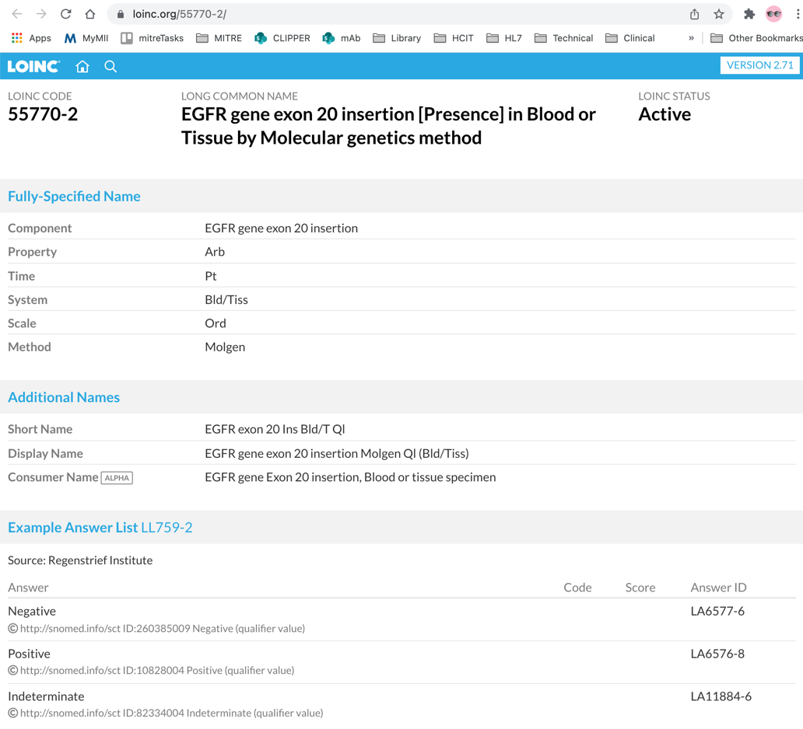
Example Biomarker Lab Result – Somatic Mutation
Presence has an example answer list with values:
Positive
Negative
Indeterminate
Since it’s an example answer list, we could change this to Present/Absent to align with CG Reporting IG, provided that it is equivalent.

Slide 18
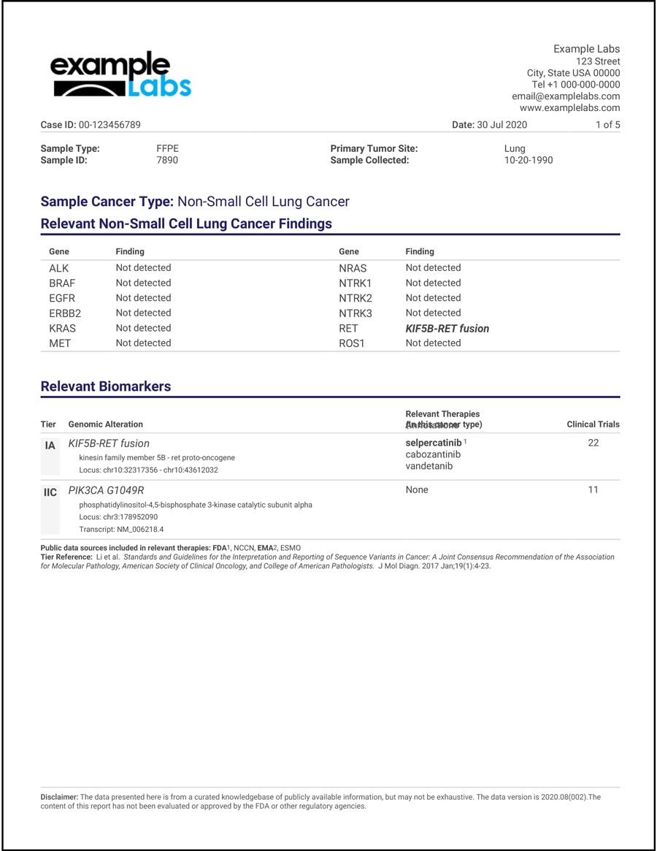
Another example: Cancer Gene Panel
Molecular markers (e.g.: ALK, BRAF, etc.) hides the variant details – noted as detected or not detected.
Fusion gene
Associated with one of the genes (e.g.: finding KIF58-RET fusion as a mutation on the RET gene)
identifies the locus.
source: Thermo-Fisher Scientific

Slide 19
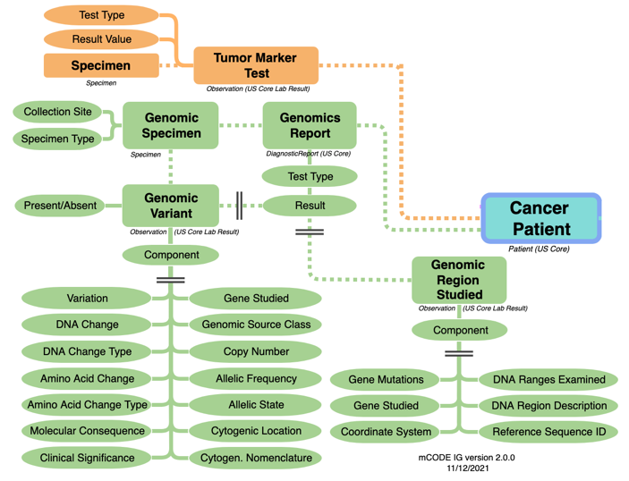
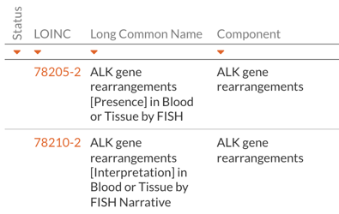
Mapping Pattern – Link to Genomics Reports
Can we treat tumor markers and genomics reporting under one bigger umbrella for “Biomarkers”?
Category could determine the type of biomarkers (DNA mutation, RNA mutation, protein, etc.)
One profile per biomarker category type
Reference the greater complexity with Observation.derivedFrom
NGS Genomics Reporting
General Lab Services
Biomarker | Example
source | tumor
category | DNA mutation
name | ALK
result | present
interpretation | pathogenic
derivedFrom 0..* | Variant DiagnosticImplication
Biomarker | Example
source | tumor
category | DNA mutation
name | ALK
result | present
interpretation | pathogenic
derivedFrom 0..* | Observation (78205-2) Observation (78210-2)
GenomicsReport
result(Variant)
Variant
DiagnosticImplication
Notes:
should I pull in a dependency on the CG Reporting IG to prototype this?

Slide 20
Pattern: Gene Fusion **PRELIMINARY**
GeneticSpecimen::
Observation.type.
valueCodeableConcept
TUMOR Tumor
Biomarker | Example
source | Tumor
category | gene_fusion
name | BCR-ABL1
result | present
interpretation | pathogenic
derivedFrom | Reference(CancerGeneticVariant) Reference(DiagnosticImplication)
CancerGeneticVariant::
Observation. component:molecular-consequence
SO:0001565 gene_fusion
Biomarker Category ValueSet: DNA_Mutation which includes fusion genes
Logic:
Application reads Observation.code to determine “biomarker pattern”
inspect DiagnosticImplication:: component:molecular-consequence
if present, concatenate gene-studied values into Biomarker.name.
CancerGeneticVariant::Observation. component:gene-studied
HGNC:1014 BCR
CancerGeneticVariant::
Observation. component:gene-studied
HGNC:1014 BCR
CancerGeneticVariant::
Observation. component:gene-studied
HGNC:76 ABL1
DiagnosticImplication::
Observation. component:clinical-signifance.valueCodeableConcept
LA6668-3 Pathogenic

Slide 21
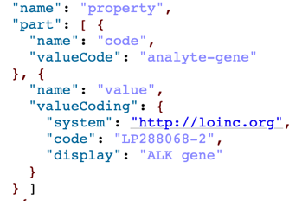
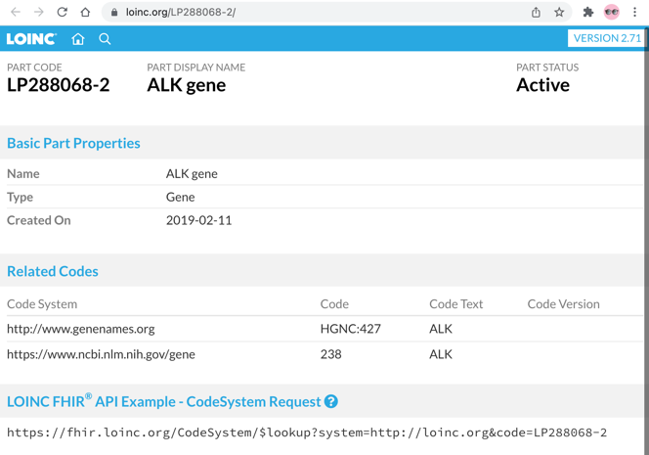
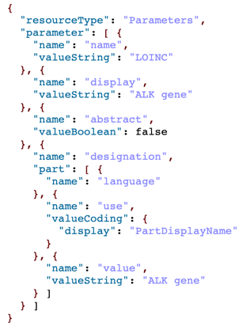
Possible link through analyte-gene property?
Can we leverage DNA tests to have LOINC part numbers with a mapping or reference to the HGNC code and/or symbol represented in the “analyte-gene” property as an alternate code?
https://fhir.loinc.org/CodeSystem/$lookup?system=http://loinc.org&code=78210-2
https://fhir.loinc.org/CodeSystem/$lookup?system=http://loinc.org&code=LP288068-2
Where’s HGNC?

Slide 22
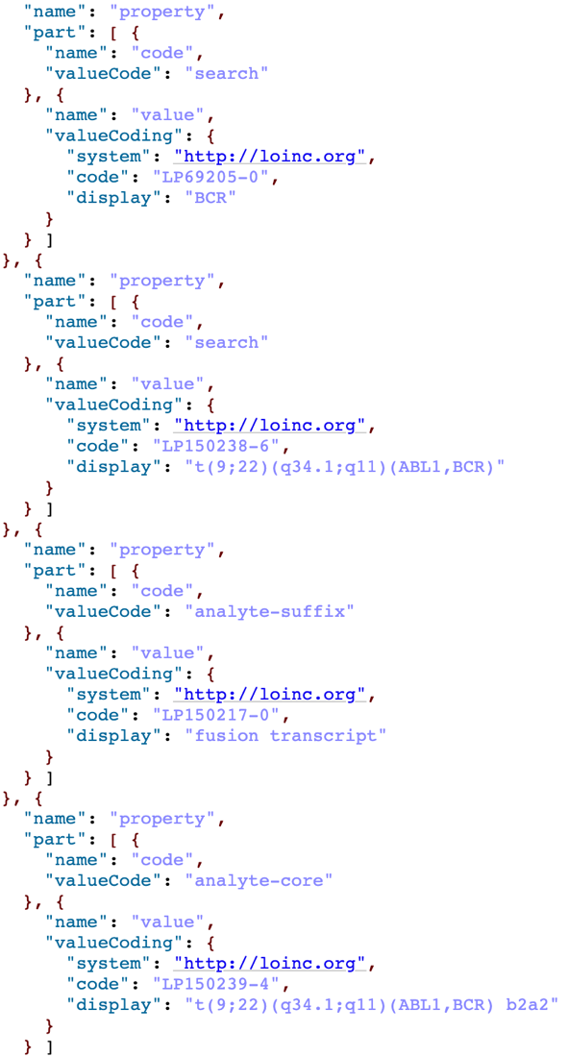
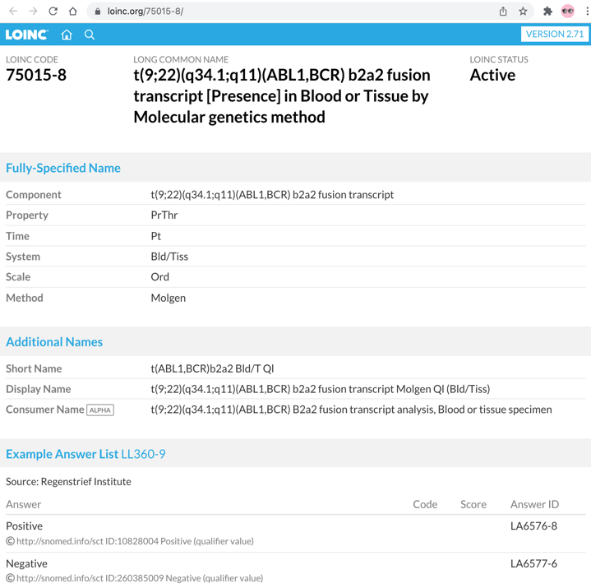
Outlier - gene fusion in LOINC
only one gene involved in the fusion event appears as a part number. ABL1 missing. Also assigned to code (which is ambiguous) rather than analyte-gene (which is more explicit)
Biomarker | Example
source | Tumor
category | gene_fusion
name | BCR-ABL1
result | present
interpretation | negative pathogenic
derivedFrom | Reference(Observation for 75015-8)
alternate code or map for
molecular-consequence SequenceOntology concept SO:0000806 to denote a fusion event.
Answer list on not consistent with other molgen tests of present or absent.
Is positive present and negative absent?
clinical significance is lost in this interpretation.
Notes:
SequenceOntology fusion concept: http://www.sequenceontology.org/browser/current_release/term/SO:0000806 is preferred.
SNOMED pre-coordinates BCR-ABL1 fusion (https://browser.ihtsdotools.org/?perspective=full&conceptId1=56564003&edition=MAIN/SNOMEDCT-US/2021-09-01&release=&languages=en) and this will not scale.

Slide 23
Next Steps

Slide 24
Summary / Asks
General consensus that the problem cannot be resolved by the CG group alone but rather collaboration with O&O.
Biomarker harmonization for shared molecular markers is needed between
genomics sequencing reference labs conforming to the CG Reporting IG, &
general reference labs with LOINC coded tests
Alignment from some LOINC molecular marker tests with CG is potentially computable using LOINC parts – as long as they’re consistently represented.
Possible Asks:
add alternate codes for
property: analyte-gene (using HGNC code) – to align gene names
property: analyte-suffix (using SequenceOntology code) – to align molecular-consequence
support > 1 gene code for fusion events

Slide 25
Next Steps
Continuing discussion in CGWG Wednesday Q4 session if time is available.
post-WGM Outreach:
Follow-up with O&O re: biomarker harmonization?
Where to capture guidance?
Could be in mCODE but really should be addressed at a higher level since it applies to multiple clinical specialties (e.g.: Cardiology)
Should requested LOINC parts changes be formally requested with the LOINC committee?

Slide 26
Thank You!
HL7 Working Group Meeting
January 19, 2022
© 2021 THE MITRE CORPORATION. ALL RIGHTS RESERVED.

