Slide 1
clinFHIR ConMan/Kiwi
Cologne, May 2018

Slide 2
Testing types
Recording outcomes of technical testing
Not actual tests - summarization
Will feed comments to Jira
Clinical testing
Scenario (next version Scenario Builder)
Define scenario/s under Track
Users build graph & make comments
Single model
For initial requirements
Also feed comments to Jira

Slide 3
Clinical testing: Scenario based
Allow clinicians to build scenario graphs against a specific scenario & make comments/notes
Education
Review resource Types
Validate clinical content of Profiles & IG’s
Can use core types & Logical Models (LM)
Logical Model is prelude to a ‘real’ profile
Working on Profile -> LM
Summary displays for comments/notes
Will feed into Jira

Slide 4
ConMan: Architecture
Event
Track
Track
Track
Scenario
Track
Technical Test Results
Track
Instance Graph

Slide 5
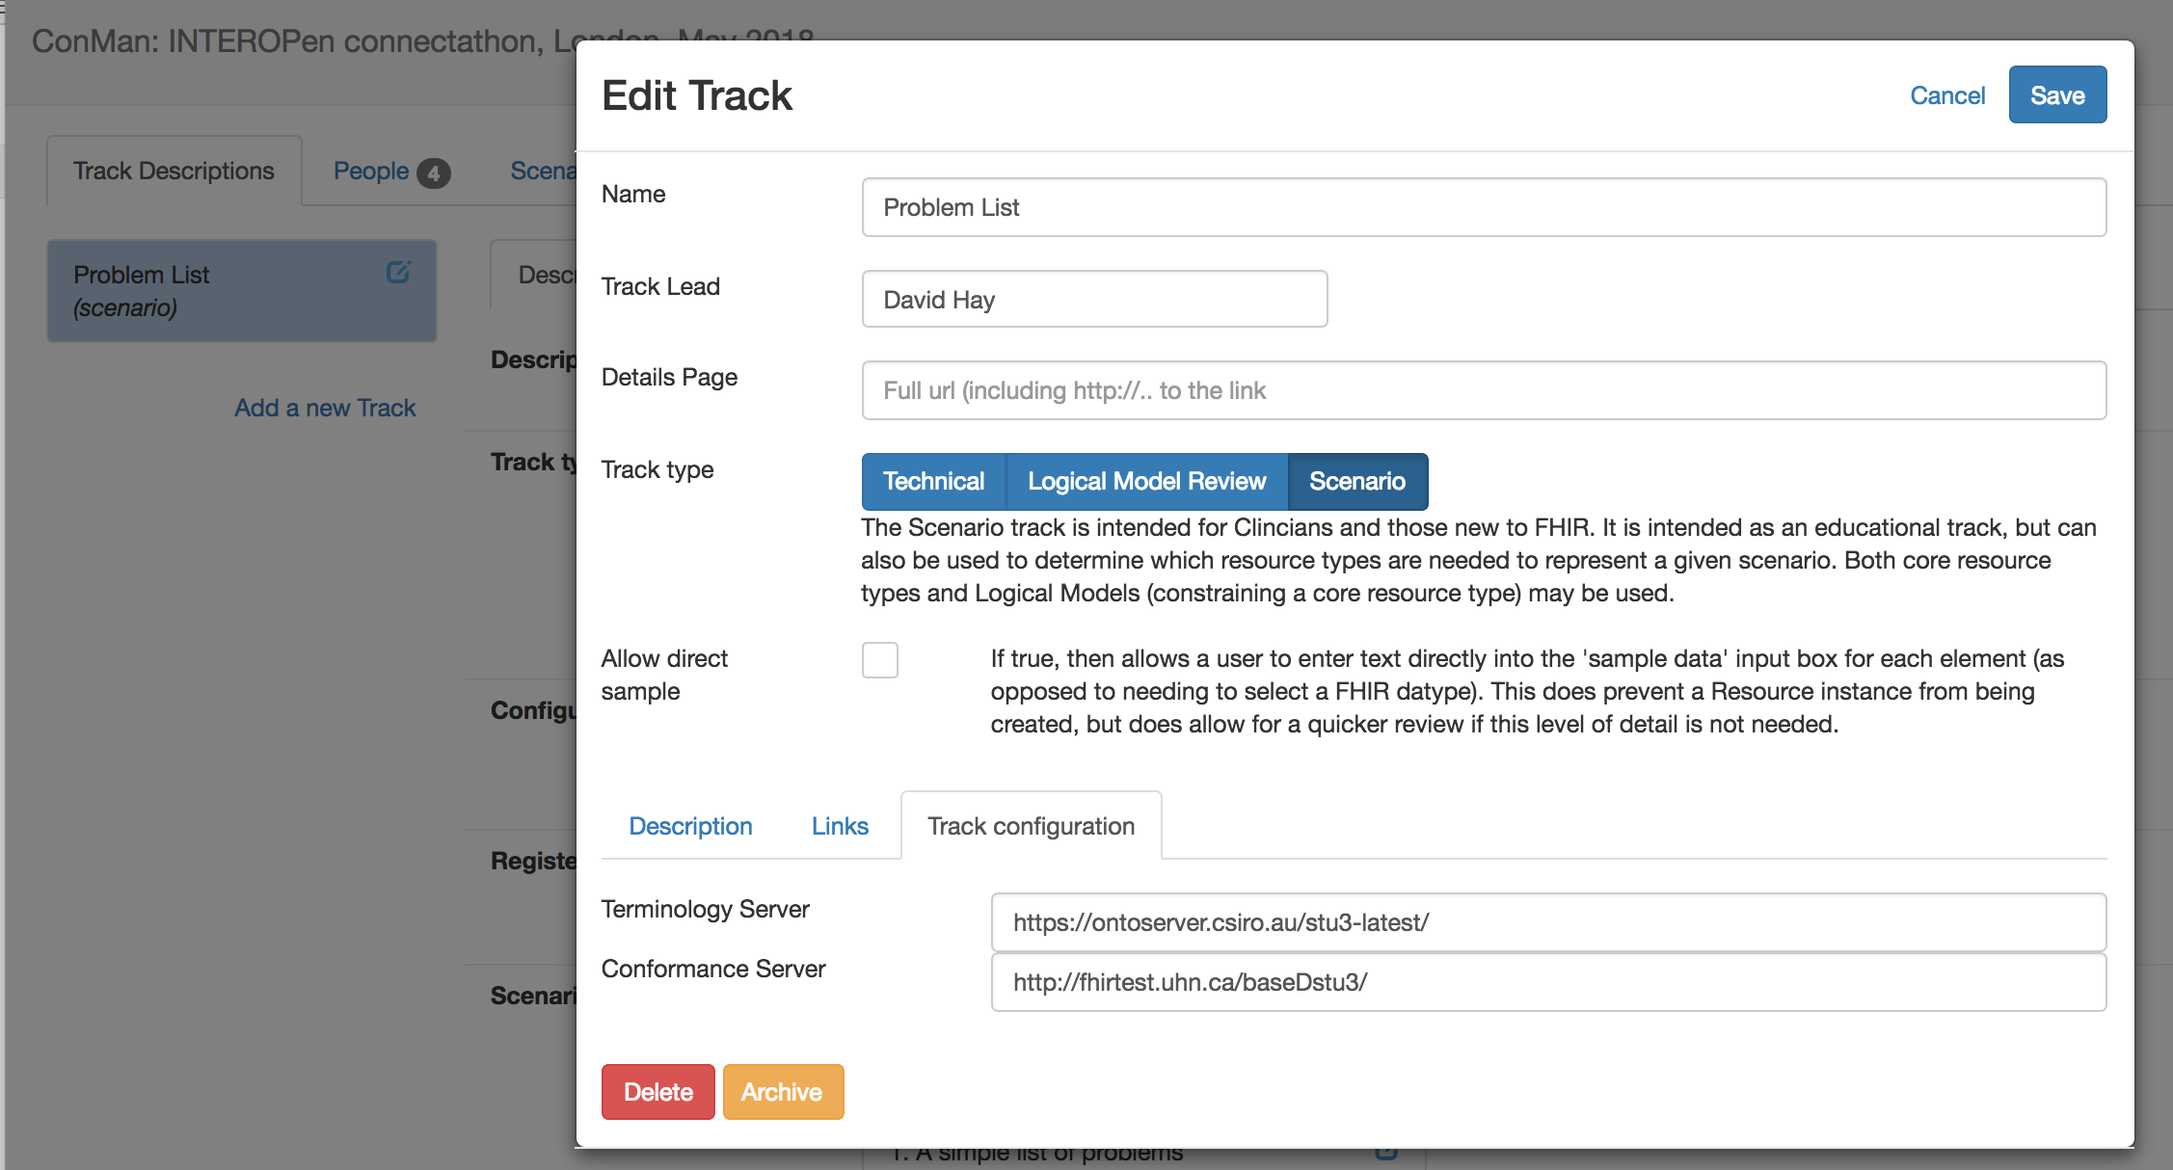
Define Track

Slide 6
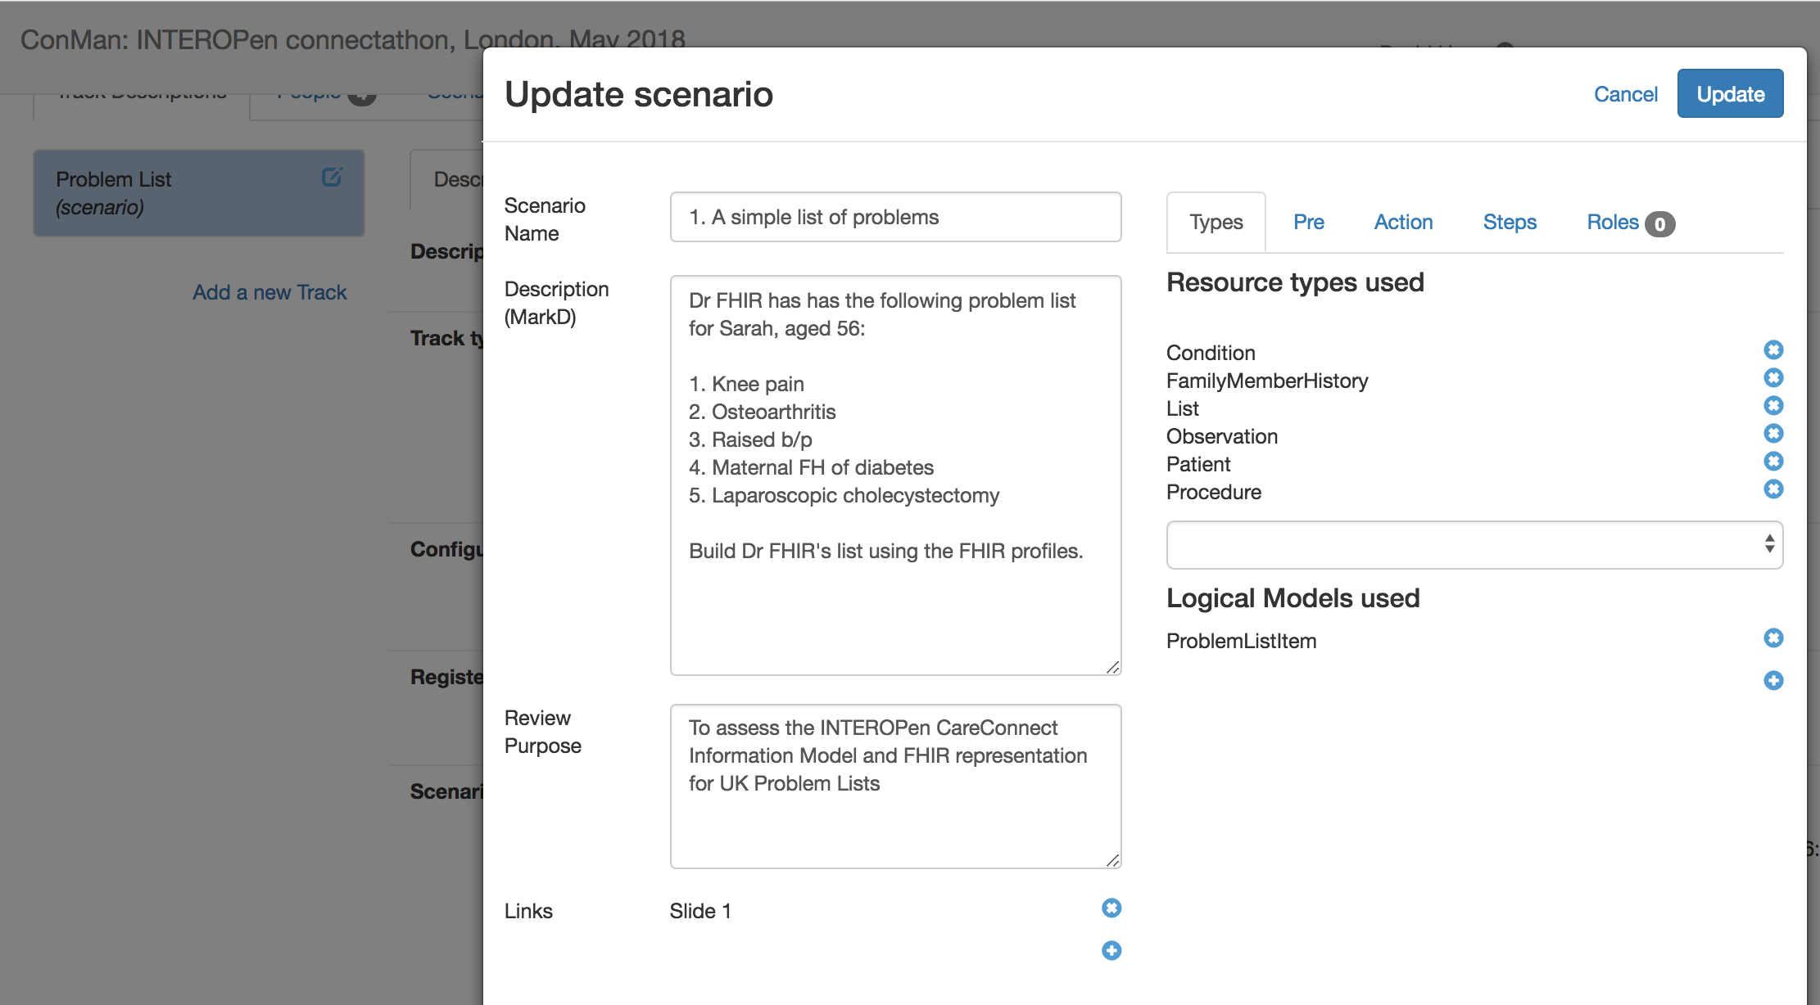
Define Scenario

Slide 7
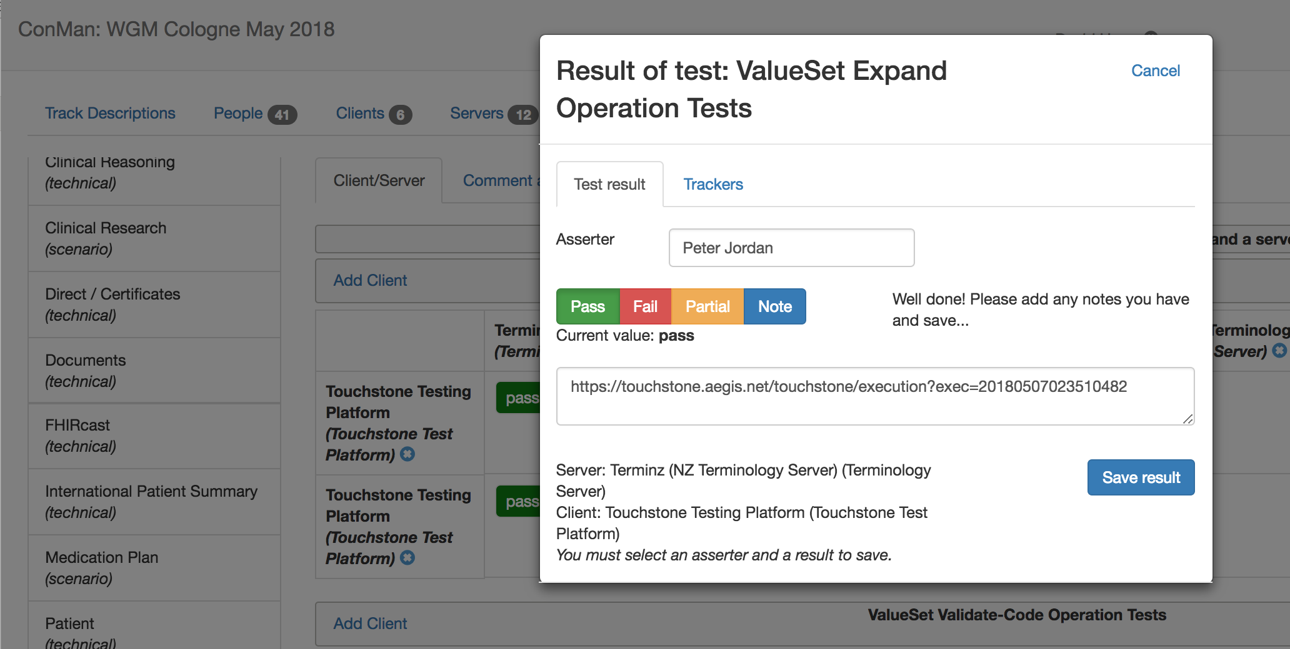
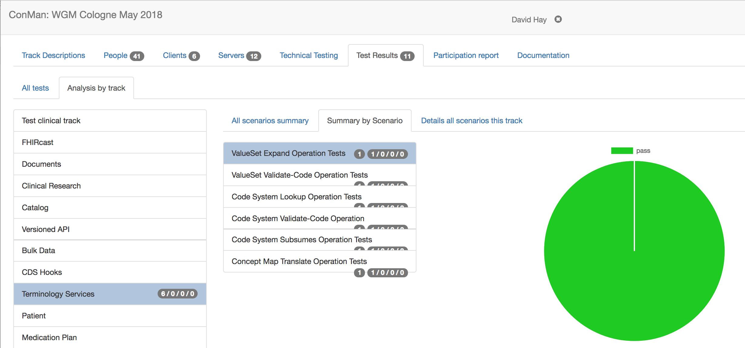
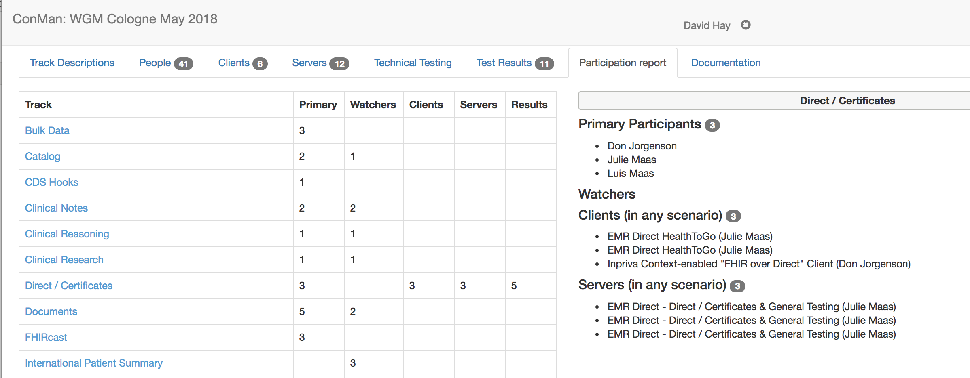
Technical recording and summary
Looking to feed from Touchstone

Slide 8
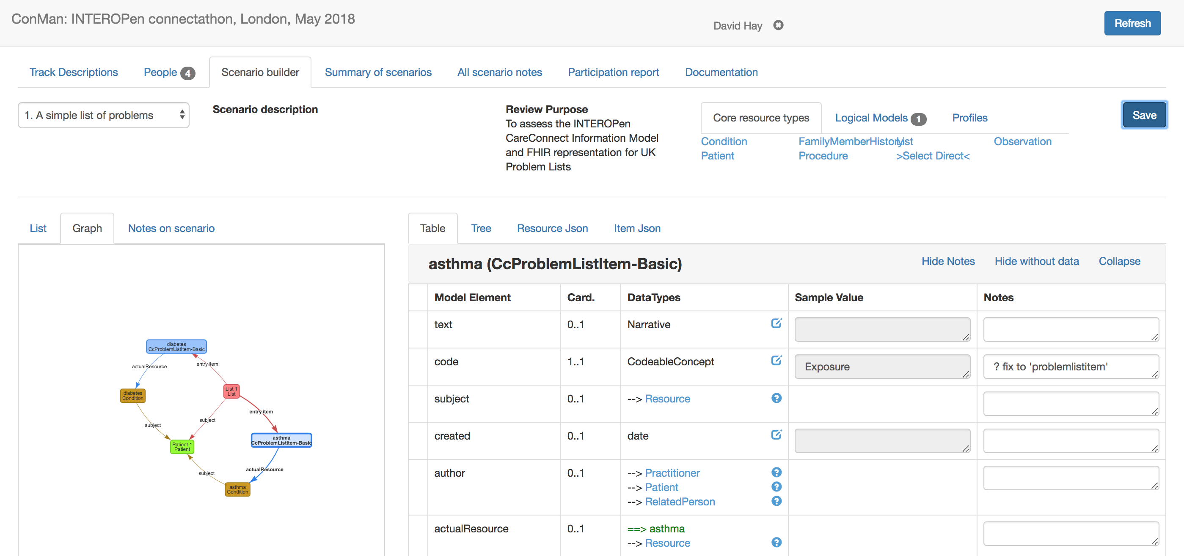
Clinical SceUser instance graph
Each user has 1 graph per scenario

Slide 9
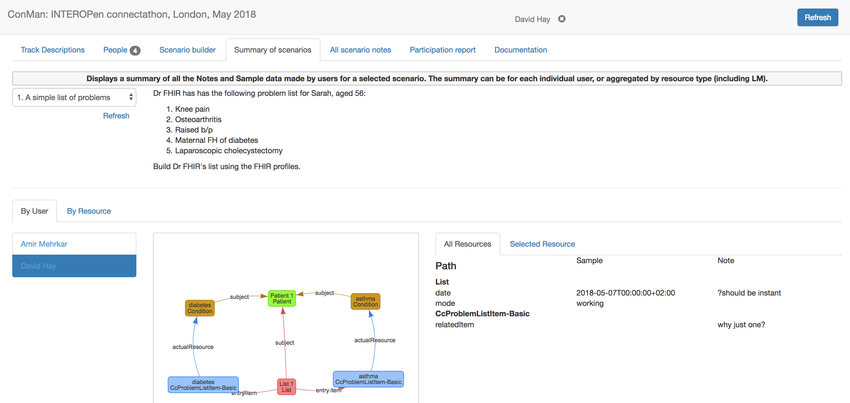
Summary of Scenarios

Slide 10
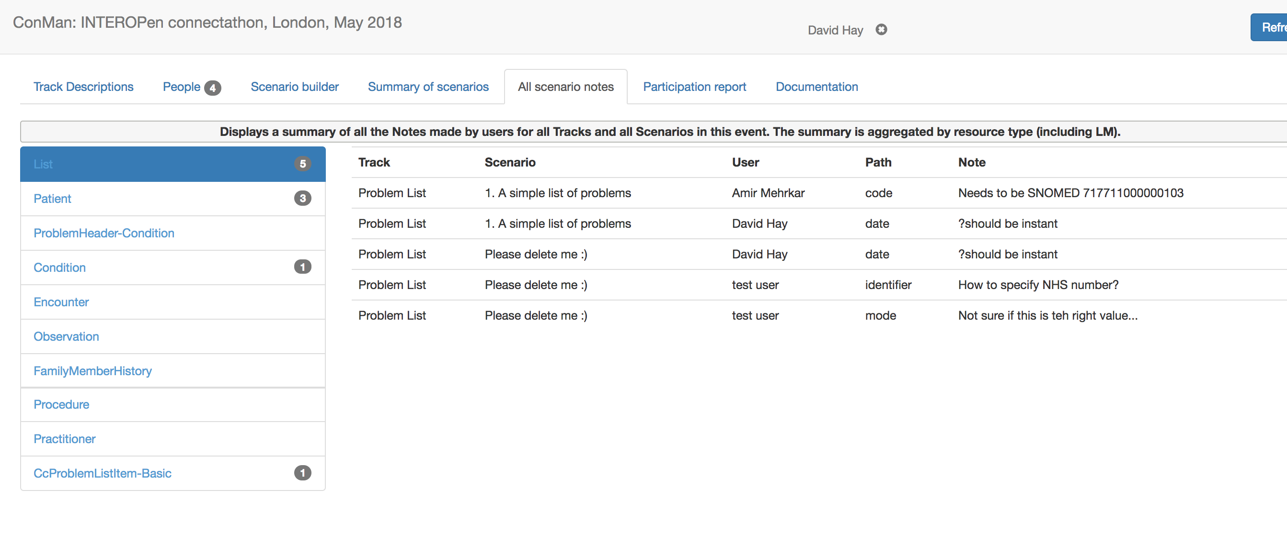
All event scenarios

Slide 11
Steps for a COF event
Before the event: Configure
What type
Educational, artifact review
Create Tracks & Scenario
During the event: Complete
Users complete scenario’s (1 per user)
At the end of the event: Review
How did participants go?
Raise any ‘tracker’ items…

