Slide 1
Implementation Guide Creators Birds of a Feather
Thursday, February 5, 2020
Sydney WGM

Slide 2
IG Creators
We are a growing community
100s of IGs
1000s of stakeholders
205 IGs under autobuild https://github.com/FHIR/auto-ig-builder
125 Repos in https://github.com/HL7
As community grows, IG-related processes need to become more formal and controlled
We also should learn to speak with one voice

Slide 3
Today's Topic: Maturing the publishing process
IG Authoring
Tool of Choice
IG Publisher Inputs
IG Publisher Software (IGP)
Implemention Guide (IG)
IG Template (IGT)

Slide 4
Resources
Nothing is free
IG Creation is under-resourced
The community of IG Creators needs to come together to push for more resources

Slide 5
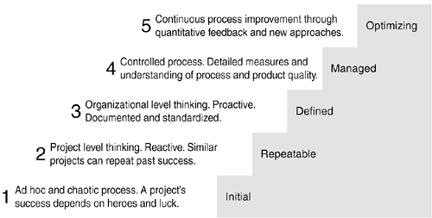
CMM Software Maturity Levels

Slide 6
Symptoms of process immaturity
IGP deployed, crashes on one or more IGs
Information on releases and changes hard to find
Changes promulgated without providing adequate transition time for IG Creators
Success depends on heroic efforts by a small number of individuals
High level of distress felt by stakeholders

Slide 7
Four Proposals:
Versioning
Issue Reporting
Release Documentation
Test Server or Go/No-Go Release Testing

Slide 8
1) Versioning
IG Publisher and IG template are versioned (major.minor.patch)
Proposal: Any change that requires any action by IG Creators to adopt that version is not a patch release
Examples of minor version changes:
Introduction of new error checks and warnings reported by IGP
Change/addition to the ImplementationGuide resource

Slide 9
2) Issue Reporting
Proposal: Publisher and template issues should be formally reported
This reduces "Zulip confusion" and allows releases to formally reference the issues that are addressed
Where the report goes needs further discussion:
JIRA is the easiest, but typically not used for "hot" issues
Github requires knowledge of which component is causing the issue

Slide 10
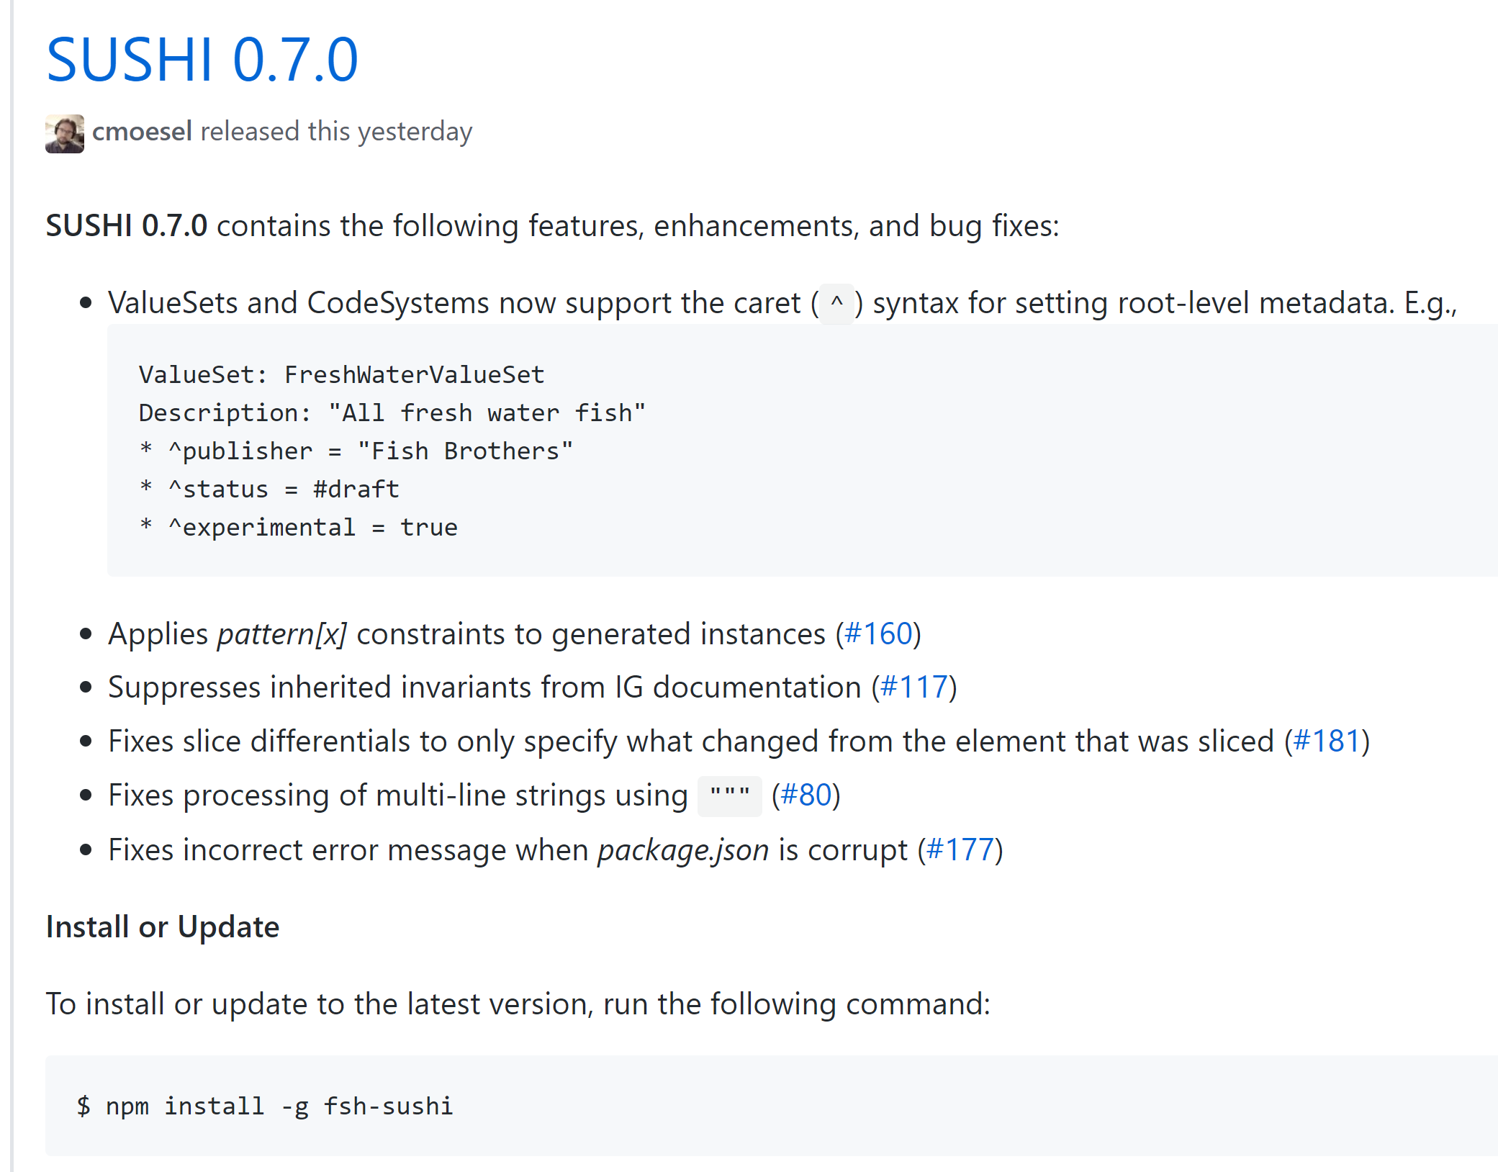
3) Release Documentation
All releases of IGP and IGT should have release notes
Release notes should explain three things:
New features
Bug fixes by issue number
Instructions for the user
Release notes should appear on the Github repo where the software lives
Example

Slide 11
Literally 3 hours ago...

Slide 12
4a) Test Server
Pushing IGP changes directly to production server (CI-Build) is dangerous
This practice doesn't give IG Creators time to transition
Proposal: Test server
Every new release (even a patch) is released first on the test server
Test server can re-run all IGs to gauge the impact of of the change
Number of build failures
Number of QA errors
IG Creators can test changes to their IGs in a safe environment
Establish norms for how long patches/minor/major versions are available on test server before pushing to production server

Slide 13
4a) Test Server
Pushing IGP changes directly to production server (CI-Build) is dangerous
This practice doesn't give IG Creators time to transition
Proposal: Test server
Every new release (even a patch) is released first on the test server
Test server can re-run all IGs to gauge the impact of of the change
Number of build failures
Number of QA errors
IG Creators can test changes to their IGs in a safe environment
Establish norms for how long patches/minor/major versions are available on test server before pushing to production server

Slide 14
4b) Go/No-Go Release Testing
An alternative to a test server:
IGP and IGT release a "Go/No-Go" version prior to the general release
Users given time to do local builds with new software
For patch releases, a short time for smoke testing
For major and minor releases, time allocated for testing and transition
HL7 provides some kind of "stop button" or voting tally board for the release (could be as simple as a SurveyMonkey)
Pre-established release criteria determines when the nominated software is good-to-go to general release

Slide 15
Next Steps
Share results with FMG
Acquire resources
HL7 - Wayne K.
Other possible supporters?

Slide 16
Topic for Next time: Does the existing IG meet all needs?
Highly technical document
Meets some needs, but not others
We need to communicate with informaticists, sponsors, clinicians, etc.
Additional ways to package information:
Data element view (flat list) -- very useful
Graphical views -- David Hay
If we have a way to process SDs into graphical views, how can it be added when the template is mandated?

