Slide 1
Grahame Grieve
Managing Patient Merge

Slide 2
The Fundamental Problem
In all clinical institutions, clerical staff create duplicate records for patients
Rate varies from 1% -> 20% (link, link)
Depends on culture, processes, patient-mix
Cost = $2k / inpatient (link)
ONC Target: 0.5% (link)
Specialist and Clinical staff find and fix duplicates
Fixing duplicates itself has an error rate – 5%?
Related problem: Encounters etc in the wrong patient record

Slide 3
Merge vs Link
Link Patient Records
Mark duplicate in both records
Display hints in UI when dealing with either patient
Also useful in federated record systems
Merge Patient records
Move all information from one record to the master
May leave the old record as an ref to the master (should not be used)
Hotly contested which is better and safer (institution may have a mix)

Slide 4
HL7 v2 Events
A18 Merge patient information
A24 Link patient information
A30 Merge person information
A34 Merge patient information - patient ID
A35 Merge patient information - account only
A36 Merge patient information - patient ID and account number
A37 Unlink patient information
A39 Merge person - patient ID
A40 Merge patient - patient identifier list
A41 Merge account - patient account num
A42 Merge visit - visit number
A43 Move patient information - patient identifier list
A44 Move account information - patient account number
A45 Move visit information - visit number

Slide 5
Patient Resource

Slide 6
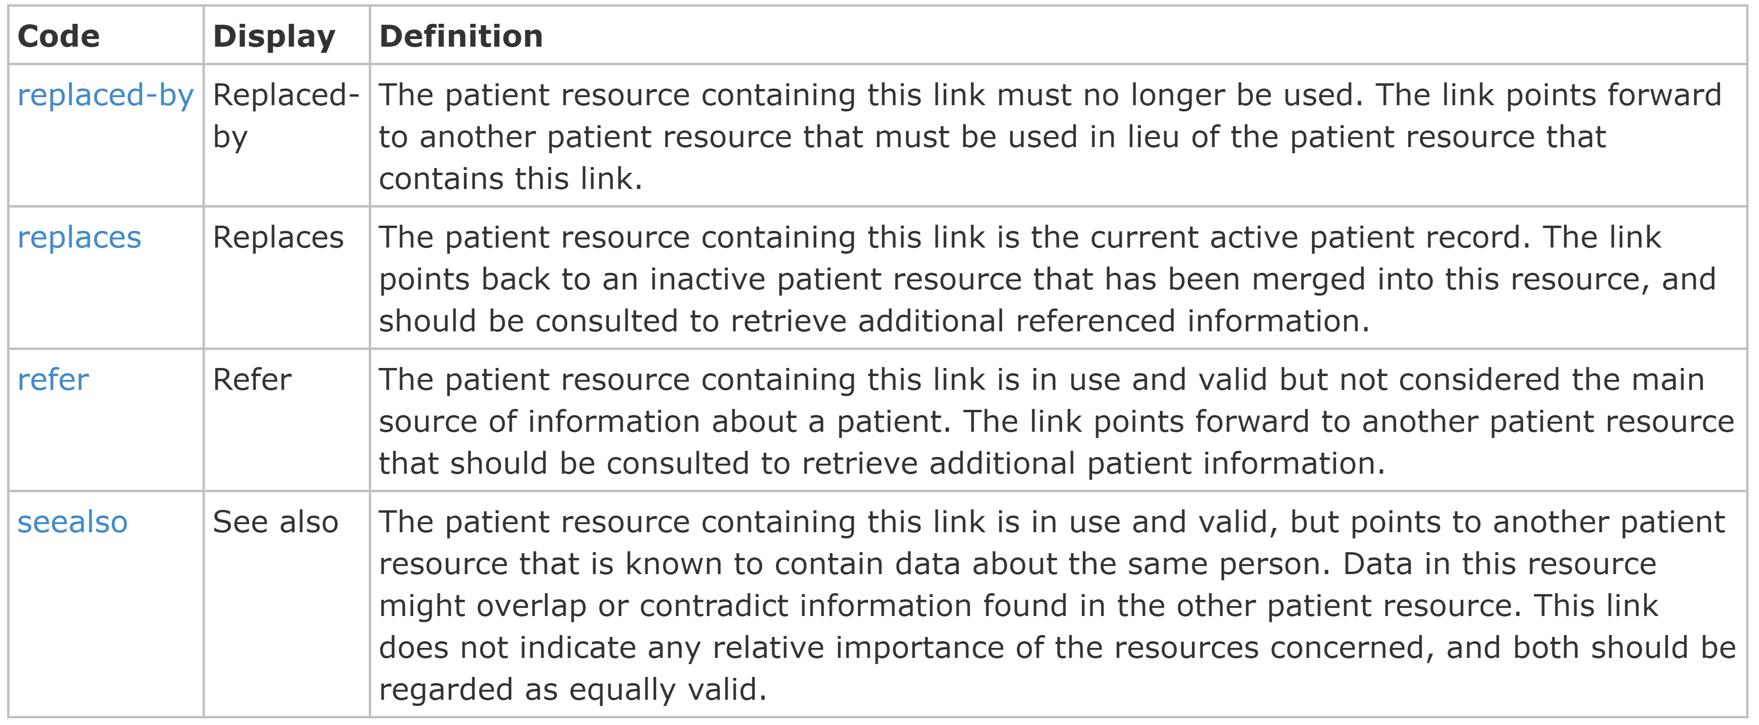
Patient Resource

Slide 7
Person Resource

Slide 8
Multiple Use Cases
Merge
Link
Primary
Equivalent
Person resource: federated identity assertions
including across participant types)
Linkage resource: Do not use (need to stop it from saying to use it)

Slide 9
Patient Documentation
Duplicate Patient records
Patient registration in error (duplicate records). By using a link of type 'replaced-by', the record containing such a link is marked as a duplicate and the link points forward to a record that should be used instead. Note that the record pointed to may in its turn have been identified as created in error and forward to yet another Patient resource.
Patient record in a Patient index
A Patient record may be present in a system that acts as a Patient Index: it maintains a (summary of) patient data and a list of one or more servers that are known to hold a more comprehensive and/or authoritative record of the same patient. The link type 'refer' is used to denote such a link.
Distributed Patient record
In a distributed architecture, multiple systems keep separate patient records concerning the same patient. These records are not considered duplicates, but contain a distributed, potentially overlapping view of the patient's data. Each such record may have its own focus or maintaining organization. In such cases, links of type 'see also' can be used to point to other patient records.

Slide 10
Patient Merge
This specification does not specify merge functionality: if multiple patient records are found to be duplicates, they can be linked together, as described above. These links merely express the relationship between records, and in the case of a replacement link, indicate a "master" record. This specification does not mandate that FHIR servers migrate information between such records on finding such a link. Note:
Health information administrators may call the process "merging", but it is often implemented as "linking" at the record level
Servers are allowed to implement merging/record migration even though it is not mandated.

Slide 11
Patient Merge (2)
Note: We are seeking input from the implementer community on what effect linking/merging/unlinking should have on other functionality such as the GET operation, searching, reverse includes, etc.; How should an unlink behavior be done? How will the patient compartment interact with the merge?
This functionality and related behaviors is subject to ongoing experimentation and implementation testing, with a definition to be proposed in a future version of this specification.

Slide 12
Doing a Patient Merge
Perform a patient Merge:
Update Patient B to say replaced by Patient A
Update Patient A to say replaces Patient B
Find all resources for Patient B and fix to say Patient A
Problems:
Probably don’t have rights to all resources for Patient B
Probably not all records associated with Patient B are on the API
Transaction safety
Almost certainly a workflow: propose a merge, review, confirm it

Slide 13
Patient Merge Operation
Patient/$merge?from=[id]&to=[id]
This will copy data from the 2nd patient record into the 1st, and move referenced content from the 2nd patient to reference the 1st.
What other parameters are needed?
Do we want to merge sub groupers (e.g. Encounters) as well?
Is it even needed? (yes!)
What about unmerge? (no: create all new records from scratch)

Slide 14
After a Patient Merge
What does reading the patient return? Get [base]/Patient/B
200 + record for Patient B that refers to Patient A
304 + redirect to Patient A, then return Patient A
Both are potentially unsafe. Both are implemented today

Slide 15
After a Patient Merge
What does referring to the patient mean? Get [base]/Observation?subject:Patient=B
No records (+ OperationOutcome?)
Records for Patient A
Both are unsafe. Both are implemented today.
See http://www.healthintersections.com.au/?p=2950

Slide 16
Where to now…?
Ongoing work by Patient Administration https://confluence.hl7.org/display/PA/Existing+Behaviours
Is anyone interested in a connectathon track?

