Slide 1
FHIR Servers and externalized Terminology Services
Michael Lawley | Group Leader, Health Informatics, Australian E-Health Research Centre
4 May 2019

Slide 2
FHIR Terminology Services
CodeSystem, ValueSet, ConceptMap
$expand, $validate-code, $lookup, $translate, $subsumes, $closure, $find-matches

Slide 3
Terminology in FHIR Search
Some search parameters in FHIR are of type ‘token’
These can leverage terminology services
:above/:below
/Condition?body-site:below=http://snomed.info/sct|272673000 (all Conditions where the finding site is a descendent of Bone Structure)
:in/:not-in
/ProcedureRequest?code:in=http://snomed.info/sct?fhir_vs=refset/32570361000036108 (all ProcedureRequests in the Imaging Procedure refset)

Slide 4
FHIR Server tx interactions
SCRUD & tx operations on CS, VS, CM
Forward all requests to tx
_search with token
:below, :above “simple” hierarchy tests
:in, :not-in full complexity of ValueSet/$expand
$validate
Bindings: requires ValueSet/$expand (or ValueSet/$validate-code)

Slide 5
Simple approach to externalisation
Send appropriate $expand request (possibly a POST with a ValueSet definition in the body) code:below=abcd → include:[{filter: [ {property:”parent”, op: “=“, value: “abcd”} ]}]
Use results in your internal search query: SELECT … WHERE condition.code in (’1234’, ‘2345’, …)
May not scale well for large ValueSets
May be better to add results of “SELECT code FROM condition” to the ValueSet definition itself

Slide 6
Use database stored procedures
e.g., Postgres can do HTTP requests
CREATE TYPE coding AS ( system text, code text, display text );
CREATE FUNCTION fexpand ( vs text, count integer default 10000, endpoint text default 'https://stu3.ontoserver.csiro.au/fhir’ )
RETURNS SETOF coding AS …
Can then use fexpand(…) in the FROM clause of your search query
Notes:
Could do similar with UDFs in Cassandra, …

Slide 7
Use $closure to locally cache isa hierarchy
Get all codes used in your Condition.body-site, Observation, etc resources
Send to $closure, get back parent-child edges (in a ConceptMap)
Cache in a local table
Use local table for :above/:below searches
As new code are used in your data, send to $closure and get back new edges (if any) to update the local table

Slide 8
http://snomed.info/sct?fhir_vs=isa/123456
http://snomed.info/sct?fhir_vs=ecl/<<12345+MINUS+<<7672

Slide 9
Grahame’s server
Never calls $expand
Only calls $validate-code
Cache’s result
Rebuilds cache on ValueSet change
How to handle unseen/unknown ValueSets (implicits)?
Issues a $validate-code for every known local code
Could optimize this with a range-constrained ValueSet and $expand
If externalized tx – how to detect ValueSet change to drive cache rebuild? Simple if all changes pass through main server.
How is versioning handled? e.g. multiple versions of SNOMED?

Slide 10
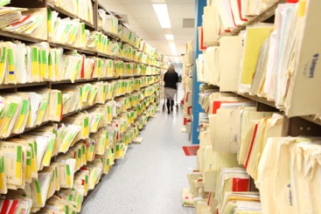
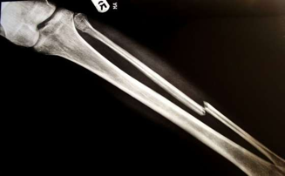
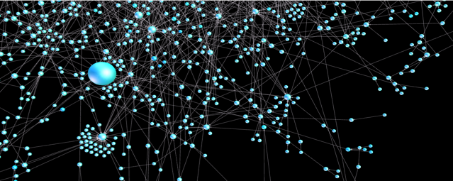
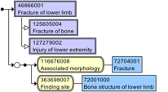
Contact us
Australian e-Health Research Centre
Michael Lawley, PhD Group Leader, Health Informatics
t +61 7 3253 3600
e michael.lawley@csiro.au
w aehrc.com
http://ontoserver.csiro.au/
http://ontoserver.slack.com
the Australian e-Health research centre | Health & Biosecurity

