Slide 1
Context-aware app suggestions
Aziz Boxwala, MD, PhD, Elimu Informatics
Guilherme Del Fiol, MD, PhD University of Utah
June 6, 2018

Slide 2
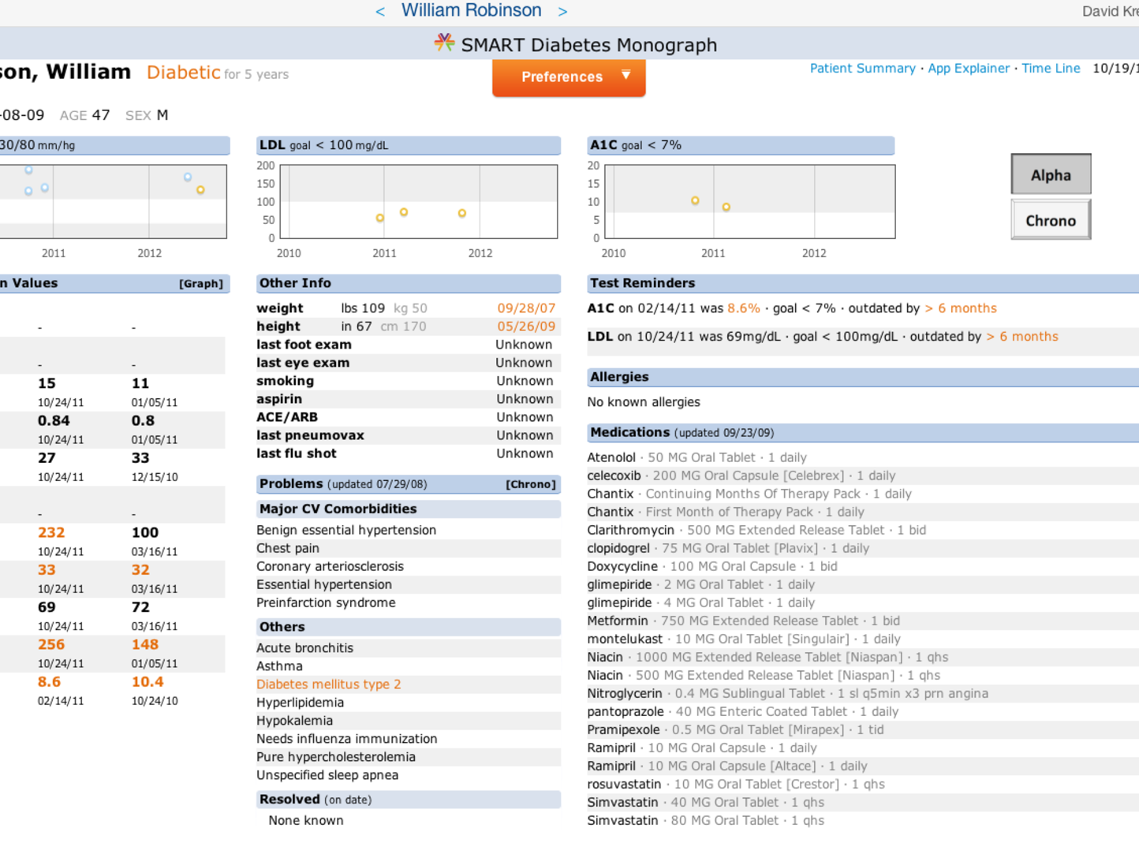
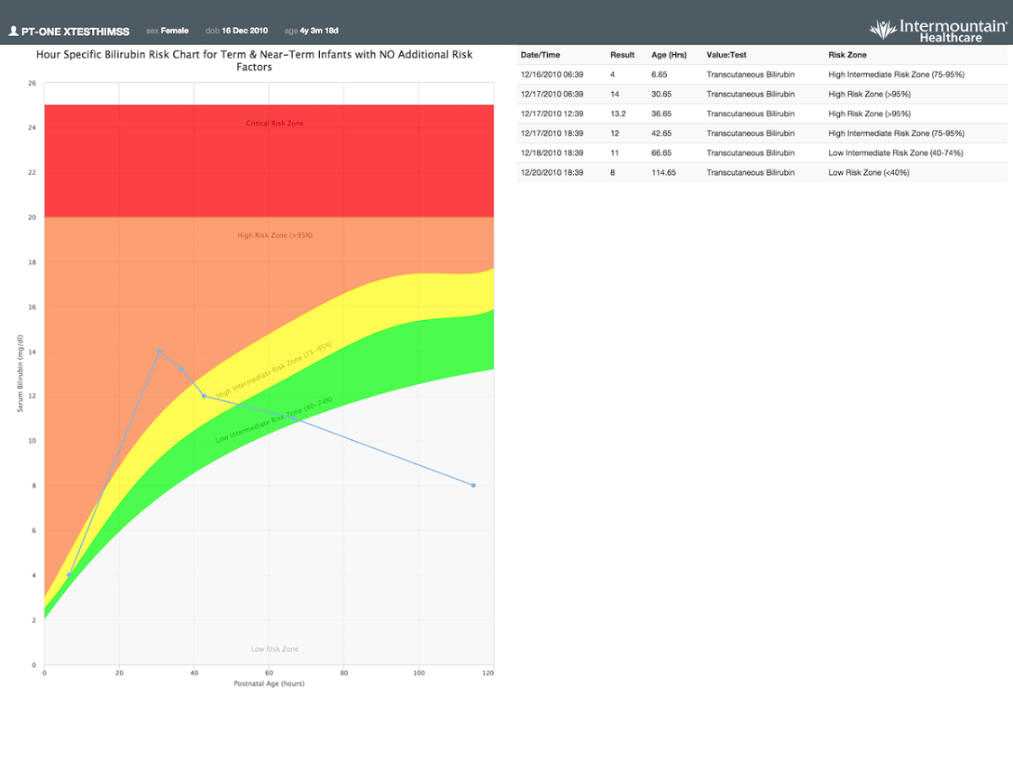
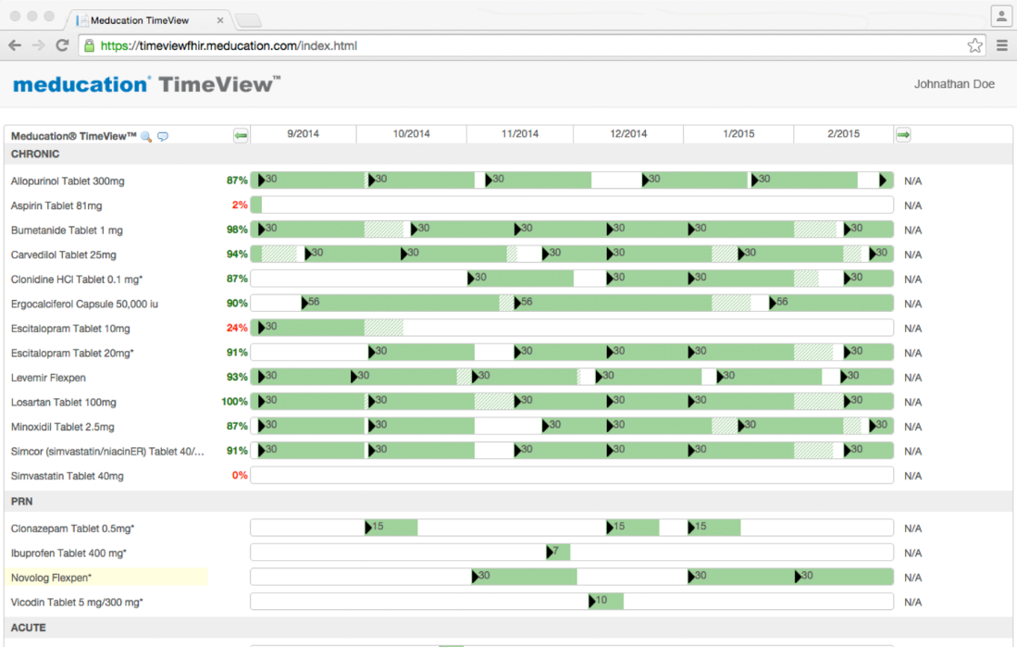
Launching apps in context
Many SMART on FHIR apps should be used in specific data contexts (problem, abnormal lab, med)

Slide 3
Leads to
Proprietary approaches to launching apps: write rules, menu configuration…
No standard for when an app should be surfaced

Slide 4
Two standards with partial capability to fill this need
Surfaces context-aware patient information
But…no PHI exchanged – SMART apps need patient identifier
Cards provide links to SMART apps
But … initial hooks are workflow triggered, not user triggered in specific data contexts

Slide 5
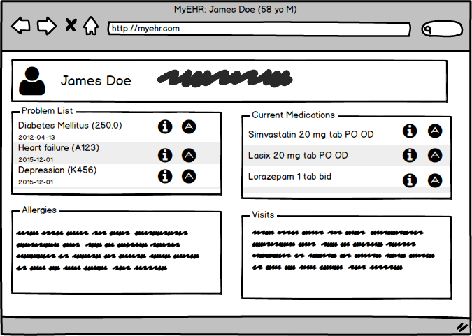
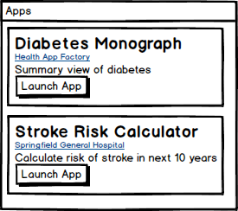
Proposal
New hook: similar launch triggers as infobutton – “app button”
Clicking on those buttons evokes cds-hooks request with app cards (or others) returned

Slide 6
Hook proposal
Workflow
User initiates request
Same triggers as infobutton
Hook:
Context-aware-app-request
Or any other name
Context
patientId
context-item: The resource representing the condition/medication-statement/observation/… that the user clicked on
The Diabetes condition resource in the example on the previous page
Note: this is purely a cds-hooks proposal, influenced and informed by the infobutton spec

