Slide 1
mCODE
Model Walkthrough for Clinical Genomics Working Group
May 8, 2019

Slide 2
Minimal Common Oncology Data Elements (MCODE)
A standard health record for Oncology.
The minimal set of data elements applicable to all cancers, and collected for:
standardized information exchange among oncology information systems.
use by multiple stakeholders.
Oncology data element domains: patient, disease, treatment, outcomes, genomics.
Patients
Providers
Research
CANCER
Payers
Patient
Registries
Disease
Treatment
Outcomes
Genomics
Vendors
Government / Regulatory

Slide 3
Where does this fit with HL7 Cancer Interoperability and CIC
Initial goal: create a core and extended model for cancer, starting with Breast Cancer
Breast Cancer IGs are narrow and deep
mCODE is broad and shallow
EHRs are the main application
Assessment / Workup
Diagnosis
Treatment
Evaluation /Outcome(s)
Monitoring
Diagnostics
(labs, radiology, surgery, assessments, etc.)
Staging
Therapy
(chemo, surgery, radiation, cellular, etc.)
OS, PFS, etc.
Workup
HL7 Breast Cancer Data IG
(Releases: 5/18, 9/18)
HL7 Breast Cancer Radiology IG
(est: 9/18)
mCODE IG (all solid tumor cancers)
(est: 9/18)

Slide 4
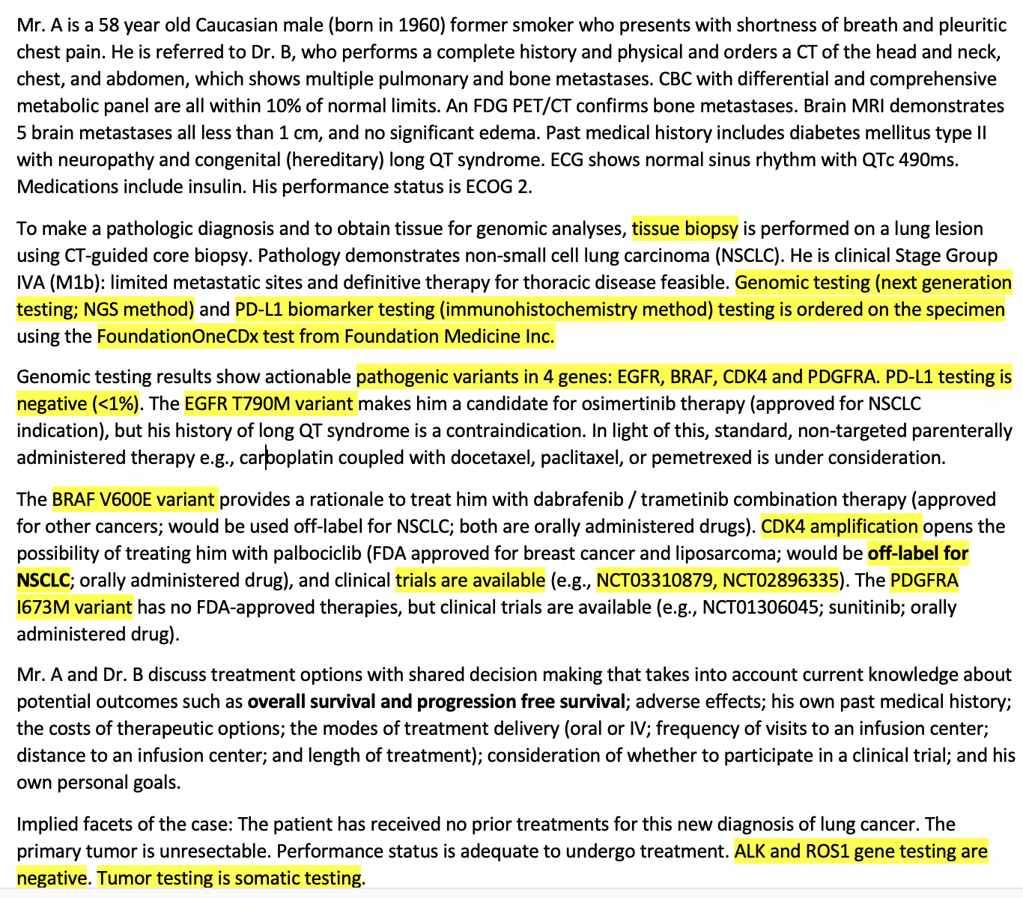
ASCO NGS Use Case
Use case defined by an ASCO Clinical Task Force, including
Medical/Surgical/Radiation oncologists, Pathologists, Radiologists
High-level Elements
Genomics diagnostic report
Test name
Specimen
Gene
Variant
Interpretation
Genomic origin (somatic, germline)
**Scoping criteria: would we find this as structured data in an EHR, or expect a medical oncologist to enter this today?

Slide 5
mCODE level of detail …is minimal
increasing detail
Source: FHIR Genomics: What You Need to Know for Project Implementations

Slide 6
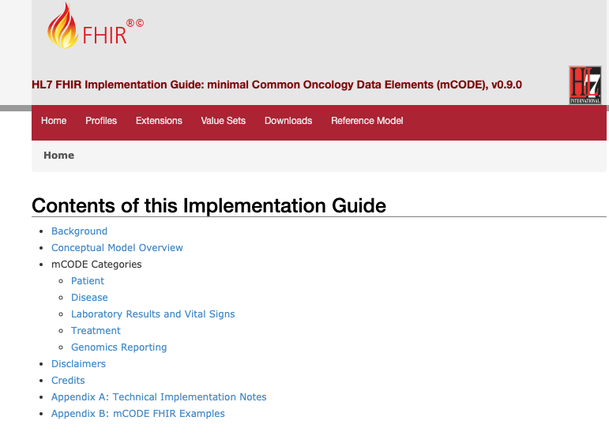
Use Case - Overall thinking
Scope focus
Split into two types – tumor markers, and genetics markers
Level 1 and 2 FHIR Clinical Genomics adoption
A reference to a diagnostic report
Simple discrete variants and interpretations
FHIR IG is based on DSTU2
Out of scope
Molecular sequencing data
Pharmacogenomics
http://standardhealthrecord.org/guides/mcode/
Notes:
The rest of the presentation is a walkthrough of the IG Clinical Genomics Elements

Slide 7
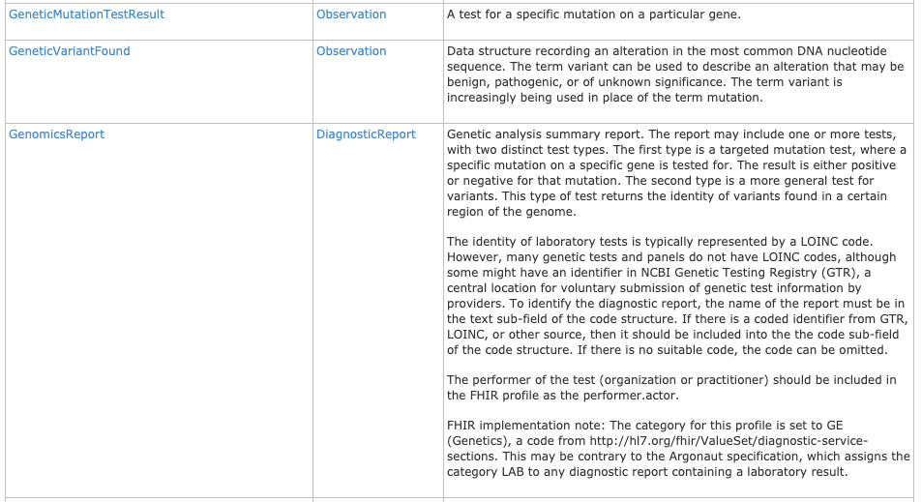
Relevant Clinical Genomics Profiles
GenomicsReport
GeneticMutationTestResult
GeneticVariantFound
http://standardhealthrecord.org/guides/mcode/profiles.html

