Slide 1
Proposed Updates to Formulary IG
February 2021

Slide 2
Agenda
FormularyDrug ←→CoveragePlan Cardinalities FHIR-30923, FHIR-29670
Efficiency of representation
Aligning FHIR IG (as intended) with QHP Formulary
Richer Description of Prescription Limits - FHIR-29964
Moving from Booleans to small, descriptive valuesets
Minor changes to Cost Sharing description - FHIR-30924
Aligns with current QHP Plan Descriptions
Plan-Specific Mail Order Flag on Formulary Drug? FHIR-30925
PlanID Description Refinement FHIR-28293
Changing String values to URL values (as appropriate) - FHIR-30412
Changing CoveragePlan.emailPlanContact FHIR-30933
Support for Marketing URLs for multiple languages - FHIR-29965

Slide 3
Future Agenda
Behavior of Formulary Endpoint when member has authenticated.
Should “look like the formulary for the member’s plan”
Need to define precisely

Slide 4
FormularyDrug ←→CoveragePlan Cardinalities FHIR-30923, FHIR-29670
In QHP Formulary (that inspired design) each Drug could reference 1..* (plan, tier, prescribing restrictions)
In Formulary IG, each Drug references 1 (plan, tier, prescribing restrictions)
Inefficient representation
Proposed resolution:
Align with QHP Formulary
Make Plan-Specific info 1..* in Formulary Drug
→ Note: Interaction with possible changes to Formulary behavior when member is authenticated.

Slide 5
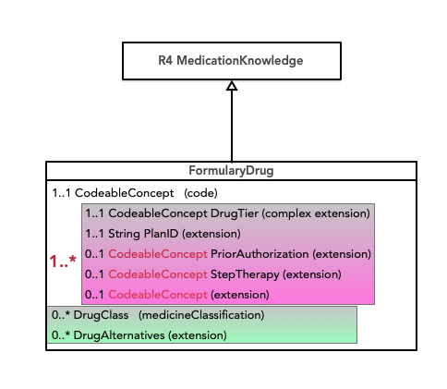
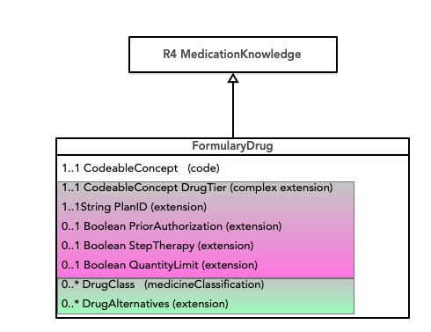
Plan-Specific Info Cardinality Change
STU1.0.1
Proposed

Slide 6
Richer Description of Prescription Limits FHIR-29964
Assertion: Boolean values will mislead members
Proposed changes
Step Therapy: (Currently Boolean)
FALSE → No Step Therapy Applies
True → Applies or Applies to New Starts Only
Prior Authorization: (Currently Boolean)
FALSE → No Prior Authorization
TRUE → Applies or Applies to New Starts Only, or Part D vs. PartB Prior Authorization Only
Quantity Limit Type: (Currently Boolean)
FALSE → Quantity Limits Do Not Apply
TRUE → Daily Quantity Limit or Quantity Limit Over Time

Slide 7
Minor changes to Cost Sharing description FHIR-30924
CopayOption and CoinsuranceOption don't seem to fit if the Medicaid Plan has a deductible of $0.
Values: after-deductible, before-deductible, no-charge, no-charge-after-deductible
2021 Instructions for Registering QHP Formulary (slide 21) address issue:
Additional value of "Not Applicable"
Plan-Level text field for any explanation of features that don't fit well into the structure.
Zero-Cost Drugs, two options are presented: 1) CoPaymentOption: N/A, CoInsuranceOption: No Charge, or 2) CoPaymentOptiion: No Charge, CoInsuranceOption: N/A
Business rule says you can't specify N/A for both CoPaymentOption and CoInsuranceOption

Slide 8
Minor changes to Cost Sharing description FHIR-30924
Possible Resolutions:
Add narrative description for case with 0$ deductible (no value set change)
#1 + Add N/A value and business rule as per QHP (value set change)
Add Plan-level text field for any explanation of features that don't fit well into the structure.

Slide 9
Plan-Specific Mail Order Flag on Formulary Drug? FHIR-30925
"We’re currently mapping a formulary to Coverage Plan (List) and FormularyDrug (MedicationKnowledge). The CoveragePlan profile has the mail order indicator (Yes/No) and it appears to be required under the usdf-DrugTierDefinition-extension. However, mail order is not a “plan-level” attribute. It is an attribute of the drug. e.g. I’m on Medicare Advantage plan and I can get Atorvastatin through mail order but I can’t get Adempas via mail order. Both drugs are in the same formulary. Has anyone come across this issue and, if so, how did you handle it?"
The current IG (based directly on the QHP formulary) only allows specification of mail order at the plan-level, as you noted. There is no facility to identify FormularyDrugs that do (not) have mail order options.
Add Plan-Specific Flag to Formulary Drug NoMailOrder Boolean 0..1 - Can be used to flag drugs that are exceptions to Mail Order

Slide 10
PlanID Description Refinement FHIR-28293
The description of PlanID is HIOS-centric
“Unique, 14-character, HIOS-generated Plan ID number”
What about non-QHP plans?
“Is the PlanID supposed to be something that is visible to providers and patients via their insurance card in order to support the use cases wherein PlanID is referenced as a search parameter? Or is an internal value sufficient?”
Propose to change:
“Unique (to a payer across all markets?), generated Plan ID number, such as HIOS ID for QHPs or Contract Number for Medicare Advantage Plans. (Plan IDs must be unique, even across different markets).”

Slide 11
Changing String values to URL values (as appropriate) - FHIR-30412
Propose: value[x] should be of type url

Slide 12
Changing CoveragePlan.emailPlanContact. FHIR-30933
Ref: http://hl7.org/fhir/us/davinci-drug-formulary/StructureDefinition-usdf-EmailPlanContact-extension.html
The value of this extension is string. Should be url which would allow both a URL for a contact form, or an e-mail address.
Request these changes: 1) change type of value from string --> URL (see FHIR-30412) 2) change name from EmailPlanContact --> SupportContact 3) clarify narrative to mention that FHIR url type can be a web-url or an e-mail address

Slide 13
Support for Marketing URLs for multiple languages - FHIR-29965
Aetna: "We have found that our Marketing URL could have multiple languages. We have seen some examples of Spanish URLs."

