Slide 1
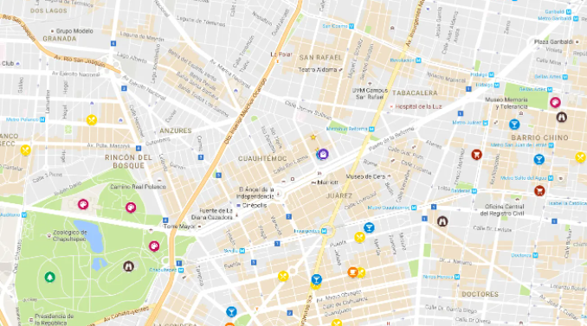
Maps that make mapping easier
Lisa Nelson
September 2021
© 2021 MaxMD

Slide 2
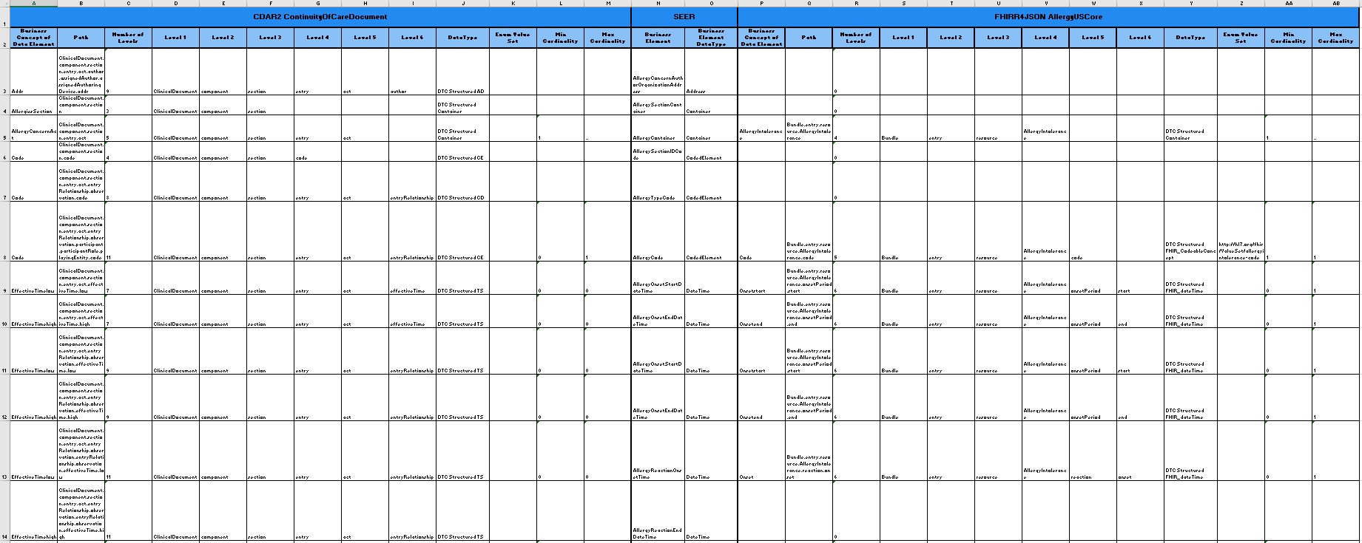
Need to establish an approach to make progress on building consensus mappings
Struggling to use this list alone as the first step in documenting mapping information for agreement from multiple SMEs

Slide 3
Creating a map requires visual spacial anchoring to be successful
The Relevance of Cartography, A Cartographer’s Perspective https://www.esri.com/about/newsroom/arcnews/challenges-to-cartography/ George Gartner, professor of Cartography at Vienna University of Technology
Understanding Visualization: A Formal Approach Using Category Theory and Semiotics https://ieeexplore.ieee.org/abstract/document/6311404 Published by IEEE
Semiotics is the study of signs and symbols and their use or interpretation.
Pragmatics is the branch of linguistics dealing with language in use and the contexts in which it is used, including such matters as deixis, the taking of turns in conversation, text organization, presupposition, and implicature.

Slide 4
Excerpt from The Relevance of Cartography, A Cartographer’s Perspective, by George Gardner
In communication science, we use the theory of semiotics to explain communication processes. In this model, syntactical, semantic, and pragmatic dimensions are used. Unlike semantics, which examines meaning that is conventional or coded in a given language, pragmatics studies how the transmission of meaning depends not only on structural and linguistic knowledge of the speaker and listener but also on the context of the utterance. In this respect, pragmatics explains how language users are able to overcome apparent ambiguity, since meaning relies on the manner, place, time, and other characteristics of an utterance.

Slide 5
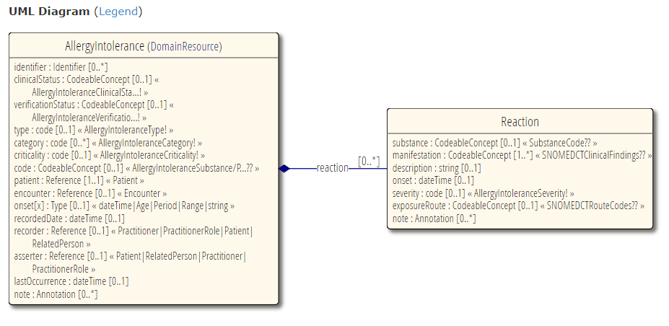
US Core 4.0.0 Allergy Intolerance 4.0.0 profile

Slide 6
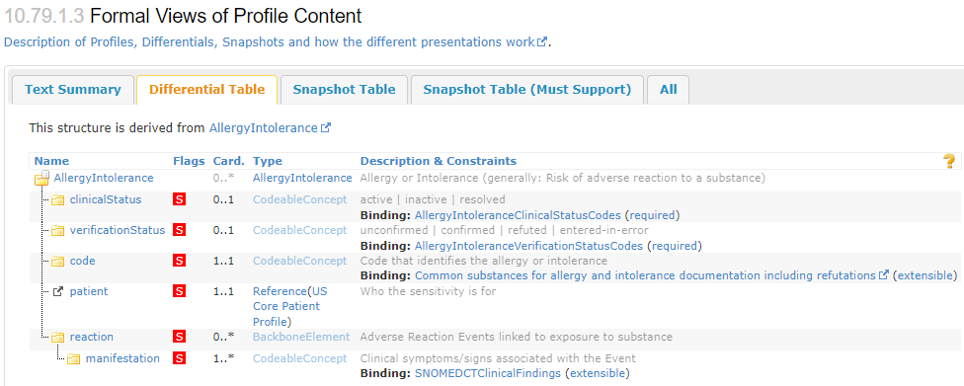
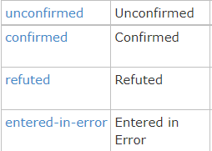
Must Support Elements from US Core
http://hl7.org/fhir/ValueSet/allergyintolerance-clinical
http://hl7.org/fhir/ValueSet/allergyintolerance-verification
Gap

Slide 7
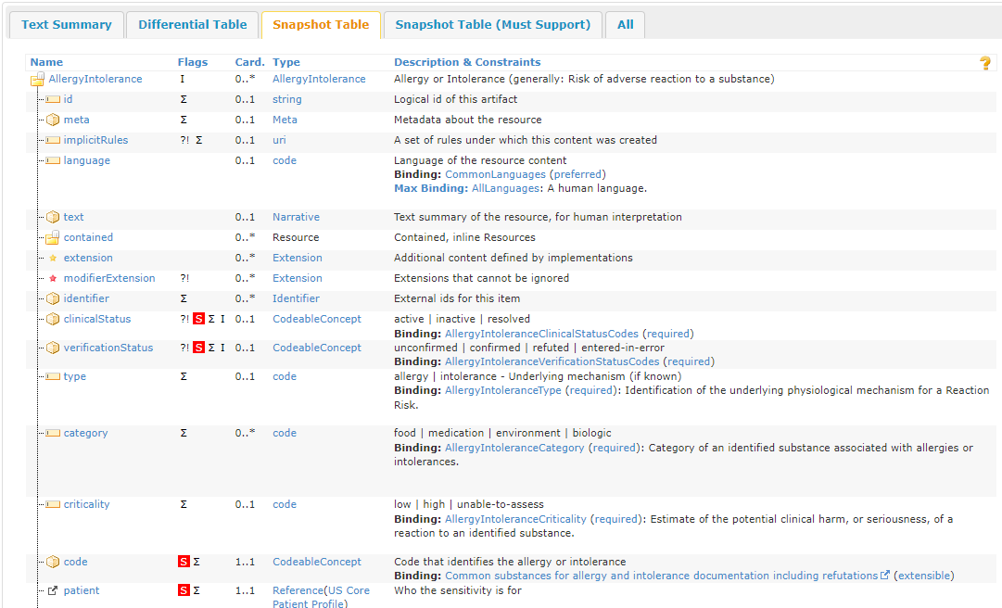
ValueSet alignment problems

Slide 8
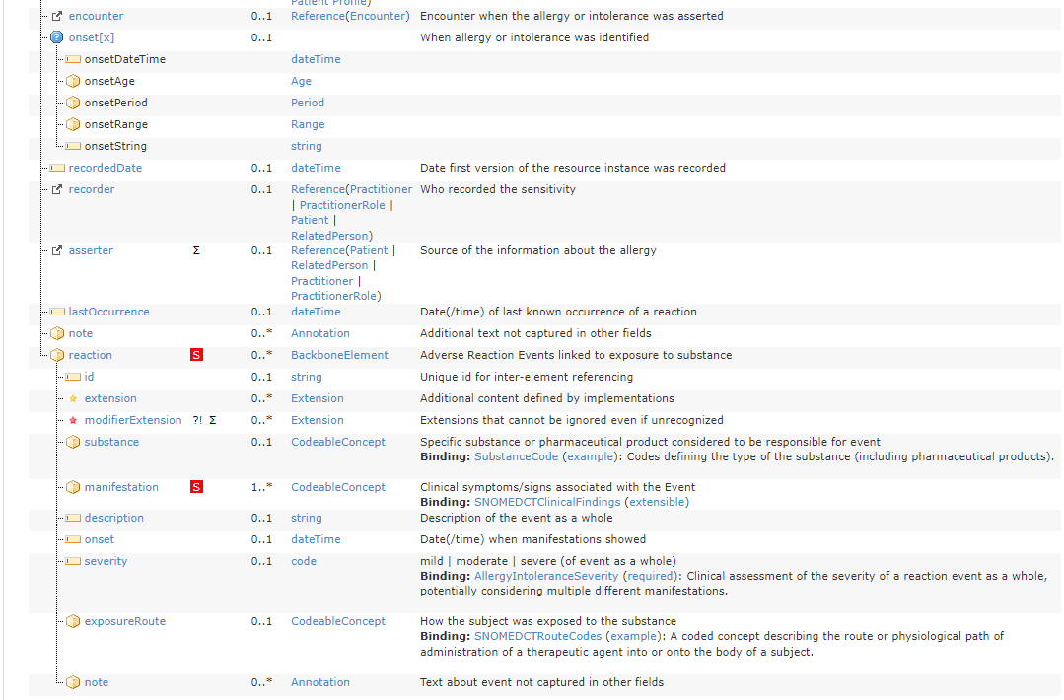

Slide 9
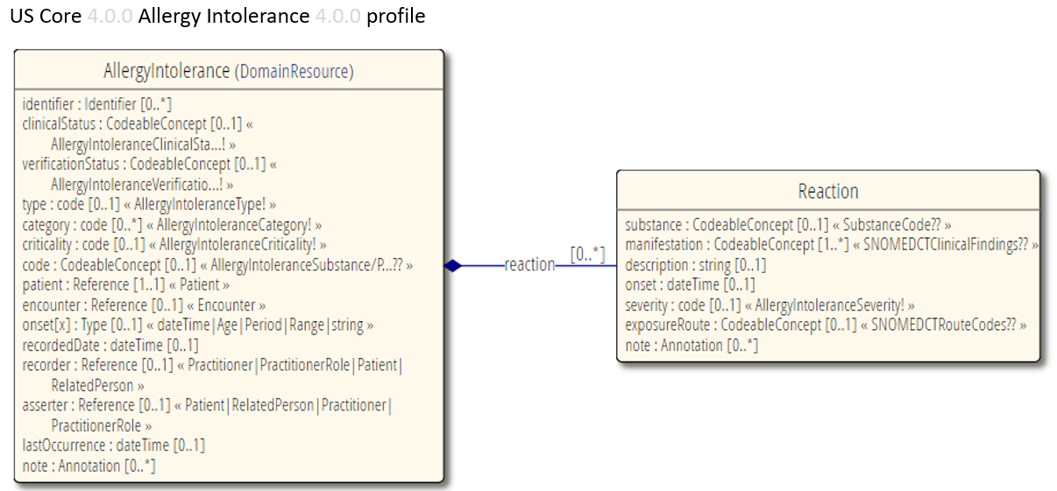
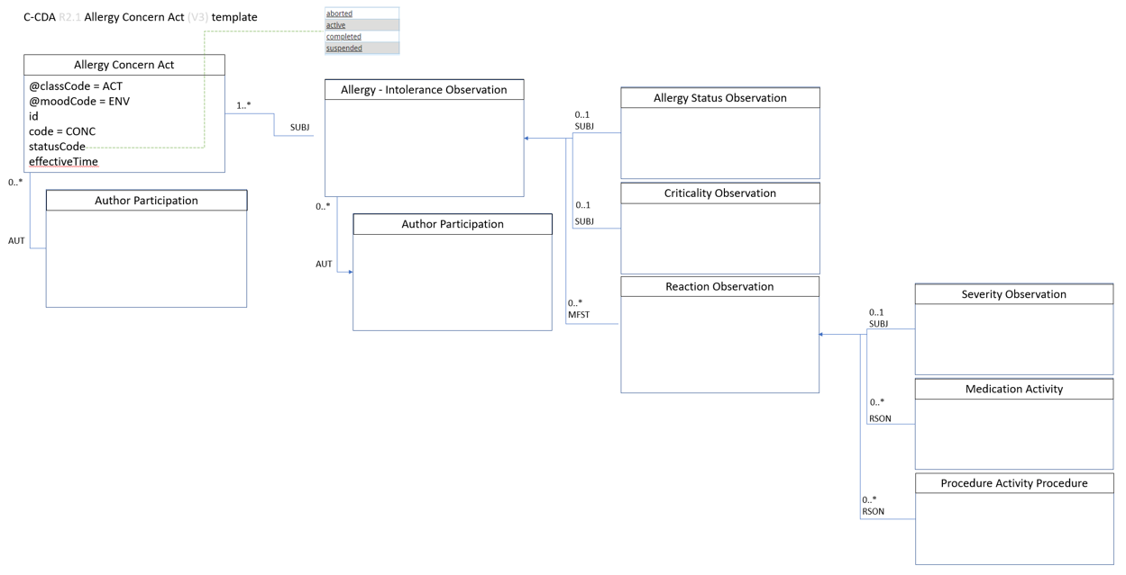
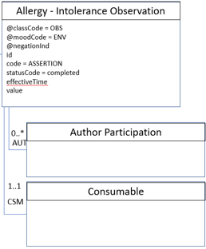
Mapping Gap

Slide 10
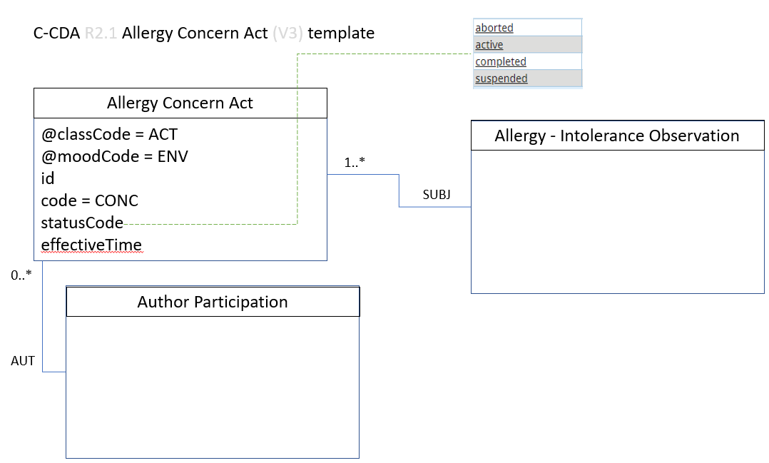
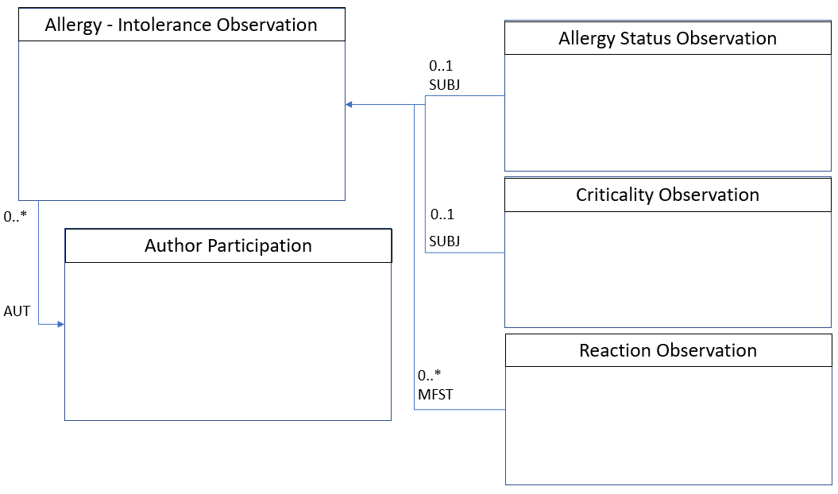
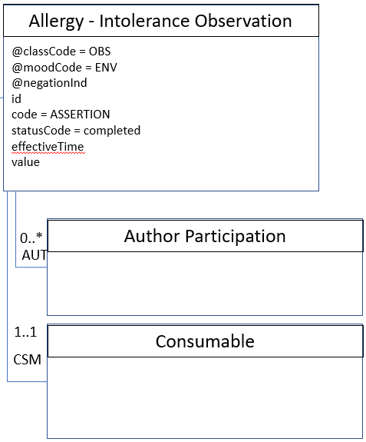
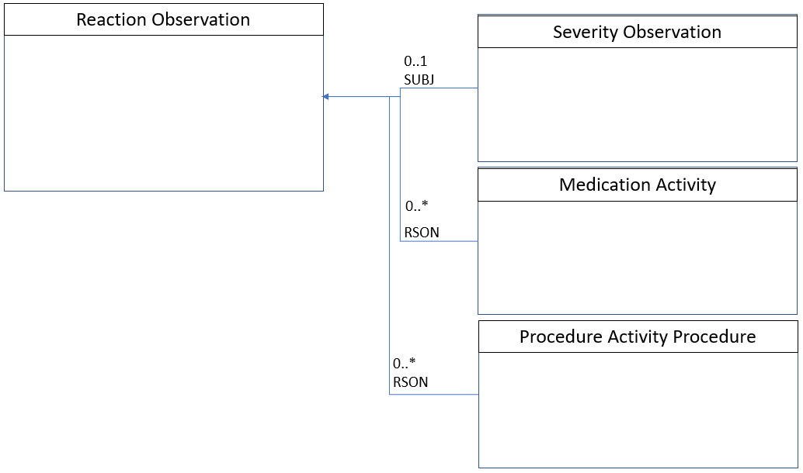

Slide 11
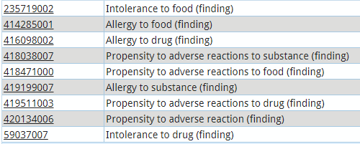
ValueSet ProblemAct statusCode 2.16.840.1.113883.11.20.9.19 STATIC (CONF:1198-19086).
C-CDA R2.1 Allergy Concern Act (V3) template
MAY contain zero or one [0..1] @negationInd (CONF:1098-31526). Note: Use negationInd="true" to indicate that the allergy was not observed.
Allergy Concern Act
@classCode = ACT
@moodCode = ENV
id
code = CONC
statusCode
effectiveTime
Allergy - Intolerance Observation
Note: If the allergy/intolerance is known to be resolved, but the date of resolution is not known, then the high element SHALL be present, and the nullFlavor attribute SHALL be set to 'UNK'.
Assumption 1..1
1..*
@classCode = OBS
@moodCode = ENV
@negationInd
id
code = ASSERTION
statusCode = completed
effectiveTime
value
SUBJ
Note: The consumable participant points to the precise allergen or substance of intolerance. Because the consumable and the reaction are more clinically relevant than a categorization of the allergy/adverse event type, many systems will simply assign a fixed value here (e.g., "allergy to substance").
0..*
Author Participation
AUT
time
assignedAuthor
id
code
assignedPerson
name
representedOrganization
id
name
telecom
addr
Author Participation
0..*
ValueSet Allergy and Intolerance Type 2.16.840.1.113883.3.88.12.3221.6.2 DYNAMIC (CONF:1098-7390)
ValueSet Healthcare Provider Taxonomy 2.16.840.1.114222.4.11.1066 DYNAMIC (CONF:1098-31671)
AUT
1..1
Consumable
CSM
@typeCode = CSM
participantRole/@classCode=MANU
playingEntity/@classCode=MMAT
code
ValueSet Substance Reactant for Intolerance 2.16.840.1.113762.1.4.1010.1 DYNAMIC (CONF:1098-7419)

Slide 12
Allergy - Intolerance Observation
Allergy Status Observation
0..1
@classCode = OBS
@moodCode = ENV
code = 33999-4 (LOINC) Diagnosis status
statusCode = completed
effectiveTime
value
ValueSet Allergy Clinical Status 2.16.840.1.113762.1.4.1099.29 DYNAMIC (CONF:1198-7322)
SUBJ
Criticality Observation
ValueSet Criticality Observation 2.16.840.1.113883.1.11.20549 DYNAMIC (CONF:81-32928)
0..*
0..1
@classCode = OBS
@moodCode = ENV
code = 82606-5 (LOINC) Criticality
statusCode = completed
effectiveTime
value
Author Participation
SUBJ
AUT
Reaction Observation
0..*
@classCode = OBS
@moodCode = ENV
id
code = ASSERTION
statusCode = completed
effectiveTime
value
MFST
ValueSet Problem 2.16.840.1.113883.3.88.12.3221.7.4 DYNAMIC (CONF:1098-7335)

Slide 13
Reaction Observation
Severity Observation
ValueSet Reaction Severity 2.16.840.1.113883.3.88.12.3221.6.8 DYNAMIC (CONF:1098-7356)
0..1
@classCode = OBS
@moodCode = ENV
code = SEV Severity
statusCode = completed
value
SUBJ
Medication Activity
0..*
RSON
Procedure Activity Procedure
0..*
RSON

Slide 14
Map | Business Concept | Template/Path | field | attribute | Value Set
 | Allergy-Intolerance | Allergy Concern Act
 | Allergy-Intolerance Category | Allergy Concern Act/Allergy – Intolerance Observation | value |  | Mapping needed from ValueSet Allergy and Intolerance Type 2.16.840.1.113883.3.88.12.3221.6.2 DYNAMIC (CONF:1098-7390) to US Core Allergy Category ValueSet
 | Allergy/Intolerance Type | Allergy Concern Act/Allergy – Intolerance Observation | value |  | ValueSet Allergy and Intolerance Type 2.16.840.1.113883.3.88.12.3221.6.2 DYNAMIC (CONF:1098-7390)
 | Allergy/Intolerance Clinical Status | Allergy Concern Act/Allergy – Intolerance Observation/ | value |  | ValueSet Allergy Clinical Status 2.16.840.1.113762.1.4.1099.29 DYNAMIC (CONF:1198-7322)
 | Allergy/Intolerance Verification Status
 | Allergy-Intolerance Substance Def: The kind of Allergy-Intolerance
 | Allergy-Intolerance Criticality | Allergy Concern Act/Allergy – Intolerance Observation/Criticality Observation | value |  | ValueSet Criticality Observation 2.16.840.1.113883.1.11.20549 DYNAMIC (CONF:81-32928)
 | Reactant Substance Def: The substance that caused the reaction | Allergy Concern Act/Allergy – Intolerance Observation/Consumable | code |  | ValueSet Substance Reactant for Intolerance 2.16.840.1.113762.1.4.1010.1 DYNAMIC (CONF:1098-7419)
 | Reaction Manifestation | Allergy Concern Act/Allergy – Intolerance Observation/Reaction Observation | value |  | ValueSet Problem 2.16.840.1.113883.3.88.12.3221.7.4 DYNAMIC (CONF:1098-7335)
 | Reaction Severity | Allergy Concern Act/Allergy – Intolerance Observation/Reaction Observation/Severity Observation | value |  | ValueSet Reaction Severity 2.16.840.1.113883.3.88.12.3221.6.8 DYNAMIC (CONF:1098-7356)
 | Reaction Exposure Route | Allergy Concern Act/Allergy – Intolerance Observation/Reaction Observation/Medication Activity | routeCode |  | Not clear how this is expected to be used in FHIR or C-CDA
 | Note | A note activity entry in the allergies and intolerances section, or in a entry relationship to the Allergy-intolerance entry. | text |  | Code is 34109-9 and should have translation from ValueSet Note Types 2.16.840.1.113883.11.20.9.68 DYNAMIC (CONF:3250-16939)

Slide 15
Map | Business Concept | Template/Path | field | attribute | Value Set or Comment
 | Allergy-Intolerance Reporter | Allergy Concern Act/Author Participation | time name organization
 | Allergy-Intolerance Recorded Date | Allergy Concern Act/Author Participation | time
 | Allergy-Intolerance Recorder | Allergy Concern Act/Author Participation | name organization
 | Allergy-Intolerance Onset Date/Time | Allergy Concern Act/Allergy – Intolerance Observation | effectiveTime | /low
 | Allergy-Intolerance Asserter | Allergy Concern Act/Allergy – Intolerance Observation/Author Participation | name organization
 | Date/Time of Reaction | Allergy Concern Act/Allergy – Intolerance Observation/Reaction Observation | effectiveTime | /low /high
 | Last Occurrence of Reaction | Allergy Concern Act/Allergy – Intolerance Observation/Reaction Observation | effectiveTime | /low | Could be effectiveTime or effectiveTime/low of the most recent Reaction
 | Allergy-Intolerance Diagnosis Associated Encounter | Allergy Concern Act/Allergy – Intolerance Observation/Entry Reference | id

Slide 16
Map | Business Concept | Definition
 | Allergy-Intolerance | Allergy Concern Act
 | Allergy-Intolerance Category | A high-level categorization of an allergy or intolerance. Required binding to: food, medication, environment, or biologic.
 | Allergy/Intolerance Type | Identification of the underlying physiological mechanism for a Reaction Risk. Required binding to: allergy, or intolerance.
 | Allergy/Intolerance Clinical Status | The status of the allergy or intolerance determined by the asserting practitioner or the patient and documented by the recorder. Required binding to: active, inactive, or resolved.
 | Allergy/Intolerance Verification Status | The assessment of the “confirmation status” of the allergy or intolerance determined by the asserter and documented by the recorder. Required binding to: unconfirmed, confirmed, refuted, or entered-in-error.
 | Allergy-Intolerance Substance Def: The kind of Allergy-Intolerance | The typical way of describing the kind of allergy. Extensible binding to: a set of common substances used when describing an allergy or intolerance
 | Allergy-Intolerance Criticality | Estimate of the potential clinical harm, or seriousness, of a reaction to an identified substance determined by the asserter and documented by the recorder. Required binding to: low, high, or unable-to-assess.
 | Reactant Substance | Specific substance or pharmaceutical product considered to be responsible for event. Example binding to a set of codes defining the type of the substance (including pharmaceutical products).
 | Reaction Manifestation | The clinical symptom/sign associated with the allergy or intolerance response. Extensible binding to a value set of clinical finding concepts.
 | Reaction Severity | An assessment of the severity of a reaction event as a whole, potentially considering multiple different manifestations as determined by the asserter and documented by the recorder. Required binding to: mild, moderate, sever
 | Reaction Exposure Route | Describes how the subject was exposed to the reaction substance.
 | Note | An annotation about the event not captured in other fields.

Slide 17
Map | Business Concept | Description
 | Allergy-Intolerance Reporter | The person who provided the information about the allergy-intolerance or the reaction.
 | Allergy-Intolerance Recorded Date | Date when the Allergy-Intolerance was first recorded as an issue.
 | Allergy-Intolerance Recorder | Who recorded the sensitivity
 | Allergy-Intolerance Onset Date/Time | When allergy or intolerance was identified (when it was identified to have first started).
 | Allergy-Intolerance Asserter | Source of the information about the allergy or intolerance in the patient’s record.
 | Date/Time of Reaction | Date(/time) when manifestations (symptoms) of the Allergy or Intolerance showed
 | Last Occurrence of Reaction | Date(/time) of last known occurrence of a reaction.
 | Allergy-Intolerance Diagnosis Associated Encounter | The related encounter where this allergy-intolerance and/or reaction event was documented.

Slide 18
Proposed Approach: Consensus-Driven Mapping
Agree on the Business Concepts that need to be mapped
Name to be used
Definition of what it is
Agree on the Path to that data element in C-CDA
Agree on the Path to that data element in US Core Profile
Review Value Set alignments and concept differences
Agree on concept mapping
Document assumptions and rules for achieving agreed data correspondences

Slide 19
Leveraging C-CDA 2021 VS Update Work
https://confluence.hl7.org/display/SD/C-CDA+to+US+Core+value+set+alignment

Slide 20
