Slide 1
FHIR Connectathon 25
HRex/CDex/PCDE
Track Highlights
Lloyd McKenzie/May Terry
(Joseph Minieri, Nikolai Schwerter

Slide 2
Attendees
Participants and Observers
Anthem
Cerner
Gevity
Humana
Interoperion
Mettles Solutions
MITRE

Slide 3
PCDE Highlights

Slide 4
Successes
Presented a PCDE Walkthrough with a client demo that can be tested by payer subject matter experts to review PCDE content.
Implemented and tested new Task resource changes.
Participant review and pressure-test of the IG with a PCDE Bundle example, resulting in identifying two JIRA issues:
Missing reference from PCDEBundle profile to PCDEComposition
Adding invariant to improve conformance of ActiveTreatment sections within a PCDEComposition
Fixed PCDE Bundle example which incorrectly had multiple treatments under one ActiveTreatment.

Slide 5
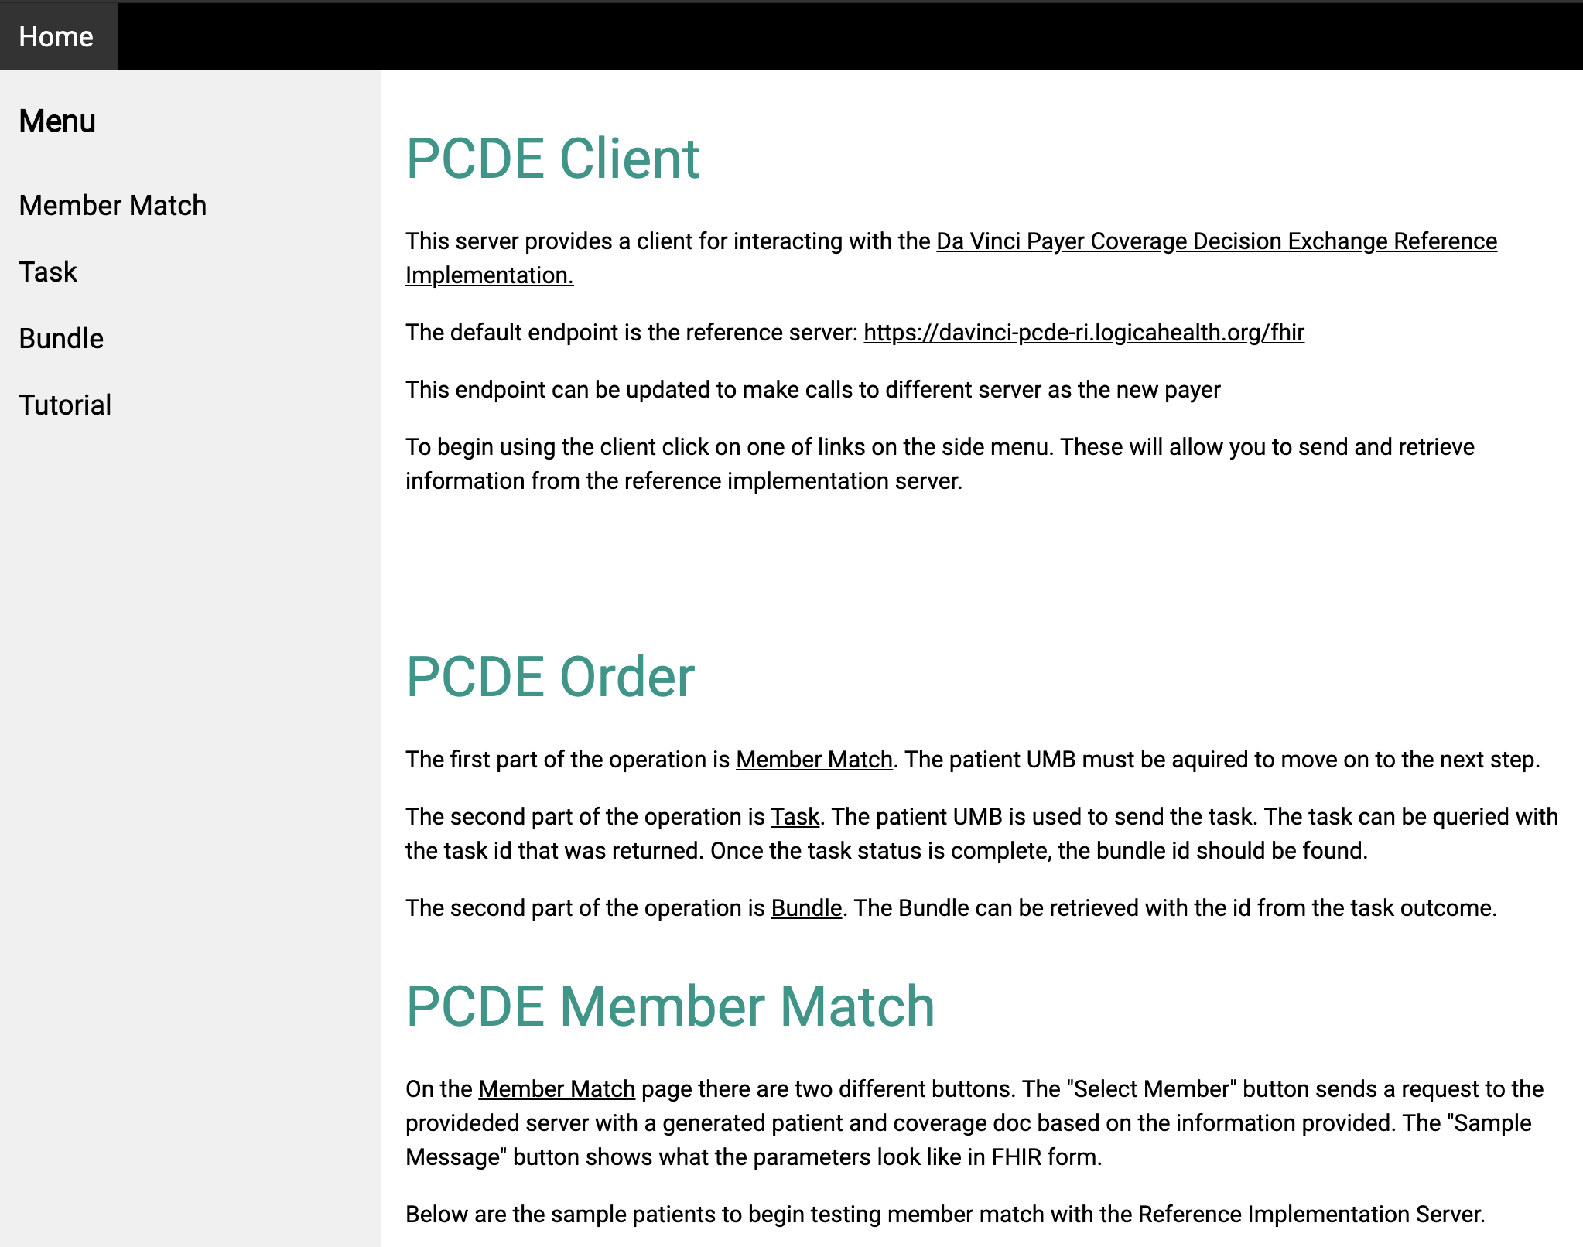
PCDE Client Demo
https://davinci-pcde-client.logicahealth.org/

Slide 6
Challenges
PCDE IG still loose on how to best represent clinical data within a PCDE CarePlan
needs more active payer feedback on the PCDE Supplemental Guide to vet recommendations.

Slide 7
Future Work
PCDE Testing Subscription/Notification use case over Polling Tasks
Support for embedded X12/EDI transactions to represent a prior authorization
as an alternative to referencing the PAS IG

Slide 8
CDex Highlights

Slide 9
Successes
Reference implementation updated to reflect new Task-based approach
Were able to test the new approach between one payer and one EHR
Identified a bit of clean-up to the HRex Task profile
Good discussion on the use of Subscription and created some examples for what subscription might look like

Slide 10
Challenges
Limited attendees made broader discussion about subscription harder – will take back to the broader group

Slide 11
Future Work
Questions to explore with respect to Subscription:
Should we include subscription in CDex release 1?
seems that the R4 mechanism is 'ready enough'
rest-hook or websocket
presume email & messaging are off the table
Full resource vs. identifier vs. either (presume ping is off the table)
With full resource, include outputs in bundle? If so, what?

