Slide 1

Vulcan FHIR Accelerator
Real World Data Track
Introduction Session

Slide 2
Disclaimer
The views and opinions expressed in the following presentation are those of the individual presenter(s) and should not be attributed to their respective employers.
No relevant financial relationship exists.

Slide 3
Vulcan Track: Real World Data (RWD) Submission to FDA
Develop HL7 FHIR capabilities to fulfill the study data submission requirements and to use of standardized RWD by biopharmaceutical sponsors to generate Real World Evidence and submitted to the FDA using established guidelines.
It is strongly expected that a great deal of the needed development to support RWD needs in FHIR will be accomplished with:
          The development of US Core to reflect FHIR requirements of the ONC Final Rule and U.S. Core Data for Interoperability (USCDI).
          The work of Vulcan (and others) on electronic source (eSource) data for clinical trials. The result is that the needs for RWD will be able to leverage and build upon those other initiatives.

Slide 4
For purposes of the Connectathon: What is Real World Data?
Informally: data created in the “real world” of everyday experience, as opposed to data created under clearly defined protocols typical of controlled clinical trials.
Example (there are many):
A person goes to a doctor for a typical healthcare reason (not as part of a clinical trial). Information is put into an EHR.
A corner pharmacy dispenses a medication to that person
That person or their doctor enters information into a Patient-powered disease Registry

Slide 5
Many gaps to cross for standards-based bridging of Healthcare and Research/Regulatory information domains
The Source Data
What information (and structure of that information) is entered at any healthcare site, registry, etc.
The Standard in Practice
How are existing data standards actually implemented at a healthcare site, registry, etc.
(for example, FHIR R4 or US Core Profiles show the total possible resources, but what parts are in place right now?)
The “Platonic” Standard
Data Standards: what is the total possible information support provided by a published standard – if used as defined and used to its maximum abiliy.
(ie, in FHIR, all Resources implemented, used in practice precisely as defined in the standard)
The Information Need
Information and structure that Researchers and Regulatory reviewers would like and expect. (Being used to well structured, protocol driven data collection)
Gap
Gap
Gap
Examples:
Difference in semantics / definitions
Different terminology systems
Different granularity of data
Different baseline expectations for data
Etc.
Etc.

Slide 6
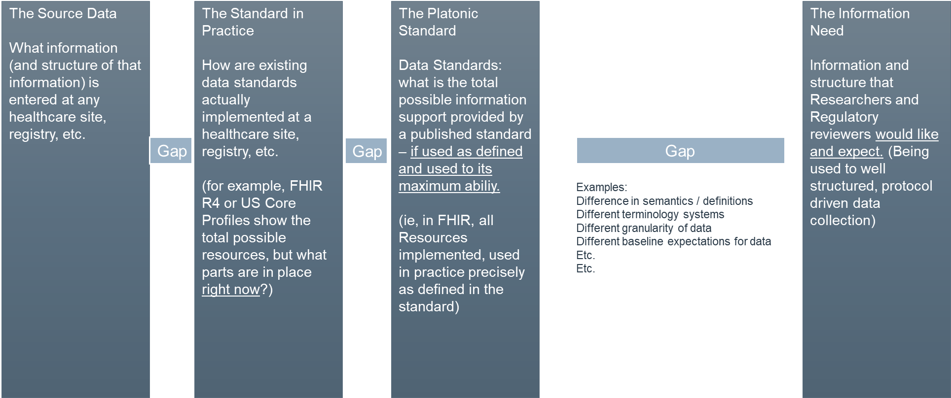
Bridging these gaps is a long-term, but necessary, effort
Big-Picture Goal: figure all of this out and harmonize. Lots of work, long time, but must be done.
Baby steps: Start with the data and infrastructure that exists now
Give researchers and reviewers as much
Information as possible about the nature of the data.
Transparency. NOT an automatic process, but a start.

Slide 7
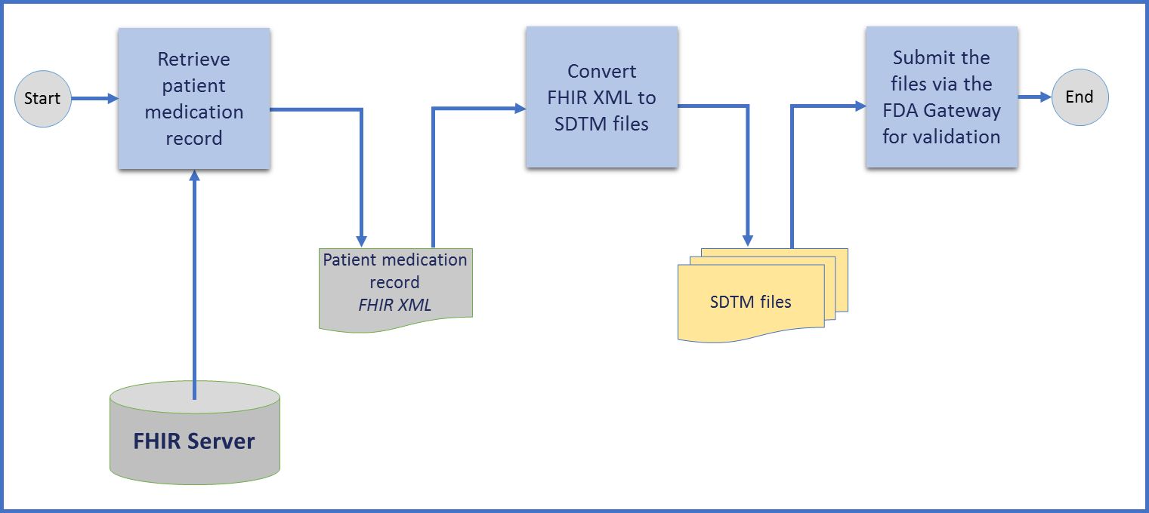
Jan 2021 Track Summary: Focus on one data area “Concomitant Medications”
Retrieve patient’s medication record from a FHIR EHR server
Create the SDTM Concomitant Medication* (CM) and Demographics (DM) domain files**
Validate created SDTM datasets
  MedicationRequest
  MedicationStatement
(*) Concomitant Medications A drug or biological product, other than a study drug, taken by a subject during a clinical trial. The protocol normally defines a specific reporting period in which the subject’s use of concomitant medications is documented, e.g., from 60 days prior to signing the informed consent until the last study visit.
(**) This step will use the CDISC FHIR mapping (https://wiki.cdisc.org/display/FHIR2CDISCUG/FHIR-to-CDISC+Mapping+Home).

Slide 8
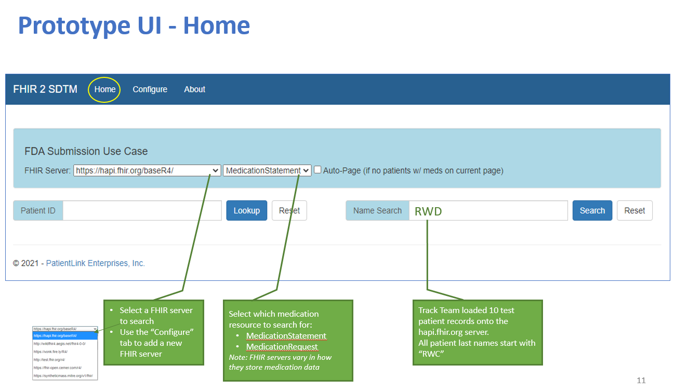
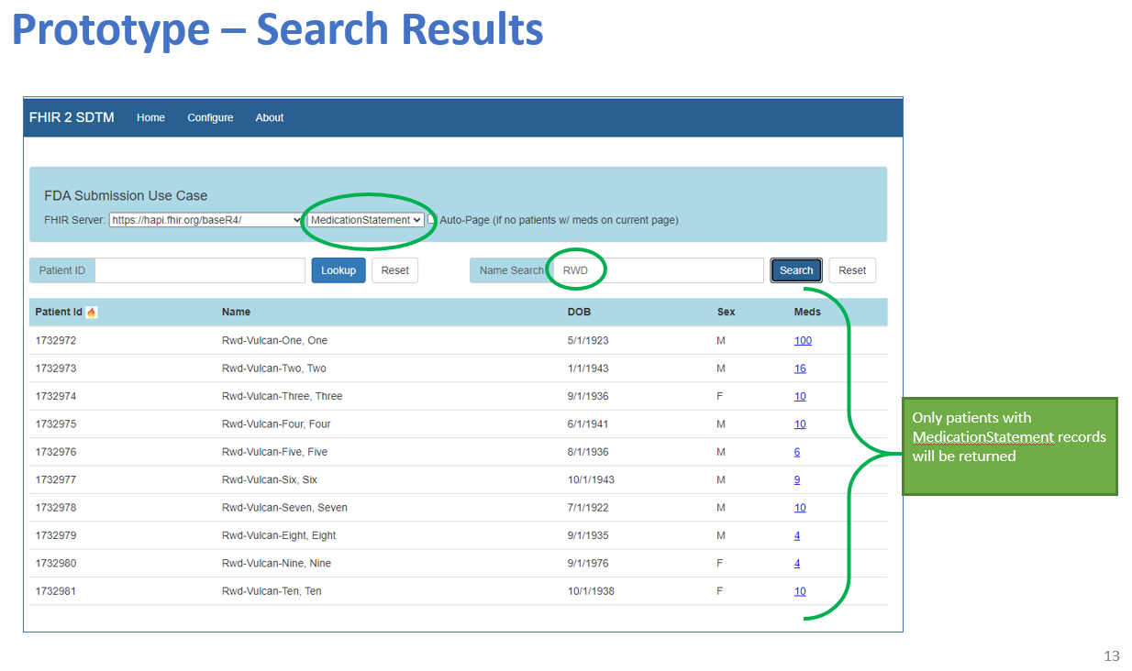
Screen Shots

Slide 9
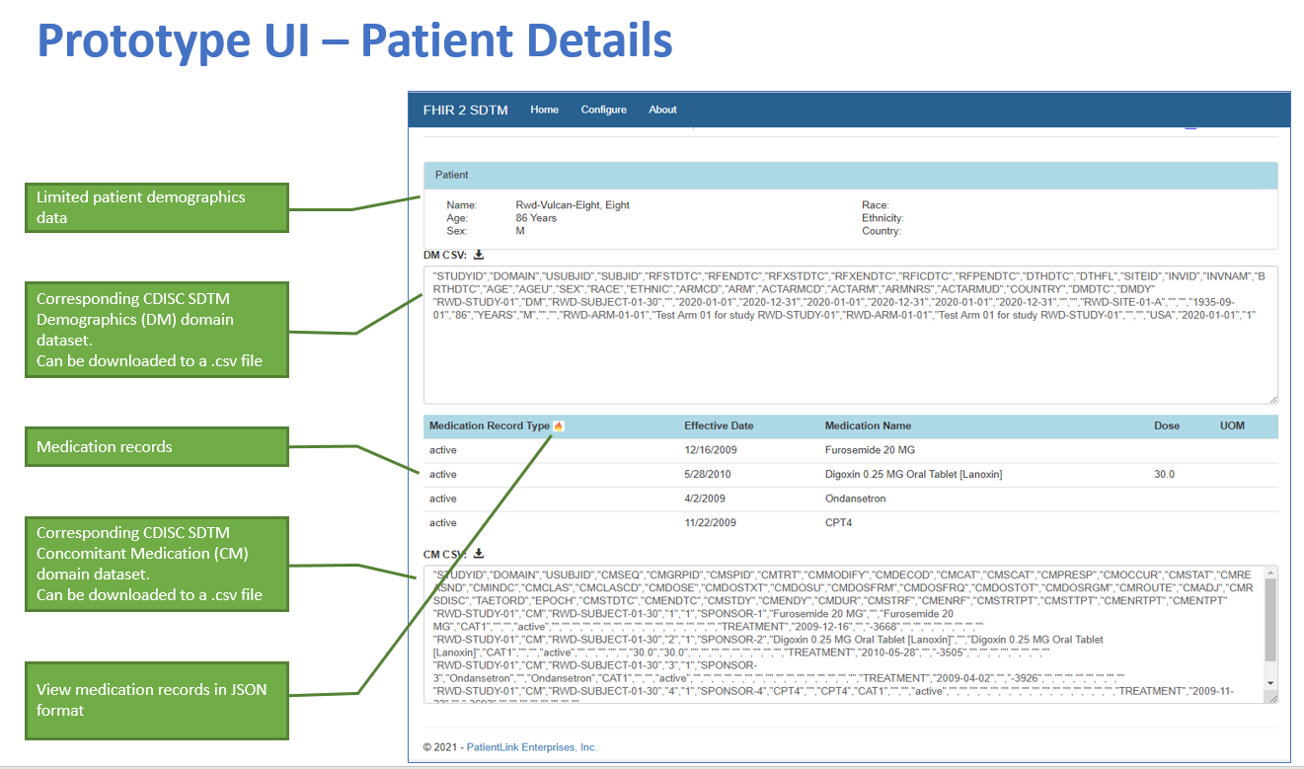
Screen Shots (Cont.)

Slide 10
May 2021 Connectathon Added Scope
Capabilities to add for May 2021 Connectathon:
Along with Demographics, develop an algorithm to extract and populate a consolidated list of Concomitant Medications when multiple FHIR medication resources exist, including:
  MedicationAdministration
  MedicationDispense
  MedicationRequest
  MedicationStatement
Add record source(s) to exported SDTM dataset, e.g.:
  Drug A had a request/dispense/administration record in the FHIR EHR
  Drug B had only a request record in the FHIR EHR
Work with multiple FHIR data sources that use different combinations of of medication FHIR resources
This effort is to demonstrate technical capability of complete data transfer and transformation. Researcher judgement required to determine actual fitness-for-purpose of the resultant data set.
Information to aid in “Confidence Level” determinations
for researchers and regulatory reviewers.
i.e., Drug A was truly taken by the patient, but Drug B
is only a prescription - no knowledge of dispense or admin.

Slide 11
Main Architecture: Gather medication from ALL resources
Add Resource Name “tag” (Req, Disp, Admin, State) and FHIR Server Name
Retrieve patient demographic and medication records using all FHIR Medication Resources
Demographics
Transfer from
FHIR format to SDTM format
Include medication source record “tag”
Include ID of source system (ie, FHIR EHR XYZ)
Validate SDTM according to FDA Validation Rules
Start
Medication Request
End
Medication Statement
Medication Dispense
Medication Administration
Patient medication records presented as
FHIR JSON
SDTM files
FHIR Server
Demographics (DM)
Concomitant Meds (CM) (Enhanced)

Slide 12
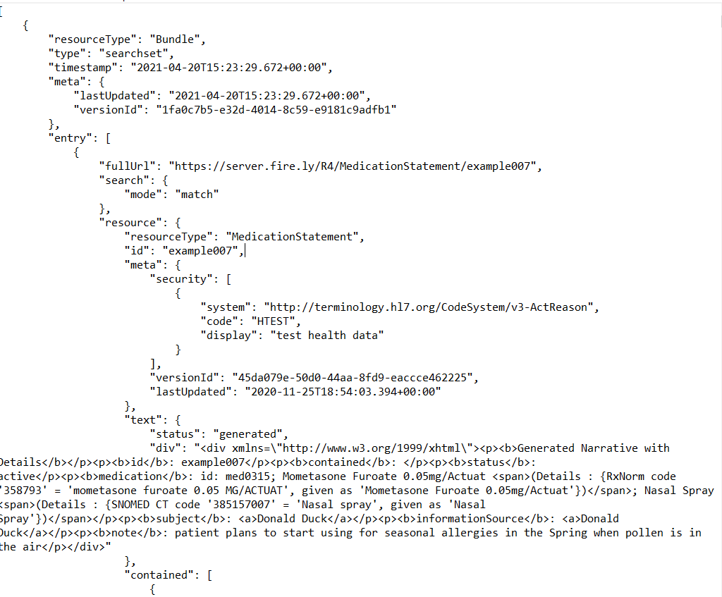
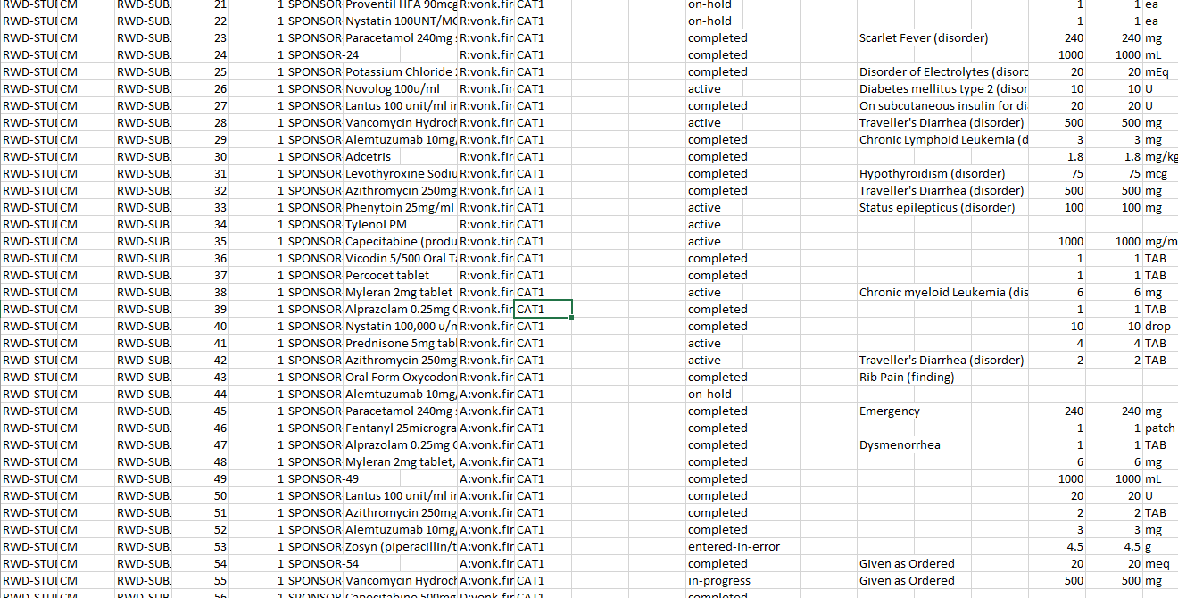
Example implementation output
FHIR “Bundle” Output
SDTM Output

Slide 13
Informal Discussion Session
Join us to discuss, in an open and informal session, to discuss the big picture challenges! Would love to hear thoughts from everyone.
Session info: May 18 2021, 3-4pm UTC (11am-Noon Eastern Time)

Slide 14
Participation opportunities
Ours is purely an example implementation (with test data) and example approach to the problem
Do you want to challenge our test implementation with your FHIR data set?
      We would love to see and test more examples of realistic permutations of EHRs and medication information
Do you have other ideas or approaches that you would like to build and demonstrate?
      Show us the way!
Do you have ideas of playing with this approach for other data areas (ie, medication exposure, vitals, expanded demographics, etc.)?
      Someone’s got to do it…
Something else??
All are opportunities for participation in this track during the May 2021 Connectathon.
Main Contacts:
Lauren McCabe, Lauren.McCabe@pfizer.com
Scott Gordon, Gideon.Gordon@fda.hhs.gov

Slide 15
THANK YOU

Slide 16
BACKUPS

Slide 17
Discussion Topics
Using SDTM XML format may provide more flexibility. It will allow to include the source FHIR resource(s) used to create the SDTM file. Note: FDA does not accept SDTM in XML format. Only SAS Transport format is accepted
Patient vs. ResearhSubject? Prototype used the Patient resource.
Question: was there any thought given to the ability to store the dataset metadata with FHIR server resources and then linked to the medication statements?
  A: The focus is extracting medication data to see if we could get something useful and suitable for SDTM submission.
Medications are represented differently in different EHRs FHIR servers. Prototype focuses on MedicationStatement and MedicationRequest resources
Medication form and dose may not be present if the Medication resource does not exist, and only a medication code is provided in the MedicationStatement resource. In that case, there will be a need to lookup the medication code in a vocabulary server to obtain form and dose information

Slide 18
Issues Discussed (Cont.)
FHIR medication resources:
  Multiple conversations around the top
  One way to get a more definitive answer as to which medication resource is most likely to reflect actual data is to narrow the cohort of patients, e.g. for inpatients, the MedicationAdministration could be the closest reflection of actual medications used. Further analysis needed.
Consider the use of FHIRPath
Active vs. historical medications. Since the goal is to collect data on all concomitant and prior medications, both should be considered

Slide 19
Issues to Flesh Out Further / Consider
Continue the discussion around how to evaluate medications resources in an EHR FHIR server to determine the best way to arrive at a concise list of mediations that meets the definition of the SDTM Concomitant / Prior Medications.
Further analysis on item 6.2 on Slide 9.
Work with EHR server(s) with real patient data

