Slide 1
January 3, 2019
Agenda
Review Timelines
Preview Graphics
Review Clinical Scenario

Slide 2
Timeline
Thursday, January 3, 12:00 PM ET
Monday, January 7, 4:00 PM ET
Thursday, January 10, 12:00 PM ET – 30 Min Connectathon Prep Call
Saturday, January 12, 2:00 PM Local – Face to Face - FRIO Room
Sunday, January 13, 10:00 AM Local – Face to Face - Pecan Room
Sunday, February 10, 12:00 PM ET – HIMSS19 SET UP BEGINS
Monday, February 11, 9:00 AM ET – HIMSS19 Set up continues

Slide 3
Interoperability Showcase / Exhibition Hours
Tuesday, February 12 | 10:00 am – 6:00 pm
Wednesday, February 13 | 9:30 am – 6:00 pm
Thursday, February 14 | 9:30 am – 4:00 pm

Slide 4
HIMSS Exhibition Hall
View an interactive map here: https://www.himssconference.org/exhibition/exhibit-hall/hall-map-hours

Slide 7
Vignette 12
65” Monitor
Can show 4 systems
EMR 1 - PCP
EMR 2 - Cardiologist
EMR 3 - Hospital
Da Vinci Powerpoint with flow
Payer #3
- CRD for Oxygen
Payer #2 - ePDx
32” Monitor
32” Monitor
Payer #1 - eCDx
- Scheduling query
32” Monitor
32” Monitor
Payer #4. MRP
- CRD for Oxygen

Slide 8
Clinical Scenario
Da Vinci Vignette for HIMSS 2019 Interoperability Showcase

Slide 9
HIMSS Da Vinci Vignette --78-year-old Asian Woman (Dara)
Patient visits PCP with symptoms of angina. PCP refers to cardiologist
Interaction 1
Primary Care provider and Dara work with payer to schedule appointment with Cardiologist
(Request slots and schedule appointment -- eCDx)
Interaction 2
Cardiologist use ePDx ask payer for existing information regarding patient
Decides to admit Dara for ______
Interaction 4
Patient visits primary care physician who performs MRP and sends attestation using DEQM
Interaction 3
On discharge, orders home oxygen therapy and triggers CRD which responds with specific order/documentation requirements
Patient admitted to hospital to deal with ____
Patient is also diagnosed as emerging COPD

Slide 10
Initial Clinical Data
Name – Dara
DOB – January 10, 1940
Past Medical History – COPD Category C x 5 years
Medications – beclomethasone/formoterol (80/4.5) inhaler twice a day. Albuterol inhaler as needed.
Surgeries – none
Allergies – none
Social History – past-smoker with 100pack-year hx. No smoking x 5 years. Lives with daughter

Slide 11
Primary Care Visit
Patient present with slowly worsening shortness of breath with mild exertion over past month. Increasing, productive cough. Occasional, non-specific, chest pain with exertion. No-radiation, no sweats or nausea. Resolves with rest.
Exam – Ht 5ft 5in. Wt 110lbs, BP 110/70. HR 85, RR 14, O2 sat of 90% on RA, 89% on RA after a 5 minute walk
EKG – within normal limits
Exam showed distant breath sounds
Plan – increase beclomethasone/formoterol to 160/4.5 strength. Refer to cardiologist for further evaluation

Slide 12
Interaction 1
Payer1 Queries Cerner for appointment availability
Success – appointment is made in Cerner and Cerner displays?
Booth visitor sees
Payer app performing query to Cerner for available slots on behalf of Dara
Payer app selects a slot
Payer app shows that Dara’s appointment is successfully made
EHR shows the scheduled appointment with the cardiologist - requires navigating to admin part of Cerner system to display – Hans will confirm
Notes:
Hans’ slides from Cerner

Slide 13
Cardiology Visit
Patient seen by cardiologist who has received clinical data from primary care physician
Patient has had increasing frequency and severity of chest pain since seeing PCP.
Exam BP 115/75. HR 80, RR 16, O2 sat of 90% on RA
EKG still unchanged
Cardiologist reviews information received from Payer (ePDx) and concerned and refers patient for direct admission to the hospital for monitoring and catheterization
Technical – Cardiologist receives information from Payer (ePDx)

Slide 14
Interaction 2 - ePDx
Cerner on Chart open initiates a Payer “app” via CDS Hooks to request data – exchange security token (JWT)
Payer app
authenticates to record
writes FHIR resources - conditions, meds, allergies/intolerance, and notes (document reference with accessible URL)
returns a CDS Hooks informational card with human readable summary of clinical information that was written
Optional – returns CDS Hooks card with link to launch SMART app and its UI
SMART app displays JSON of clinical information that was written
Booth visitor sees a payer app that “monitors” the CDS Hooks, the connection with the – Clarify with HANS how we show a before and after view of the patient’s record.
Viet to create simple SOAP notes – need to discuss further
Notes:
Cerner documentation and links from Han’s slides
Argonaut IG
CDS Hooks IG
Touchstone test scripts for Argonaut?

Slide 15
Hospitalization and Discharge
Patient is admitted to the hospital and undergoes cardiac catheterization which shows a 80% blockage of her right coronary artery which is stented during the procedure.
Patient develops an oxygen requirement and is discharged on oxygen 2LPM by nasal cannula
Additional medications
Aspirin 325mg daily
Atorvastatin
Clopidogrel
beclomethasone/formoterol to 160/4.5

Slide 16
Interaction 3
Epic/RefImp – user reviews order for O2. CDS Hooks triggers invokes Payer CDS
Payer responds with documentation requirements via informational card or a URL to the documentation requirement. Bob to write based on CMS O2
Booth visitor sees Epic/RefImp displaying payer’s informational card or link to URL
Goal is to demonstrate documentation (CRD) upon the order of the supplemental oxygen at discharge.
Participants should be testing with reference implementation and Aegis test scripts
Notes:
CRD IG
CDS Hooks
Ref Imp
Test Scripts

Slide 17
Interaction 4
Patient returns to PCP for discharge follow-up within 7 day
Medications are reviewed and MRP performed
Provider attests to MRP in RefImp
RefImp sends attestation to Payer system
Payer system displays confirmation of attestation
Booth visitor sees RefImp and Payer app confirmation
Participants should be testing with reference implementation and Aegis test scripts
Notes:
DEQM IG
Ref Imp
Test Scripts

Slide 18
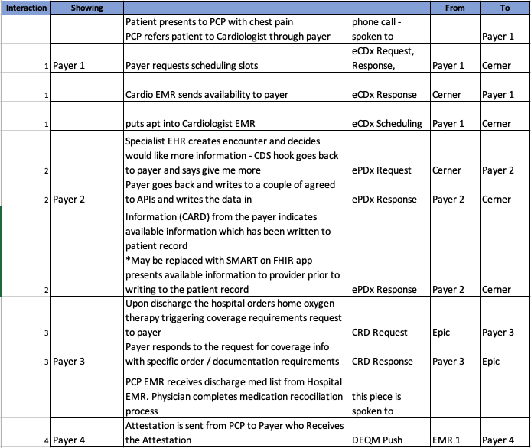
Use Case Flow
Each row in this table represents a transaction in the HIMSS scenario. The following slides indicate what clinical data will be used.
Payer actors will be determined based on build outcomes in the coming weeks.

Slide 19
Commit for testing at Connectathon

