Slide 1
condition-select app hook
Aziz Boxwala, MD, PhD, Elimu Informatics
Guilherme Del Fiol, MD, PhD University of Utah
June 6, 2018

Slide 2
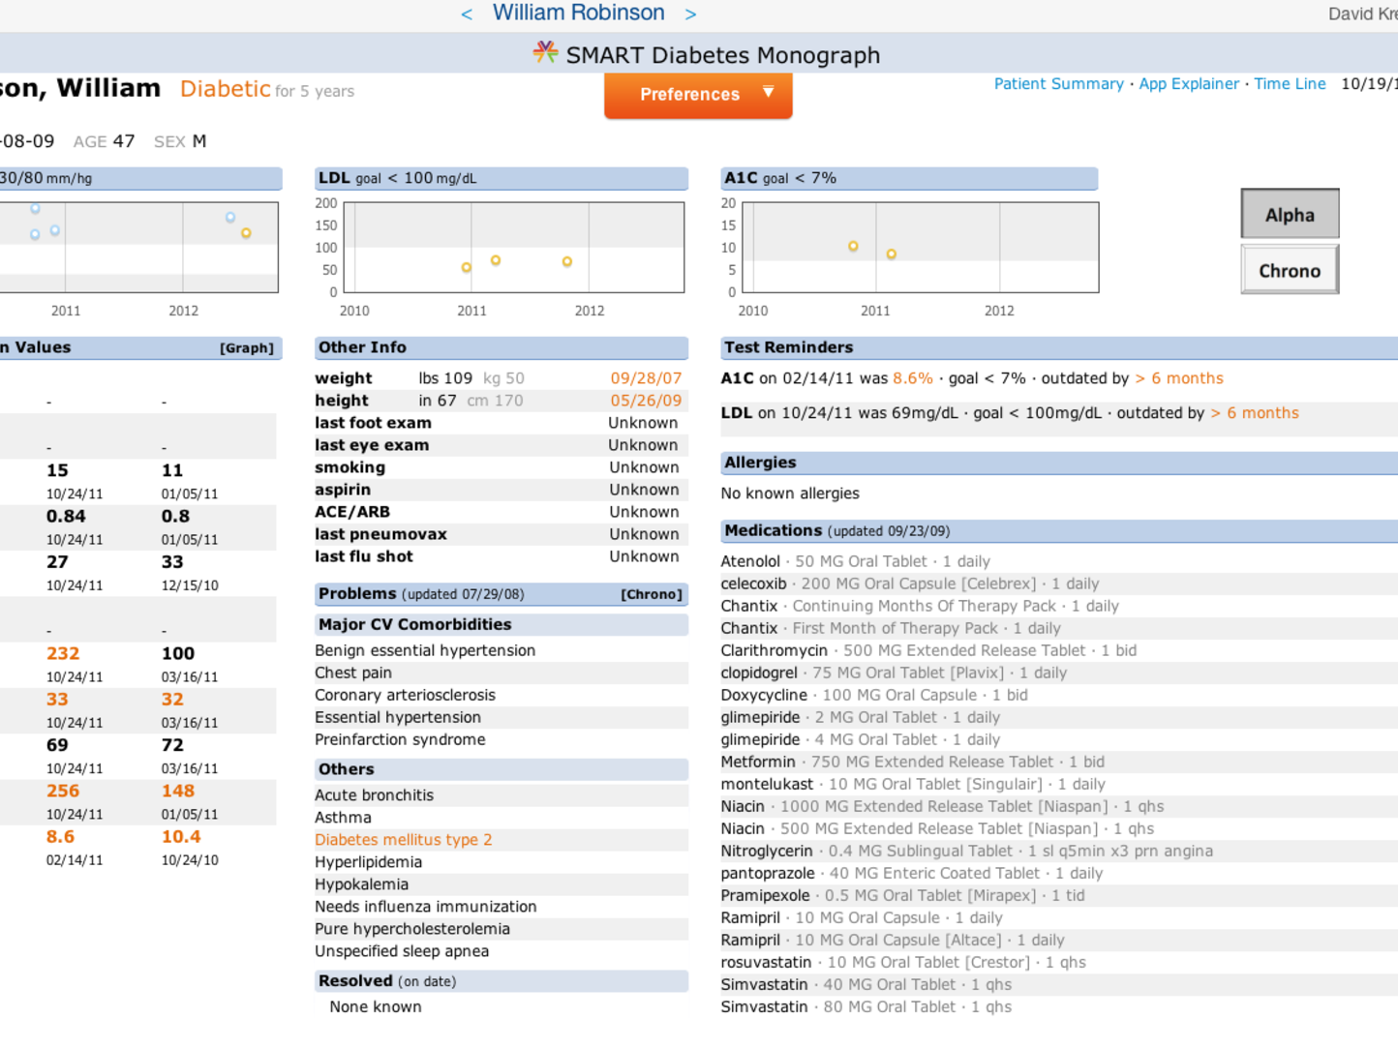
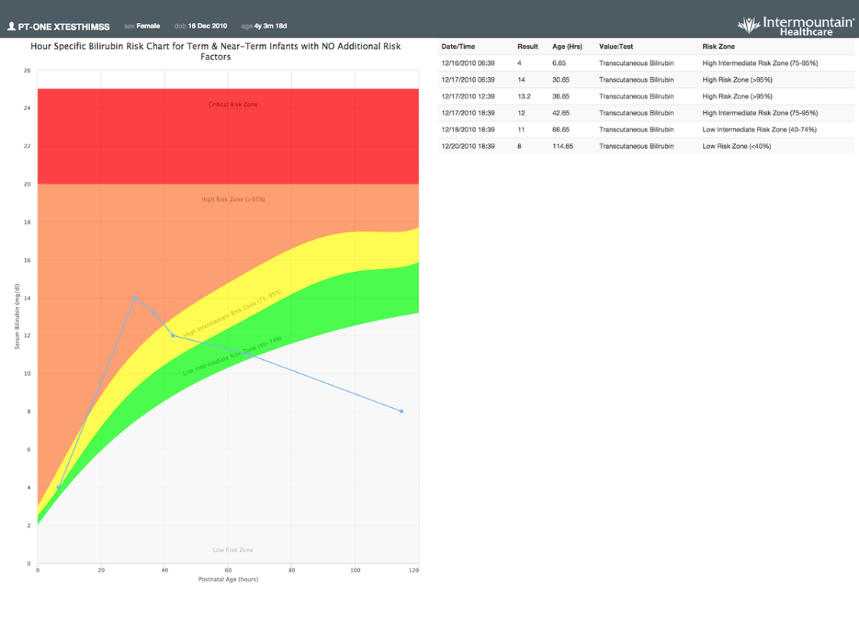
Launching apps in context
Many SMART on FHIR apps apply to specific problems/conditions

Slide 3
Leads to
Proprietary approaches to launching apps: write rules, menu configuration…
No standard for when an app should be surfaced

Slide 4
Recap: October 30 2018
Develop a standard approach for users to discover apps available around specific data contexts (e.g., apps for a problem in a patient’s chart)
Previously, we have looked at
Using CDS Hooks with new triggers
Concerns about this type of trigger being too broad
Extending Infobutton spec to include apps in responses
Major issue with security since infobutton requests and response do not include PHI. SMART on FHIR app launches necessarily contain PHI.

Slide 5
Now
Discard infobutton extension approach
Develop specific hook for triggering cds when a problem or condition in a patient’s record is selected

Slide 6
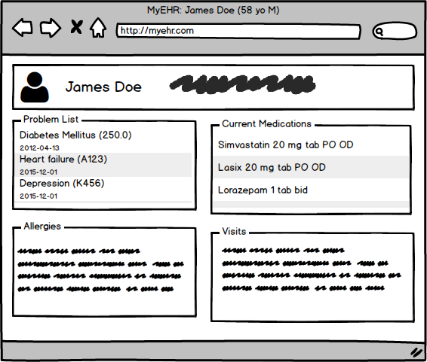
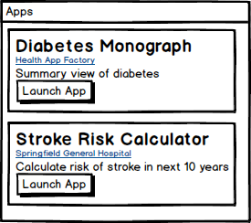
Proposal: condition-select hook
Workflow: user selects a problem that exists in the patient’s record
How the selection action is implemented is left to the client’s discretion. E.g., left mouse click, right click, finger tap, swipe, a dedicated button.
select
App cards or other cards returned

Slide 7
Hook: condition-select
Workflow
The user selects one of the conditions present in a patient’s condition list (aka problem list)
Context
The condition that was selected
Field | Optionality | Prefetch Token | Type | Description
patientId | REQUIRED | Yes | string | The FHIR Patient.id of the current patient in context
condition | REQUIRED | Yes | object | FHIR Condition resource that was selected

Slide 8
Example
 | "context":{ "patientId": "1288992", "condition": { "resourceType": "Condition", "id": "8762911", "patient": { "reference": "Patient/1288992", "display": "Hook, Captain" }, "encounter": { "reference": "Encounter/1234321" }, "asserter": { "reference": "Practitioner/909881", "display": "Wei, Fhir A" }, "dateRecorded": "2018-10-28", "code": { "coding": [ { "system": "http://snomed.info/sct", "code": "368009", "display": "Heart valve disorder" } ] }, "category": { "coding": [ { "system": "http://hl7.org/fhir/condition-category", "code": "diagnosis", "display": "Diagnosis" } ], "text": "Diagnosis" }, "clinicalStatus": "active", "verificationStatus": "unknown", "onsetDateTime": "2012-01-15" } }

